Slide 1
FARA Presentation
Egil W. Holgersen

Slide 2
FARA - Who we are
FARA is the leading Nordic supplier of IT solutions and related
services to the Public Transportation sector
More than 20 years of success in this industry
  Acquired Buscom, Finland 2007
  Acquired TNC Connect, Denmark 2007
  Acquired CPT Nordic, Sweden 2008
Head office located in Trondheim, Norway; with branch offices in
Oslo - Norway, Finland, Denmark and Poland
105 employees (+ consultants)
Turnover 2013 (NOK) 149 000 000

Slide 3
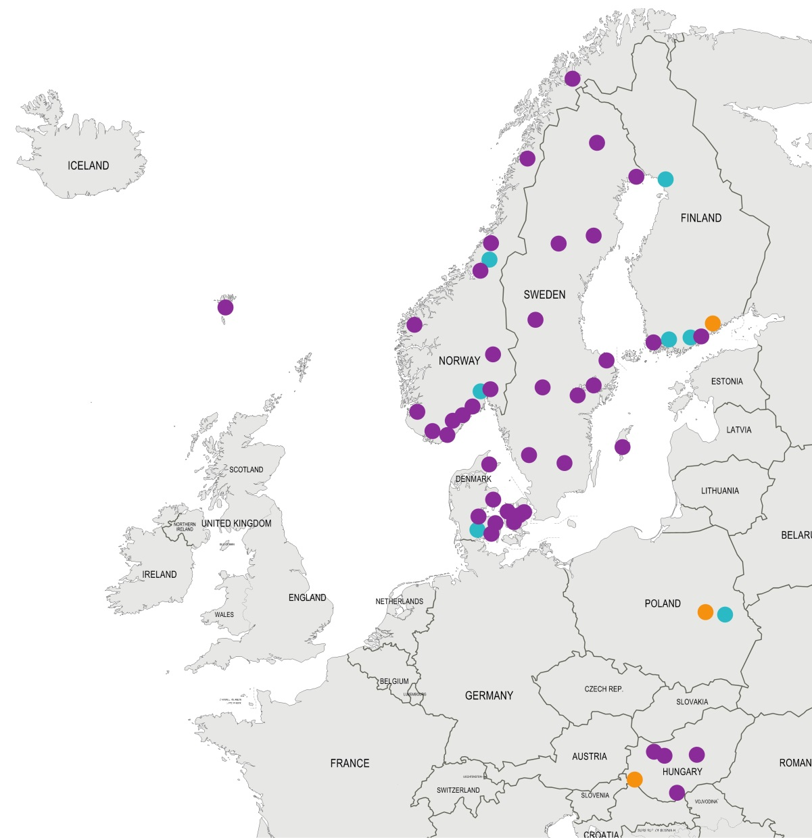























Market leader in the Nordic countries

Slide 4
Facts and figures from our systems
On-board ticket machines | 8 000
Portable ticket machines | 1 350
EMV Payment terminals | 2 200
Sales Offices | 194
Reporting applications | 189
Data warehouse licenses | 61
Platform validators | 5
Active travel cards | 2 000 000
Number of drivers | 19 000
No. of Sales Transactions/yr* | 64 424 000
No. of Transactions/yr* | 164 703 000
Total Sales Turnover/yr (NOK)* | 2 554 737 000
  *hosted and operated by FARA 2012

Slide 5
Payment Solutions
Cash on-board
  Still being used in Norway and Sweden, but is being slowly phased out
EMV terminals onboard (Payex)
  Widely used in Norway and Sweden
  Chip and Go functionality being tested in Sweden
Webshop
  Credit Card payment (Payex)
Sales Service & Mobile
  Credit Card payment (Payex)
  Premium SMS (PSWincom)
  Klarna Mobil
  Mobile Account (prepaid online account)

Slide 6

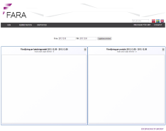
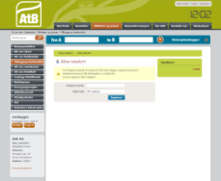
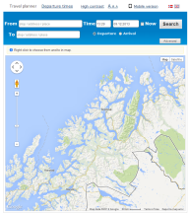


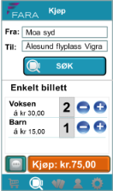




FARA SPACE and Clients
TVM
Price
Calculation
KIOSK
Mobile App
New
POS Light
WEBSHOP
??
FARA Cloud Web Services API
FOD/
NOD
Card API
Sales Service
Validation
Service
SIRI Stop monitoring
Admin Config
Payment providers

