Slide 1
Sales Manager Dag Arne Jerstad
Ruter Dialogkonferanse

Slide 2
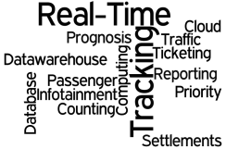
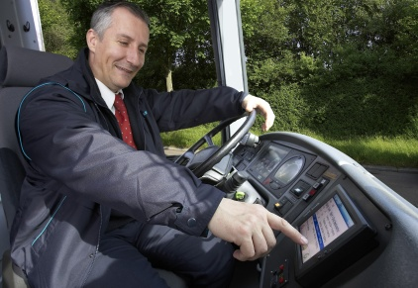
Smart Mobile Applications for Real-time and Ticketing
Notes:
SMART:myDrive – Alt for den kørende (ombord i køretøjet) – både for passagerer og chauffør
SMART:myTravel – Alt for den rejsende. Både på Web, Mobil og At-Street
SMART:myOperation – Alt for den administrative side. Kan både være mobile (f.eks. Pad) og stationære systemer
SMART:myCloud – Alt services i skyen (hosting centeret)

Slide 3
Positioning Services
There are essentially two major things to track with positioning – vehicles and people
Through real time solutions we have been mostly focused on tracking vehicles (e.g. the position of a bus, tram, train, …)
Compare reality with pre-planned expectations.
GPS accuracy: =< 10m and gps update per second
As of early 2015, high-quality, FAA grade, Standard Positioning Service (SPS) GPS receivers provide horizontal accuracy of better than 3.5 meters in general. The European Galileo system is intended to (in commercial applications) provide horizontal and vertical position measurements within 1-metre precision.
Notes:
Of particular interest is the European Galileo system – both from a precision and cost perspective. One of the aims of Galileo is to provide an indigenous alternative high-precision positioning system upon which European nations can rely, independently from the Russian GLONASS , China Bei Dou and US GPS systems, in case they were disabled by their operators. The use of basic (low-precision) Galileo services is free and open to everyone, while the high-precision capabilities will be available for paying commercial users.
Galileo is intended to provide horizontal and vertical position measurements within 1-metre precision, and better positioning services at high latitudes than other positioning systems.
The first Galileo test satellite, the GIOVE-A, was launched 28 December 2005, while the first satellite to be part of the operational system was launched on 21 October 2011. As of May 2016 the system has 14 of 30 satellites in orbit. Galileo will start offering Early Operational Capability (EOC) from 2016, go to Initial Operational Capability (IOC) in 2017–18 and reach Full Operational Capability (FOC) in 2019. The complete 30-satellite Galileo system (24 operational and 6 active spares) is expected by 2020.

Slide 4
Positioning Services
Today most people carry one or more devices with high-precision position services enabled. This enables tracking of the individual within areas like buildings (e.g. a terminal) and even vehicles (e.g. a bus).
This allows for new services like:
Be-in/be-out services based on location were the public transport services knows each person’s use of transport services, travel flow and change of mode of transport
Load balancing (e.g. number of people at a stop) and seat allocation as it is possible to know exactly where each person is located and how many seats are available in the vehicle

Slide 5
Proximity technology in existing solutions
The FARA customers (PTA’s) have been provided reports based on data from validation and ticket purchase.
The PTA expectation is to keep and improve this data also for the «mobile app ticket travelers»
Option 1: Use validators to read QR-codes
Option 2: Combine Mobile SMART phone data with Beacons to provide validation and travel data

Slide 6
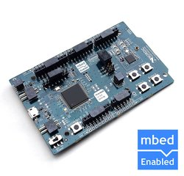
Proximity technology in existing solutions
FARA is evaluating the need to implement proximity technology in existing ticketing solution.
Testing validation using BLE in cooperation with Nordic Semiconductor AS
using a string representation of the QR-code ticket.
The following two tests were performed:
Time spent from the FARA mobile application asks for connection to Nordic Semiconductor nRF51 device to connection is established.
Time spent from connection is established to ticket is transferred to the Nordic Semiconductor nRF51 device.

Slide 7
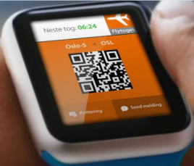
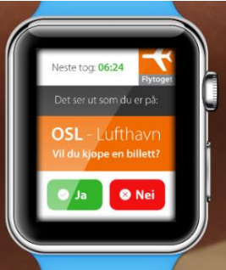
Beacon applications
When a mobile phone enters the “beacon area” at
the stop, a notification pops up in the mobile application
with the possibility for the user to buy ticket from this stop
See real time departure information from this stop
When mobile phone enters the “beacon area” in the bus,
a notification pops up in the mobile application with the
possibility for the user get journey information for the bus
the user entered

Slide 8
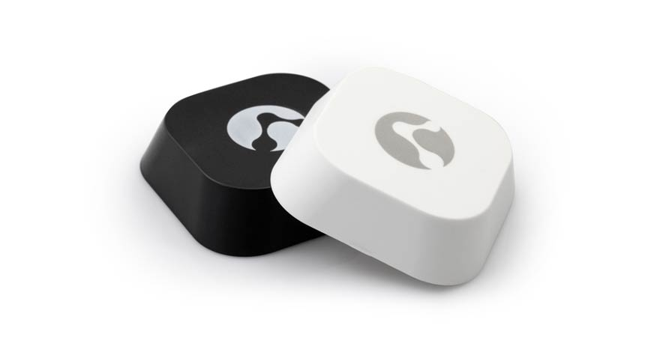
Beacon Management
During small scale testing we have used our own web-based beacon repository.
For large implementations we see a need for a commercially available enterprise management solution to deploy and run a beacon infrastructure.
Logistical services such as pre-configuration, labeling and deployment should be considered
Integration through API’s to infrastructure and planning
tools should also be considered.

