Slide 1
Minibuss

Slide 2
RAL coating
Fully coated, RAL 110 70 60

Slide 3
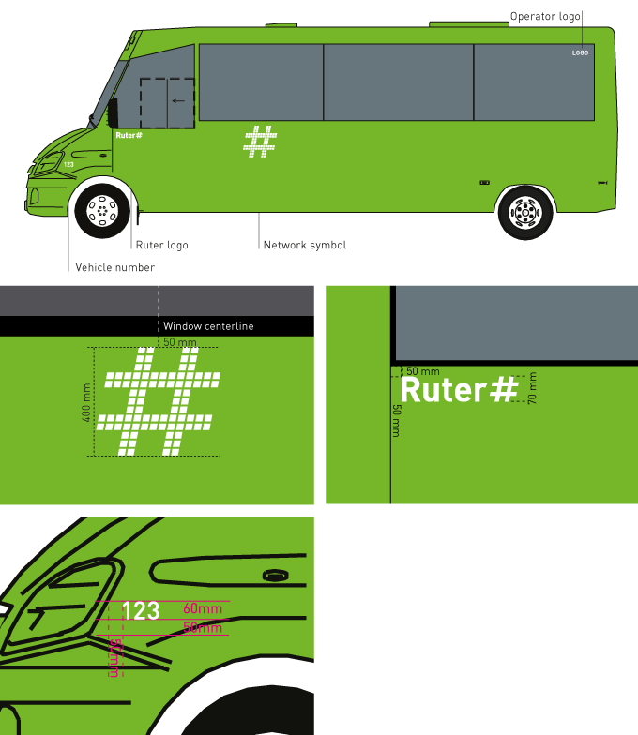
Driver´s side
Ruter logo, Network symbol and vehicle number is produced in filmcolor: 3M Scotchal 100-10 (or similar).

Slide 4
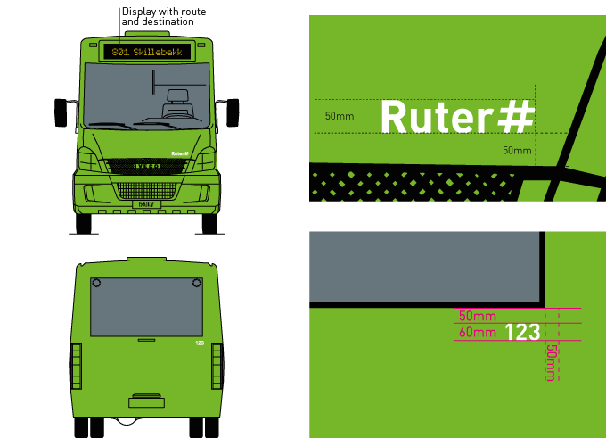
Front and back
Vehicle number and Ruter logo is produced in filmcolor: 3M Scotchal 100-10 (or similar).

Slide 5
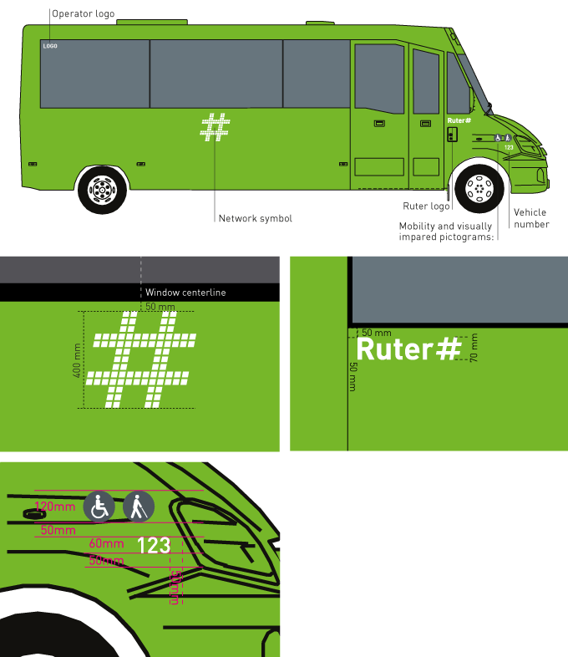
Entrance side
Ruter logo, Network symbol and vehicle number is produced in filmcolor: 3M Scotchal 100-10 (or similar).

Slide 6
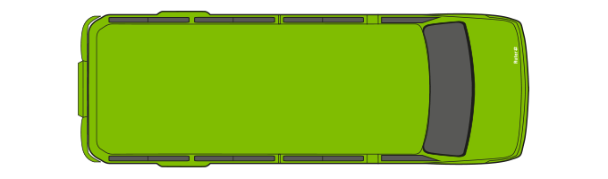
Above
Fully coated roof.

Slide 7
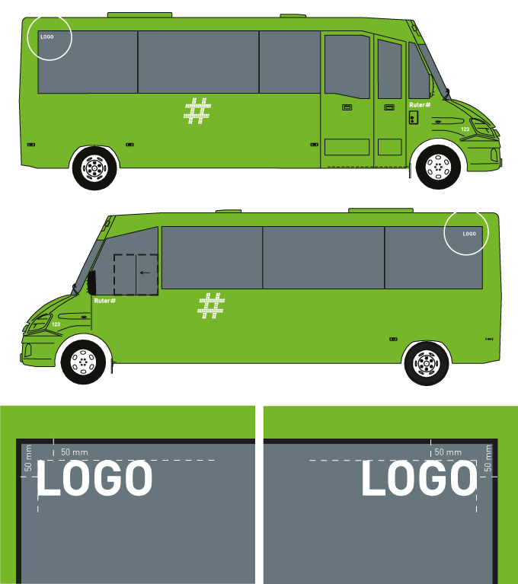
Operators logo
3M Scotchal 100-10 (or similar)

