Slide 2
Ticketing and Payments for Transportation

Slide 3
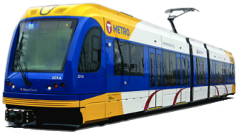
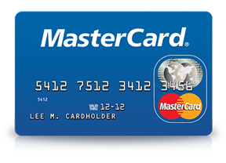
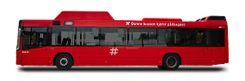
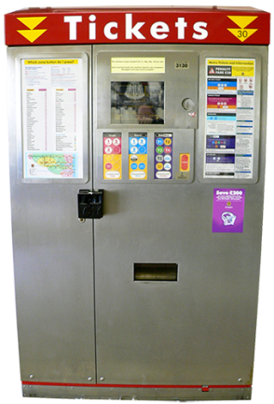
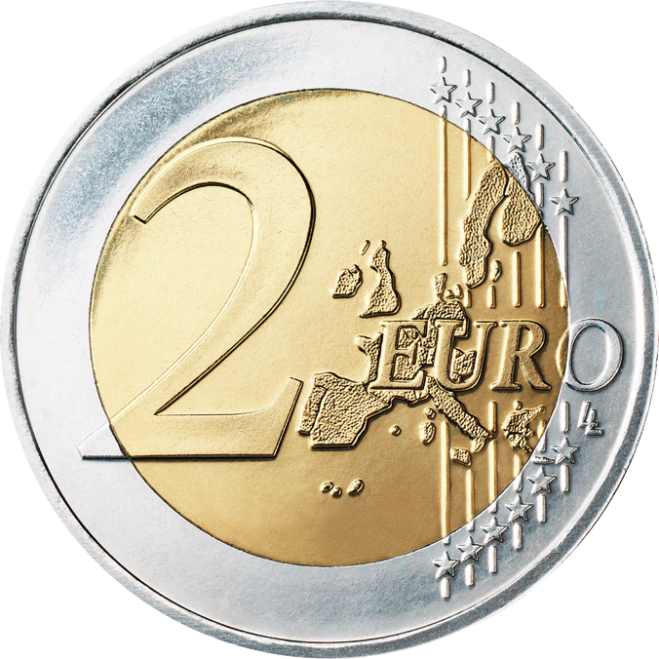
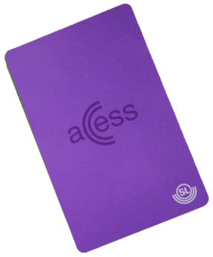
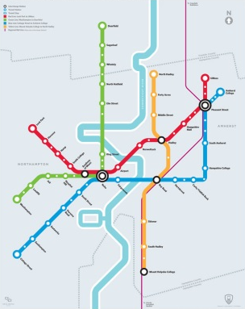
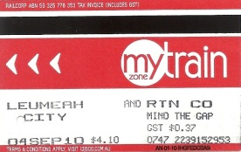
Transportation is changing from this
Means of
transportation
Payment methods
Point of purchase
Tickets
Planning
Notes:
Transition mellan då och nu

Slide 4

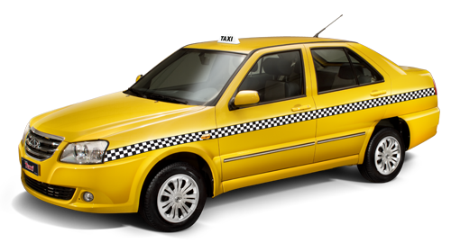

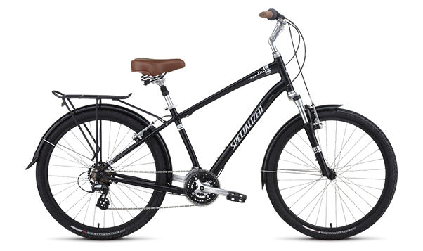




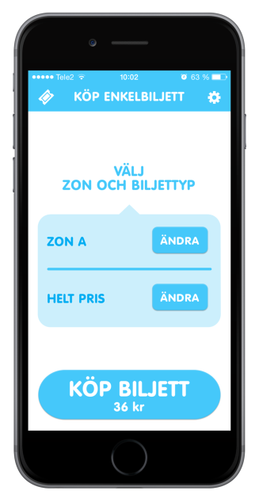
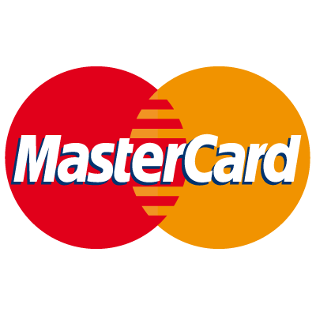


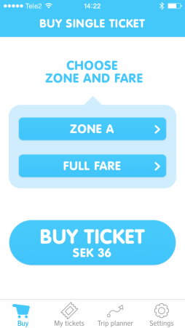


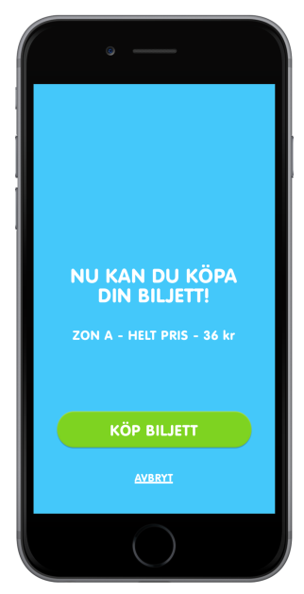


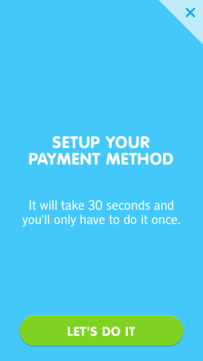
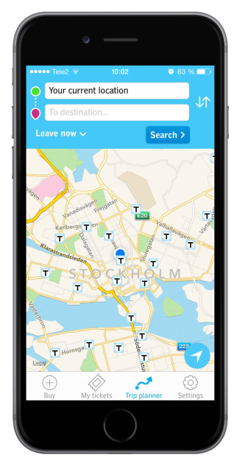
To this
Means of
transportation
Payment methods
Point of purchase
Carpool
Tickets
Planning

Slide 5
Transportation is regarded a service
It’s not tied to a certain means of transportation.
It’s getting from A to B in the way that suits the best at a given time.
It’s not just PTAs offering the service
Carpools, bike rentals, Uber and shared riding are all examples of ways of transportation. When they’re distributed the same way, they compete on the same conditions, irrespective of size.
Barriers between providers decrease
The smartphone is the hub.
All people choose from all providers in the same device.

Slide 6
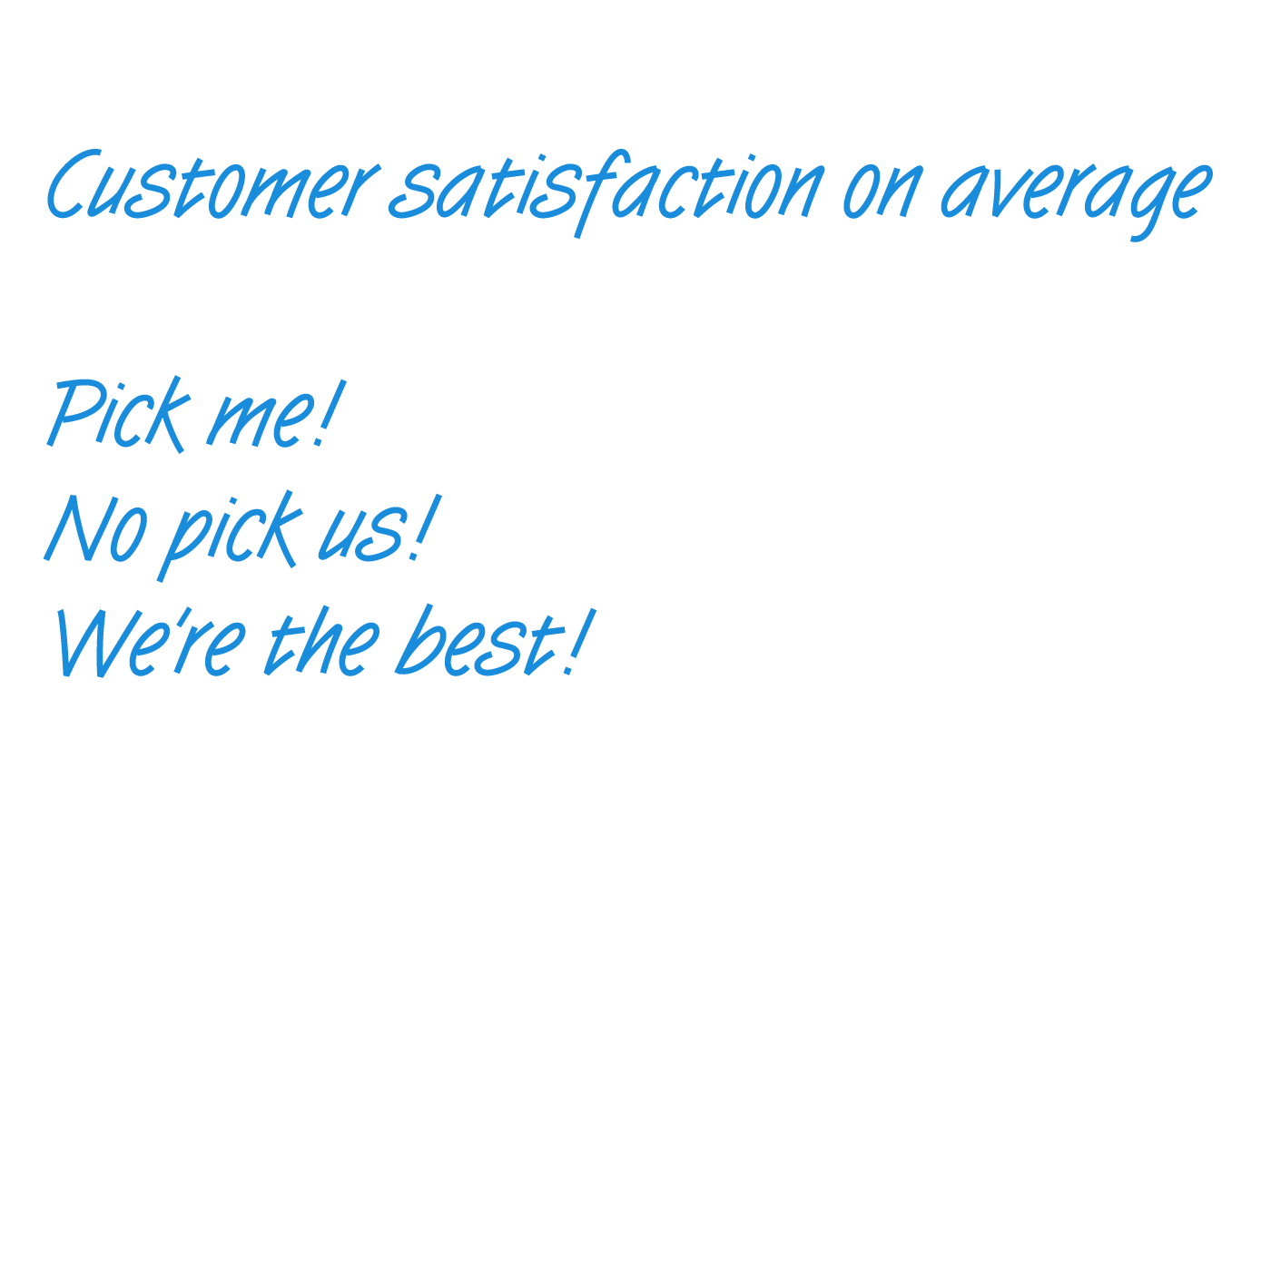









The battleground
All competition
equally accessable
BUY NOW
Simplicity is
the key factor
Notes:
Konkurrenssituation, tomboy, skoja till

Slide 7


It must be this simple
No friction
– not even first time
All preferred
payment methods – today and tomorrow
BUY NOW
Invoice
Buying in a single tap

