Slide 3
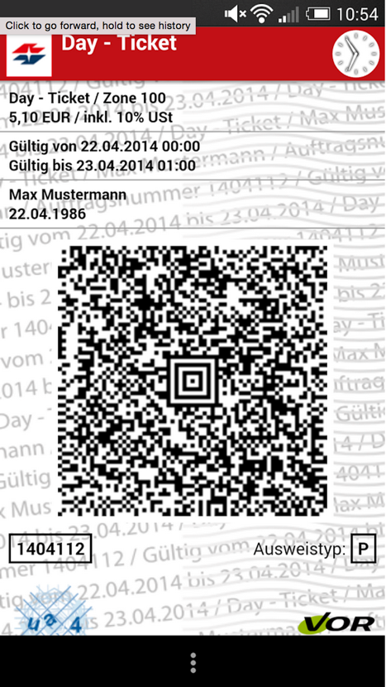
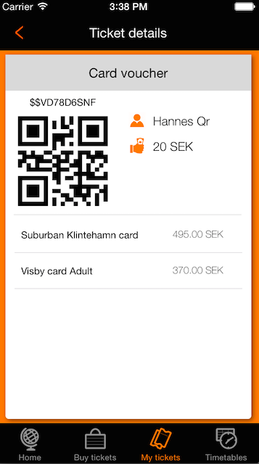
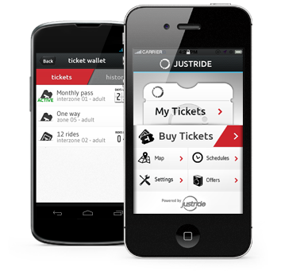
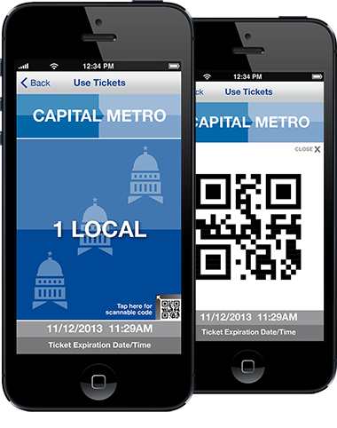

Slide 7
Notes:
We launched our first project in UK at the beginning of February. We started whit ferrys. There we proved our smart engine and

Slide 9
Notes:
We did some calculations and result is that the time lost for purchasing tickets and recharging cards in one evarage eu city for one year is equally to 12 ppl lifes. I don't have time to spare, do you?

Slide 10
Notes:
85% of the ppl having smartphones are willing to use mobile tickets. About that our system si compatible with fast all iphones and with the newest android phones produced in last 4 years.

Slide 11
Notes:
The BM is revenue sharing. We buy a big bulk of tickets in advanced and reselling them to the end customers at the regular price one by one. For that we expect a little discount from the TA. In every region we have a local partners. They take care for technical and first line support and business development.

Slide 12
Notes:
One of the important thing is that we cover the installation cost and we give all the data we generate to the MU or TA. Tickey is eco and tourists friendly.

Slide 13
Notes:
The earth is our home and we should be responsible and face the problems. For example we cut 4 trees every day to produce tickets in a evarage eu capital. This is one of the things that Tickey s

