Slide 1
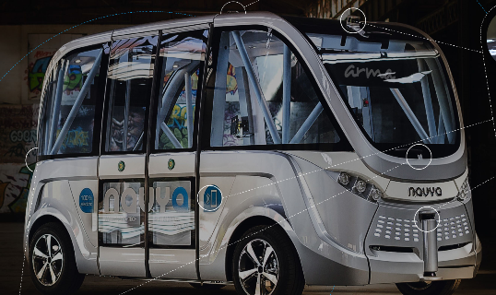
Autonomous public transport on demand
12
Januar
2017
Keolis Norge AS //Gry Olsen /Jan Jansson

Slide 2
What experiences does the supplier have in the area of autonomous vehicles or similar/related technology or services?
Keolis is a shareholder in Navya
Navya is operating 30 autonomous vehicles worldwide
In the cities of Doha (Qatar), Lyon(France), Sion (Switzerland), Perth (Australia)
Private sites in Michigan (US), Renault (France), Civaux (France), Christchurch NZ, Nanyang University (Singapore)

Slide 3
What are the most important elements that needs to be in place before Ruter can deploy an autonomous, on-demand service to our customers as an integrated part of our complete public transportation system?
Safety
Proven technical performance
Integrated customer interface (order on demand)
Awareness of the system by other road users (cars, bicycles, pedestrians)

Slide 4
How soon can do you think the market can have such a service ready for operation in Oslo and Akershus?
Already operating worldwide
Depends of the will of PTA and negotiations (talks can start tomorrow)

Slide 5
What should Ruter do to make this an appealing business opportunity for your company?
Create a strategy and down to earth plans
Continue with the dialogue to suppliers

Slide 6
Any other advice or insights to Ruter in moving forwards with this
Create a strategy and down to earth plans as said above
Build Oslo-Akershus as showroom to the world for public transport and emphasize on intermodality and self-driving cars

Slide 7
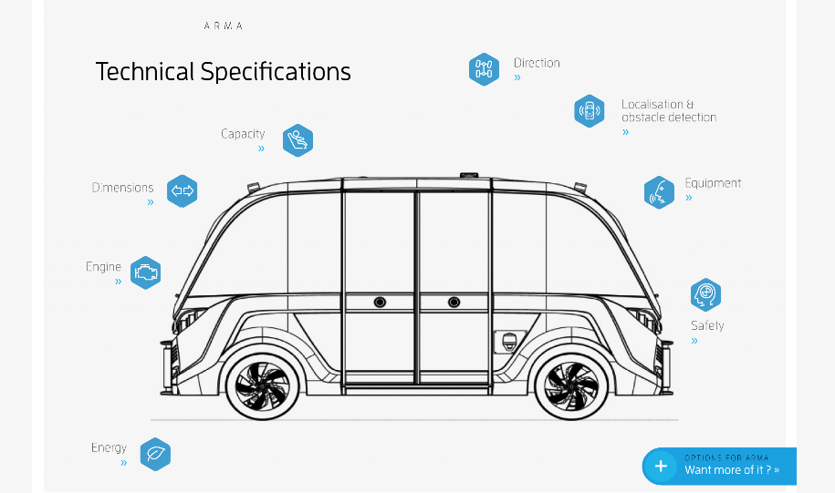
Picture

Slide 8
Picture

