Slide 1
Altran positioning in Rail, Infrastructure & Transport
MARCH 2016

Slide 2
01
Altran Group key facts
02
Altran key facts in Rail, Infrastructure & Transport
03
Altran Rail, Infrastructure & Transport market dynamics
04
Rail, Infrastructure & Transport Offers portfolio

Slide 3
Altran Group key facts
01

Slide 4
At a glance
ALTRAN GROUP KEY FACTS | ALTRAN KEY FACTS IN RAIL, I&T | MARKET DYNAMICS | RAIL, I&T OFFERS PORTFOLIO
GROUP KEY FACTS
Altran is a global leader in innovation and high-tech engineering consulting. The Group’s mission is to assist companies in their efforts to create and develop new products and services.
2015 REVENUES
€1.945bn
INNOVATION MAKERS*
25,935
INNOVATION
over 30 years
INTERNATIONAL
20+ countries
of experience for a brighter future
*EMPLOYEES OF THE ALTRAN GROUP

Slide 5
What do we do ? The solutions
ALTRAN GROUP KEY FACTS | ALTRAN KEY FACTS IN RAIL, I&T | MARKET DYNAMICS | RAIL, I&T OFFERS PORTFOLIO
GROUP KEY FACTS
Our solutions cover five major technological domains:
INNOVATIVE
PRODUCT
DEVELOPMENT
INTELLIGENT
SYSTEMS
LIFECYCLE EXPERIENCE
INFORMATION SYSTEMS
MECHANICAL ENGINEERING

Slide 6
What do we do ? The industries
ALTRAN GROUP KEY FACTS | ALTRAN KEY FACTS IN RAIL, I&T | MARKET DYNAMICS | RAIL, I&T OFFERS PORTFOLIO
GROUP KEY FACTS
Our presence in the main business sectors enables us to partner with key players in the market:
25%
24%
23%
16%
12%
ENERGY, INDUSTRY
& LIFE SCIENCES
AEROSPACE, DEFENCE & RAILWAY
AUTOMOTIVE, INFRASTRUCTURE & TRANSPORTATION
TELECOMS & MEDIA
FINANCIAL SERVICES & GOVERNMENT

Slide 7
ALTRAN GROUP KEY FACTS | ALTRAN KEY FACTS IN RAIL, I&T | MARKET DYNAMICS | RAIL, I&T OFFERS PORTFOLIO
GROUP KEY FACTS
What do we do ? The Altran Delivery Model
To accommodate the changing dynamics of our clients and the market place, our ADM covers the traditional Time & Materials approach and allows Altran to act as a strategic partner to support global projects and guarantee a consistent level of service.
COMPETENCES & SKILLS COMMITMENTS (ADM 1&2)
FIXED PRICE COMMITMENTS (ADM 3&4)
Subject Matter Expertise
Structured Team Expertise
Fixed Price Project
Outsourced Services
Specific skills that complement client teams
to support clients with individual expertise.
Access to multi-disciplinary skills provided on a Service Level Agreement basis and supported by Key Performance Indicators.
Delivery of a product or a service to guarantee committed results.
Catalogue of services that industrialise recurrent needs for committed results on a range of ordered work packages.
Risks Management

Slide 8
Altran key facts in Rail, Infrastructure & Transport
02

Slide 9
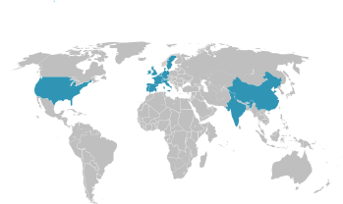
Global partner with a worldwide presence
ALTRAN GROUP KEY FACTS | ALTRAN KEY FACTS IN RAIL, I&T | MARKET DYNAMICS | RAIL, I&T OFFERS PORTFOLIO
ALTRAN KEY FACTS IN RAIL, I&T
INTERNATIONAL
12+ countries
France
UK
Spain
Portugal
Benelux
Germany
Italy
USA
Switzerland
Scandinavia
Austria
China
India
ENGINEERS
630+
CLIENTS
10+
TURNOVER IN 2015
€ 76 m
Top Clients
SNCF, Alstom, Thales, Bombardier, Talgo, Siemens, Ansaldo/Hitachi, RATP, CAF, Knorr-Bremse

Slide 10
Altran main clients in Rail, Infrastructure & Transport
ALTRAN GROUP KEY FACTS | ALTRAN KEY FACTS IN RAIL, I&T | MARKET DYNAMICS | RAIL, I&T OFFERS PORTFOLIO
ALTRAN KEY FACTS IN RAIL, I&T
HISTORIC AND NEW PLAYERS INFLUENCING THE MARKET
Suppliers | Infrastructure Providers & Operators

Slide 11
ALTRAN GROUP KEY FACTS | ALTRAN KEY FACTS IN RAIL, I&T | MARKET DYNAMICS | RAIL, I&T OFFERS PORTFOLIO
ALTRAN KEY FACTS IN RAIL, I&T
Altran partnerships models for engineering & customer services
A Tunisian group of companies specialized in innovation and high technology consulting
Product development in
industrial design, mechanical engineering, electronic production and outsourced
development projects
Academic consortium between Centrale Paris, Altran and Mazars
Crtitical systems and software development solutions
A major Cloud and Big Data player
Joint venture
Axclusive partnership
Global partnership
Acquisition
Consortium
2010
2010
2013
2014
2014
2010
2013
2014
2014
…
Exclusive partnership
Extension of the RA alliance
Acquisition
Acquisition
In Flight Operations documentation
A leading business in the supply of specialist engineering recruitment, technical personnel, and outsourced design services in the UK
Product development company,
developing complex
software-intensive systems
Asia's top-notch, full-spectrum IT services and
industry solution providers with global delivery capabilities

Slide 12
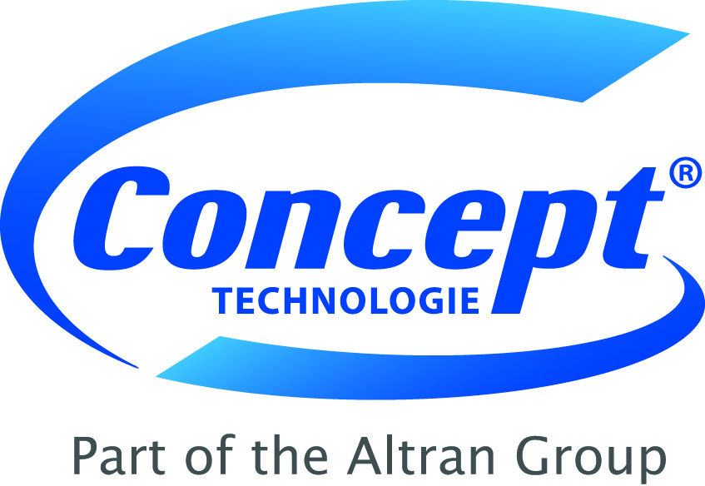
ALTRAN GROUP KEY FACTS | ALTRAN KEY FACTS IN RAIL, I&T | MARKET DYNAMICS | RAIL, I&T OFFERS PORTFOLIO
Leader for embedded software in
the semiconductors, consumer electronics and healthcare sectors
Specialist in R&D and high
technology services, specialised in software development
and mechanical engineering
Pharmaceuticals counselling, provides compliance-improvement and quality process solutions
Ex: GE Software connects streams of machine data to powerful analytics
To develop future
software platform for intelligent vehicles and machines
A cluster of partners for VueForge Big Data solution
Acquisition
Acquisition
Acquisition
Alliance
Partnership
…
2014
2015
2014
2015
2015
2015
2014
2015
2015
2015
Industrial Partnership
Partnership
Acquisition
Acquisition
Acquisition
Purposes of creating an expertise and telecoms services centre around 170 expert
engineers specialised in 4G
World leader in Passive Safety Development
French technological research institute for Aeronautics, Space & Embedded systems
Fastest growing Indian
technologies firms, specialised in semiconductor design
services
A leading international analytics
and data science consulting services company

Slide 13
Altran Rail, Infrastructure & Transport market dynamics
03

Slide 14
Railway, Infrastructure & Transport market dynamics
ALTRAN GROUP KEY FACTS | ALTRAN KEY FACTS IN RAIL, I&T | MARKET DYNAMICS | RAIL, I&T OFFERS PORTFOLIO
MARKET DYNAMICS
TOGETHER, HOW TO MAKE TRAVEL EASIER?
Digitization
Cost Pressure on European Rail
Passengers using smartphone during their commute
65%
Digital mega-projects to exploit IoT and Big Data (DB, SNCF, NR, ..)
Real Time Passenger Information
Inter-modal passenger flow
Predictive maintenance
Energy management
Free wifi on trains
BRIC countries are creating new global Rail suppliers
Threats to market share
‘Car Share’ and ‘alternative taxi’
Inner-city bicycle schemes
Automated cars
Passengers using smartphone to manage their trip
23%
RAILWAY, INFRASTRUCTURE& TRANSPORT
Geographical Expansion of Rail
BRIC and ME rail investments by 2016 1tn
Annual railway operations expenditure on external supply
€80Bn
“88% of Americans support high-speed rail” ~NYT
70,000 miles of new high-speed line in USA by 2030
(aspiration of US HSR Association)
Global Train Demand (New & Refurb)
“Train Control” (aka advanced signalling)
Global High Speed rail
+ urban rail CAGR is >10%
N. Europe 2015-2022 is buying 12,000 new
trains and refurbishing 8,000 trains
The greenest option for Governments
Global outsourced after-sales services €38Bn
Global RS supplier market by 2022
€70Bn p.a.
European ETCS emerging as global standard for high-speed, installed in 39 countries (43% outside Europe)
CBTC installed in 90 metros; N.E. CAGR 23%
PTC €1.8Bn so far; ~€7Bn final price
CO2 emissions from
Rail in EU Transport
1.8%
Global signalling supplier market by 2022
€20Bn p.a.

Slide 15
Rail, Infrastructure & Transport Offers portfolio
04

Slide 16
Altran Railway, Infrastructure and Transport Offering
ALTRAN GROUP KEY FACTS | ALTRAN KEY FACTS IN RAIL, I&T | MARKET DYNAMICS | ALTRAN RAIL, I&T OFFERS PORTFOLIO
OFFERS PORTFOLIO
A CORE EXPERTISE WITH 7 OFFERING TO ANSWER OUR CLIENTS NEEDS
TRANSPORT R&D
Mechanical, & Electrical Design
Compliance and Assurance
PLM, Process Optimisation
Supply Chain Management
TCMS, MBSE
Design-to-X
Agile engineering
Passenger flow analytics
VueForge/ Big Data
Innovation Management
ROLLING STOCK & MANUFACTURE
Interlocking & schematics design
Test and Assurance Services
SIL 4 software
Traffic Control
ETCS/ERTMS
SIGNALLING COMMAND
& CONTROL
SIGNALLING COMMAND
& CONTROL
TRANSPORT COMMUNICATIONS
Critical Networks
PA systems, CCTV, Alarms
GSM-R, LTE, PABX, WiFi
RAILWAY, INFRASTRUCTURE
& TRANSPORT
SAFETY & CONFORMITY
OPERATIONS & PASSENGER INFORMATION
Passenger Information Systems Operators systems
websites
Passenger Apps
Surveillance &
Security Systems
IV&V
Safety Engineering
Notified Body, DeBo/AsBo
Independent Safety Assessment
INFRASTRUCTURE & PROJECTS
Requirements
Capacity planning
Systems Engineering
Simulation and Modelling
Process Assessments/advice

Slide 17
Rolling Stock & Manufacture
ALTRAN GROUP KEY FACTS | ALTRAN KEY FACTS IN RAIL, I&T | MARKET DYNAMICS | ALTRAN RAIL, I&T OFFERS PORTFOLIO
OFFERS PORTFOLIO
Our domains of expertise
Key competencies in the following fields :
Rolling Stock, Trams, Braking and Traction Systems, on-board signalling systems, on-board comms systems, PLM
Our leading edge offers
Altran develops 7 value added offers in this service line:
Mechanical Design
Electrical Design
Supply Chain Management
Compliance assurance (to train safety & environmental standards)
Verification and RAMS
Process optimization (production and maintenance)
Test benches and hardware-in-the-loop
EXPERTS
+200
Our key differentiators
A competency centre (Valenciennes) offering ADM4 design and compliance services for Rolling Stock
Broad knowledge after working closely with nearly all Rolling Stock Manufacturers
We can act as an Integration Partner due to vast experience of supply chain management
We can X-shore some of the design services

Slide 18
Signalling Command & Control
ALTRAN GROUP KEY FACTS | ALTRAN KEY FACTS IN RAIL, I&T | MARKET DYNAMICS | ALTRAN RAIL, I&T OFFERS PORTFOLIO
OFFERS PORTFOLIO
Our domains of expertise
Key competencies in the following fields :
Interlocking, signalling test & commissioning, electrical schematics, FPGA, SCADA, critical software, CBTC, ERTMS
Our leading edge offers
Altran develops 4 value added offers in this service line:
Interlocking design
Signaling testing & commissioning
SIL 2-4 software design
Independent testing and assurance services
EXPERTS
+70
Our key differentiators
Underpinning knowledge of signaling fundamentals (interlocking)
Depth of knowledge in modern signalling systems (CBTC and ERTMS)
Experience of signalling products from most Tier 1 suppliers
We can X-shore interlocking/logic designs

Slide 19
Operations & Passenger Information
ALTRAN GROUP KEY FACTS | ALTRAN KEY FACTS IN RAIL, I&T | MARKET DYNAMICS | ALTRAN RAIL, I&T OFFERS PORTFOLIO
OFFERS PORTFOLIO
Our domains of expertise
Key competencies in the following fields :
Software (3GL/4GL), connectivity, Java/HTML, HMI design
Our leading edge offers
Altran develops 4 value added offers in this service line:
Full-scale design and software development for:
PIS (trainbourbe and station)
Operators websites
passenger apps
Operator surveillance and security systems
EXPERTS
+150
Our key differentiators
Cradle-to-grave software development of systems to all the above
Long-term 24X7 support
Ability to X-shore software

Slide 20
Infrastructure & Projects
ALTRAN GROUP KEY FACTS | ALTRAN KEY FACTS IN RAIL, I&T | MARKET DYNAMICS | ALTRAN RAIL, I&T OFFERS PORTFOLIO
OFFERS PORTFOLIO
Our domains of expertise
Key competencies in the following fields :
Requirements Engineering, SCADA, MBSE, project engineering, whole-systems-thinking
. Rail Systems Engineering
Our leading edge offers
Altran develops 3 value added offers in this service line:
Subsystem Supplier management and integration
Programme Master-planning (Assurance, Safety)
Requirements Capture and Validation
Infrastructure and tunnel control systems design and simulation
Capacity modelling
EXPERTS
+70
Our key differentiators
Bring best-practice systems engineering from outside transport industry and apply it to transport programmes
Modelling and simulation to assist transport infrastructure providers in key investment decisions

Slide 21
Safety & Conformity
ALTRAN GROUP KEY FACTS | ALTRAN KEY FACTS IN RAIL, I&T | MARKET DYNAMICS | ALTRAN RAIL, I&T OFFERS PORTFOLIO
OFFERS PORTFOLIO
Our domains of expertise
Key competencies in the following fields :
Safety engineering, ISA/NoBo, IV&V
Our leading edge offers
Altran develops 5 value added offers in this service line:
Safety Engineering: safety case, hazard analysis, safety management, FMECA, RAMS, etc
Safety Training
Independent Safety Assessor (ISA)
Notified Body (NoBo), Designated Body (DeBo), Associated Body (AsBo)
Software IV&V
EXPERTS
+60
Our key differentiators
Accredited as ISA/NoBo in UK, Spain, Germany (soon)
A local front-office can offer back-office accredited services from the above GEOS
Vast experience as ISA/NoBo of modern signalling (ERTMS and CBTC)

Slide 22
Transport Communications
ALTRAN GROUP KEY FACTS | ALTRAN KEY FACTS IN RAIL, I&T | MARKET DYNAMICS | ALTRAN RAIL, I&T OFFERS PORTFOLIO
OFFERS PORTFOLIO
Our domains of expertise
Key competencies in the following fields :
GSM-R, LTE, WiFi, PABX
Our leading edge offers
Altran develops 4 value added offers in this service line:
Bespoke design and development of the following systems:
Public address (PA) systems
CCTV systems
Alarms systems
Network design for critical communication systems
EXPERTS
+50
Our key differentiators
Full-scale system development, cradle-to-grave
Able to design critical SIL2-4 networks

Slide 23
Transport R&D
ALTRAN GROUP KEY FACTS | ALTRAN KEY FACTS IN RAIL, I&T | MARKET DYNAMICS | ALTRAN RAIL, I&T OFFERS PORTFOLIO
OFFERS PORTFOLIO
Our domains of expertise
Key competencies in the following fields :
Connectivity, Embedded Systems, Information Technologies & Big data (including Hadoop and Cassandra), Analytics, Innovation (Prime), Agile systems engineering
Our leading edge offers
Altran develops 5 value added offers in this service line:
VueForge co-development
Innovation Management
Design-to-X
Traffic and passenger flow analytics
EXPERTS
+30
Our key differentiators
Vueforge (including partner ecosystems, such as SAS and ability to be global integrator)
An expertise centre for innovation management

Slide 24
… at Altran
Leading-edge solutions will be delivered through a set of World Class Centers
A World Class Centre (WCC) is a centre of expertise within Altran, delivering a set of World Class solutions and serving the worldwide market.
Its area of expertise can belong to an Industry segment or be cross-industries oriented.
The World Class Centre relies on differentiating assets (including labs, patents, specific certifications…) and leverages a unique team of Innovation Makers including experts, architects and solution managers.
The World Class Centre has the required local presence to support Altran customers.
24

