Slide 1
New technology platforms for fare collection
Supplier conference
Jussi Laakso, Area Sales Manager
Nordics & Baltics, INIT GmbH

Slide 2
Handsfree ticketing - background
The base must be ID/account based ticketing system
INIT is leading supplier of account-based ticketing systems world-wide
INIT has already gained remarkable experience in several projects like
Turku, Finland
Portland, Oregon, USA
Honolulu, Hawaii, USA
Grand Rapids, Michigan, USA
Birmingham (National Express West Midlands), UK

Slide 3
Handsfree ticketing - background
Bluetooth and WiFi configured to broadcast cyclic information
MAC addresses
Scenario 1 | Scenario 2
Phone as a listener | Bus as a listener
App must be activated by the user | Bus automatically detects phone(s) with BT/WiFi inside the bus
App/phone detects the bus | Bus detects all phones
App/phone stores ID of the bus start of the trip end of the trip and sends gathered info to the back office | Bus stores phone ID’s start of the trip the end of the trip and sends gathered info to the back office
More privacy | Less/no privacy
More secure | Less secure

Slide 4
Handsfree ticketing
A
Bus | Stop | Time
A | 1 | 12:00
A | 2 | 12:02
B | 5 | 12:05
B | 6 | 12:07
Bus | Stop | Time
D | 23 | 10:44
D | 24 | 10:46
F | 137 | 16:47
F | 138 | 16:48
1
A
2
Bus | Stop | Time
D | 23 | 10:44
D | 24 | 10:46
A | 1 | 12:00
A | 2 | 12:02
B | 5 | 12:05
B | 6 | 12:07
F | 137 | 16:47
F | 138 | 16:48
User account
Payment
4
5
6
7
Services used? Reductions?
Tariff
B
B
B
B
A
3
Notes:
Fare calculation in the back-office based on smart phone presence data from the vehicles (e.g. BI-system, statistics, etc.)
only combined smart phone boardings and alightnings considered
Detection and elimination of multiple presences at transit terminals
Detection and elimination of random pass-by vehicles
As a result trip(s) made by the passenger in a certain vehicle
Pricing based on fares in the back-office system

Slide 5
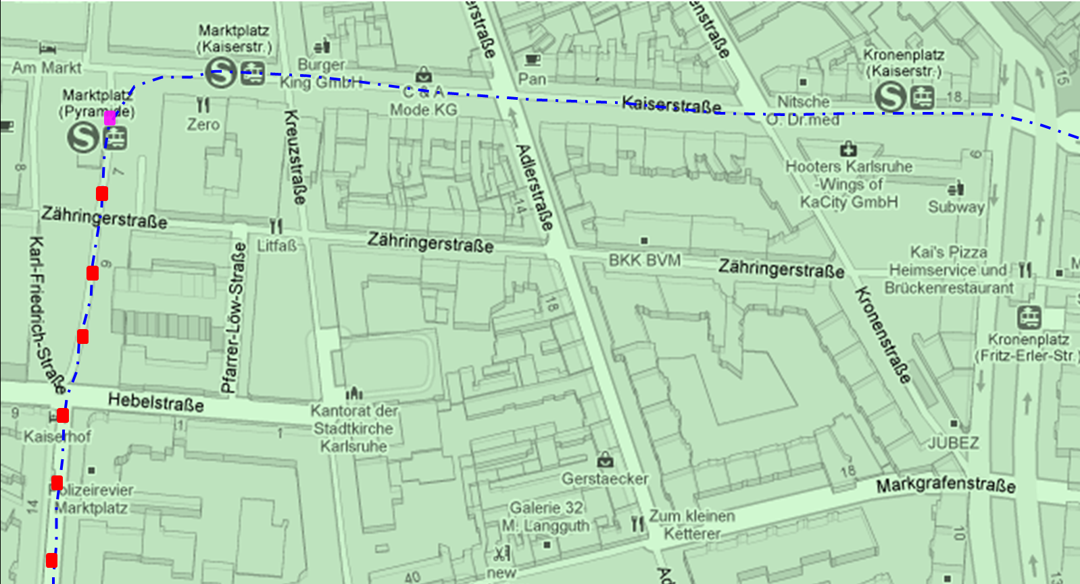
Handsfree ticketing – Add on‘s
Bus | Stop | Time
A | 1 | 12:00
A | 2 | 12:02
B | 5 | 12:05
B | 6 | 12:07
# of passengers
+ journeys
Bus | Stop | Time
D | 23 | 10:44
D | 24 | 10:46
F | 137 | 16:47
F | 138 | 16:48

Slide 6
Handsfree ticketing – open items
Ticket validation
Validation succesful only if the app is active (scenario 1)
Validation succesful only if BT/WiFi is enabled and broadcasting
Access to the BT/WiFi listerner needed
Unique identification of smart phones
Manupulation of MAC address / IMEI number
Cyber attack and fraud protection
Notes:
Man-in-the-middle-Attack
Honey-Pot
Fraud protection algorithms

Slide 7
Future ticketing – projects and research
Aim4it: Guidance of passengers (PRM) using apps and bluetooth
eMobility (Mendel)
Autonomous city buses
Connected Bus Stops
Improved prognosis (AI, Max+ algebra, Historical data)
Early warning systems for Security related incidents with AI handling of measures
Standardization work

