Slide 1
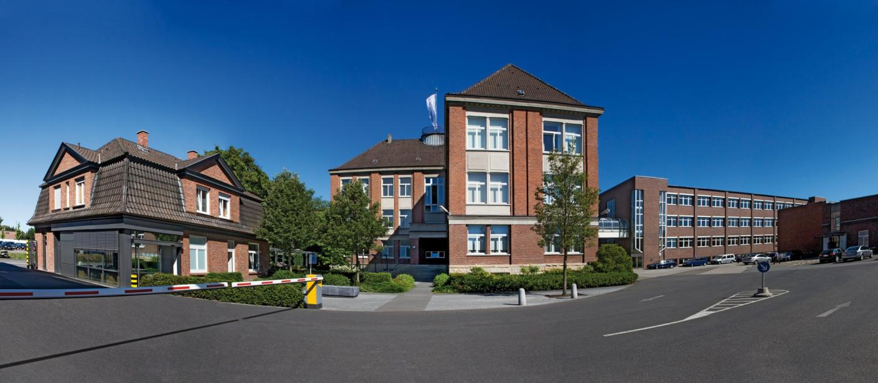
Welcome to Scheidt & Bachmann AFCS
Manfred Troll & Per Norling– Business Development

Slide 2
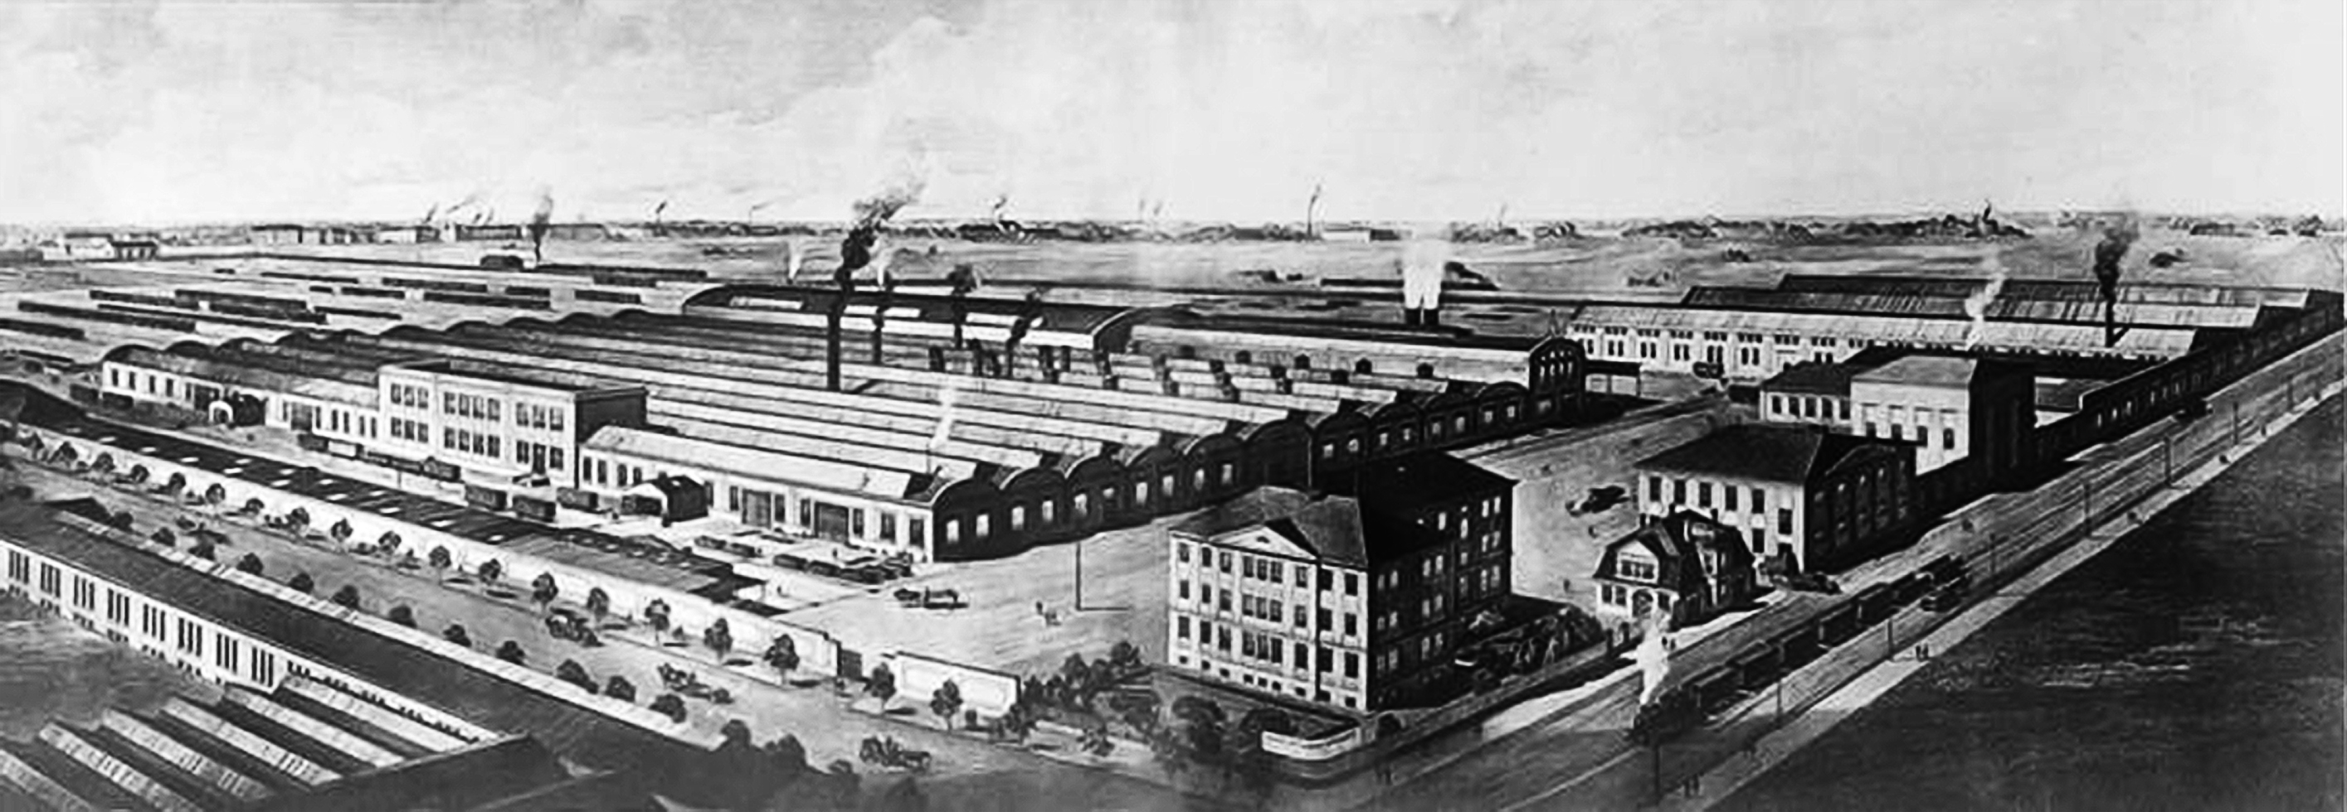
Company Profile
Company Site 1914
Administration Building 2015
© Scheidt & Bachmann GmbH 2015 000036/6.0-01102015
Founded: 1872, family owned in the fifth generation
Employees: > 3.000
Trainees: > 80
Turnover: € 300 m. (2015)
Worldwide know-how: 24 subsidiaries, 50 partners, > 50 countries

Slide 3
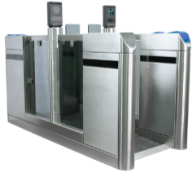
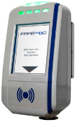
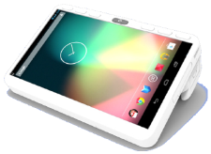
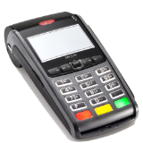
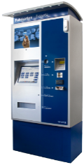
Account Based Ticketing and BiBo
ABT* + BiBo = ID based Cloud Ticketing
Journey construction
Risk Engine
Account manage-ment
Back end
Fare calculation
List management
ID reading infrastructure
ID media

Slide 4
Account based ticketing – projects awarded
Budapest, Hungary
Connecticut, USA
4 metro lines, 7 communter rail lines,
2200 buses, > 14.000 field devices,
5 years operations contract
Buffalo, USA
Dutch fare system goes ID based and EMV contactless, 2 bln transactions, 14 mln active cards, 60.000 field devices
The Netherlands

Slide 5
BiBo (Be-in / Be-out) ticketing
The principle …
… or „What happens without anybody seeing it?“
BiBo system
Which media
When
Where
Back office
Journey construction
Fare calculation
Notes:
The trick behind the BiBo system is that it automatically and reliably de- tects the presence of the passenger in the vehicle. The passenger only needs to carry their registered BiBo medium. Everything else is handled by the BiBo system. This means that the hassles of tariff systems and the process of che- cking in and out of more traditional eTicketing systems is now a thing of the past.

Slide 6
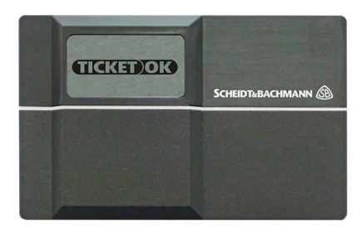
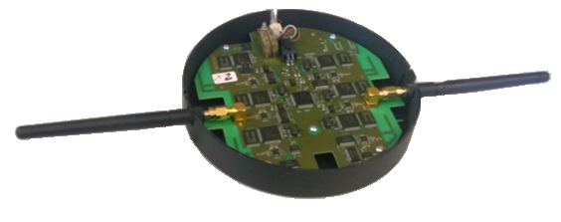
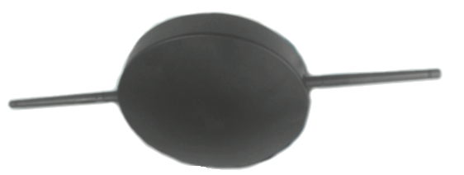
BiBo (Be-in / Be-out) components
The Scheidt & Bachmann BiBo medium and receiver
Communication via a mid-range radio interface
Special protocol for the spatial recording functions

Slide 7
BiBo (Be-in / Be-out) ticketing
The next level …
… or „Let your smartphone be your BiBo ticket!“
Smartphone App shows status of
boarding / registering

Slide 8
Many thanks for your attention!
www.scheidt-bachmann.com
troll.manfred@scheidt-bachmann.de
norling.per@scheidt-bachmann.se

