Slide 1
Listen to your City Electromobility By Volvo Buses
Dialogkonferanse Ruter – Oslo 7.april 2016 - (M2016/Fossilfri2020)
Leading bus manufacturer with focus on systems for sustainable public transport
Notes:
Ingroduction on the topic and myself (Trucks telematics)
Telamtics optimizes the usage of the asset – either intreacting with the vehicle or new services (tracking/tracing)
Orienterinf today without telematics is not possible...
Telamtics today- VM, FM, TM
First service- Zone Mgmt
Roadmap on ZM, CM, YM
Pedastrian detection/Autonomus drive
Viricity- Range prediction services

Slide 2
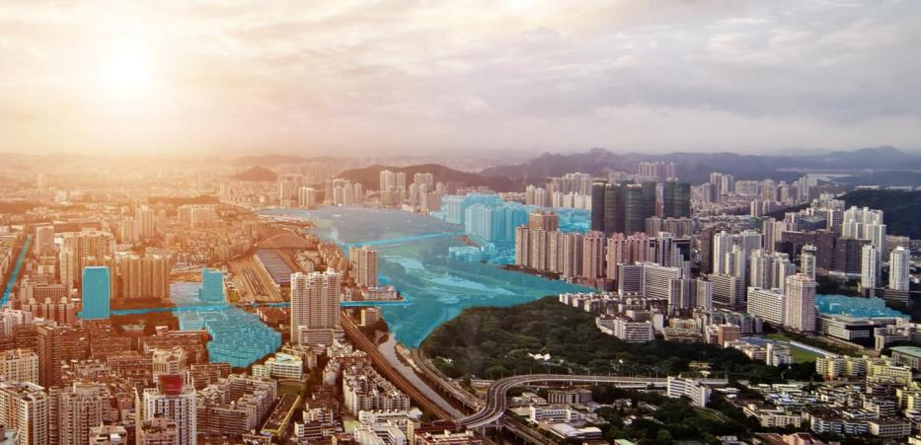
A complete offer of buses and services for tomorrows electromobility solutions
^{Zone}
^{management}
^{Traffic}
^{management}
^{Opportunity}
^{charging}
^{Low-speed zone}
^{Indoor bus stops}
^{Zero-emission zone}
^{Silent zone}
^{Safety zone}
Notes:
Volvo Buses is one of the world’s leading bus manufacturers, with a strong focus on vehicles and systems for long-term sustainable public transport.
Our offer includes complete transport solutions, city buses, intercity buses and coaches. We offer a wide range of services developed to increase our customers’ profitability.
Volvo Buses has approximately 7,500 employees, production facilities in 8 countries and sales in more than 85 markets.

Slide 3
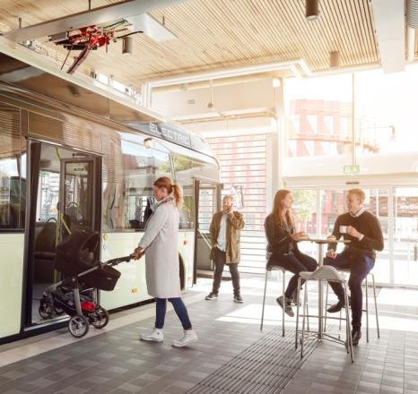
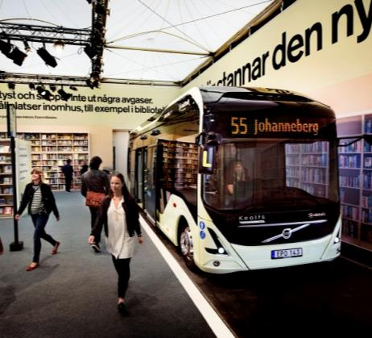
Creating new opportunities for urban planning
Bringing buses closer to passengers. Opening up possibilities bus routes in new areas
Silent mode of public transport improving quality of life and increasing real estate values eliminating noise from diesel or rail solutions
Enabling indoor bus stops in shopping centers, hospitals and living houses improving passenger comfort and safety
Indoor bus stop with cafeteria, Gothenburg
Bus stop in real library during Volvo Ocen Race
3

Slide 4
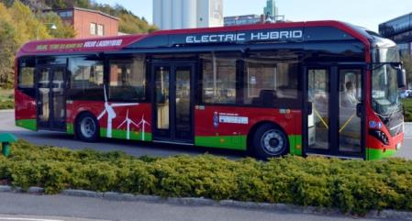
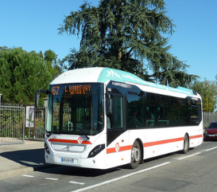
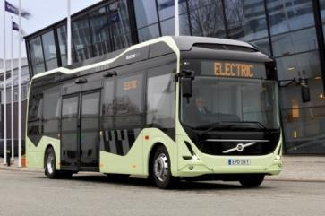
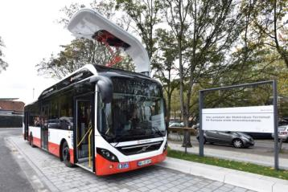
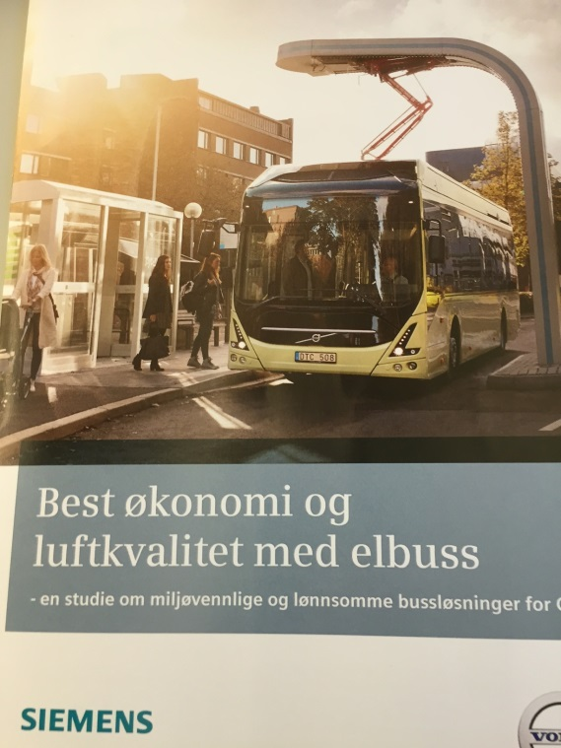
The three cornerstones of Volvo Buses’ e-mobility strategy
Product portfolio
The future will be a mix of:
Hybrid
Electric Hybrid
Electric
Complete system offering
Buses, infrastructure & services,
incl. telematics
Battery charged by km
Competitive Life Cycle Cost
Open interfaces – now standardized
One open and standardized interface for charging infrastructure
Enable buses from other suppliers
Driving standardisation together with Siemens & ABB
4

Slide 5
Summering
Attraktiv forretningsmodell
Forutsigbar
Balanse risk/profitt
Langsiktig
Åpenhet / dialog
Samarbeid / partnerskap
Større mulighet for innovasjon underveis
Tidshorisonten ved anbudsutlysning

