Slide 1
Bertel O. Steen AS Ruter Supplier Conference
12.01.17
Are Knutsen
Strategy & Business Development

Slide 2
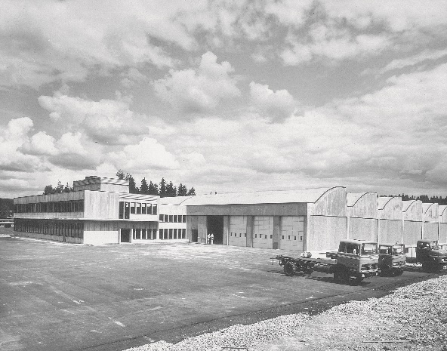
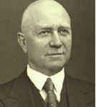
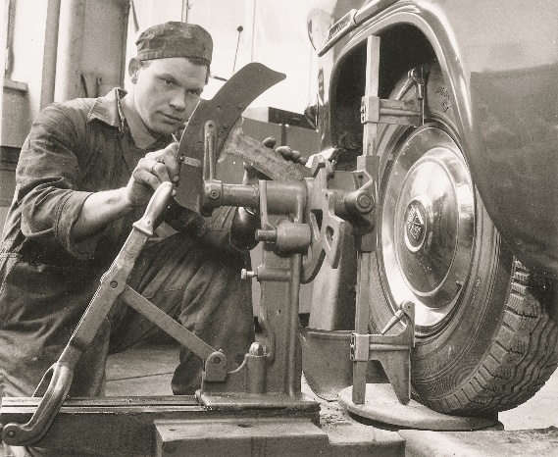
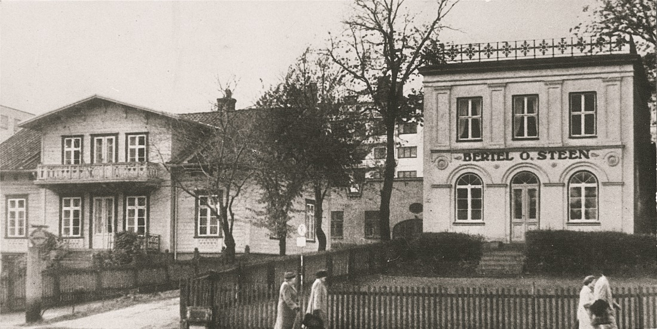
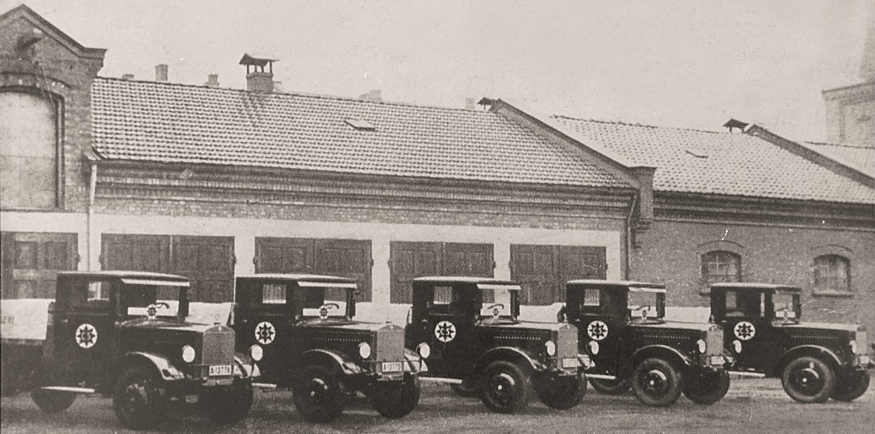
Bertel O. Steen – we have for many years been an important part of transportation in Norway, and intend to also be for the future

Slide 3
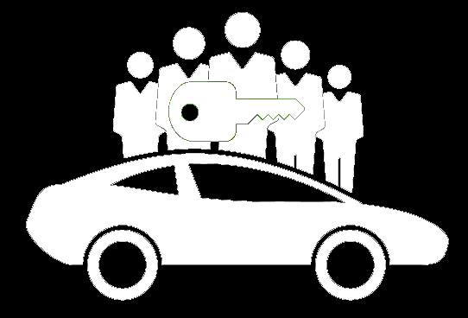
We see 4 key trends for our industy – Electrification, Connectivty, Autonomous driving and mobility
Electrification
Connectivity
Autonomy
Mobility

Slide 4
Next generation transportation systems will integrate different modes of transport in a completely different system than what we experience today
Intermodal mobility system
Transport fare management
Peer-to-peer car rental
Intelligent Parking
Real-time ride sharing
Real-time traffic management
Car sharing
Point A
Point B
Multi-modal transportation solution
Toll management
Individual travel planning
(e)Bike sharing
Connected vehicles
Autonomous driving
Center of customer interaction will be the smartphone – Providing transparency about information of different transport possibilities in real-time
Source: A.T. Kearney

Slide 5
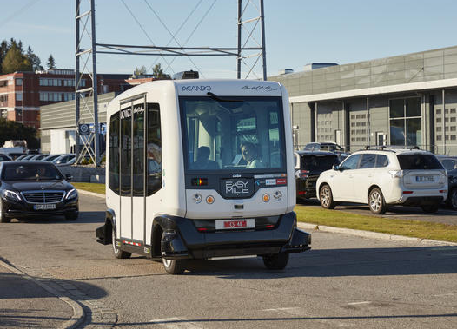
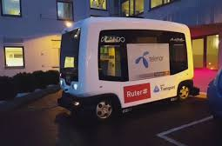
Bertel O. Steen ensures import and logistics of Easymile in Norway and we have contributed to several demonstrations in 2016, and expect more to come in 2017
Our experience
Bertel O. Steen has through 2016 ensured import and all logistics related to the autonomous electric bus EasyMile
We have hosted the first event with media and key partners (Ruter, Flytoget, Telenor, NHO Transport and Acando) at our premises
We are taking steps for also ensuring successful demonstrations and pilots of the bus in Norway in 2017
Through the year we will build our capabilities and knowledge for how to ensure the best possible services for customers

Slide 6
For autonomous vehicles to become a reality in Norway there are several obstacles that need to be adressed
Obstacles
1
Proof of concept - That proves not only technology, but also how the integration and customer experience actually is enhanced. The PoCs must show how the technology improves current systems – we need not to do autonomous just because we can. This is an important factor for also educating the customers
1
2
Infrastructure - “Smart city” infrastructure needs to be implemented so that for example a traffic light can wirelessly alert an oncoming autonomous vehicle of a red light.
The vehicles need to operate together with other traffic in some areas, in other areas the infrastructure can be specialized for certain vehicles. Facilities for charging must be developed.
2
Obstacles
3
Legal and regulatory - needs to be in place and potentially also legally tested. Data protection authorities must be part of the regulations, given that an autonomous vehicle must contain sensors that will access potential personal information that need to be handled there after. Such information is also needed to grow this as a smart service, to be personalized and optimized.
3
4
Technology must be further enhanced, meaning that the vehicles need to perform with other traffic and handle all traffic situations. This means that there will be need for extensive machine learning and sensors, both before launch of service, but also after to grow and improve. Non-autonomous vehicles, and autonomous will have to have M2M collaboration fully integrated to ensure a more seamless travel experience for the customers
4
5
5
New partnerships must be formed, where experiences from different services are brought together to deliver new. Standardization between competitors must be solved

Slide 7
Operations is still a few years ahead, but we are ready to start – and Ruter should invest and establish partnerships to grow the concepts to be an attractive business partner in the area
Going forward
2017: Tests and pilots
The coming year(s) should be utilized to pilot and start proof-of-concepts on several locations, in different seasons
2018 – 2020: First operational routes
The first routes in Oslo can be in traffic, but integrations will probably still need to grow
2020 - 2025: Standardization and growth
Learnings from the initial routes are leading to increased efficiency, new routes and gradually becoming a normal part of public transport in Oslo
Business in the concepts
Open for new cooperation's between parties
Open for learning processes, where SLAs and operational requirements are co-created as learnings arise
Open to facilitate test areas in different types of areas (hills, flat, curved and combinations)
Open for scalable procurement where supplier can grow service together with Ruter – partnership thinking is critical for a service
The key recommendation for Ruter is to establish pilots in 2017 and start the learning together with key partners

Slide 8
Thank you

