Slide 1
Ruter - Supplier Conference
12 September 2016

Slide 2
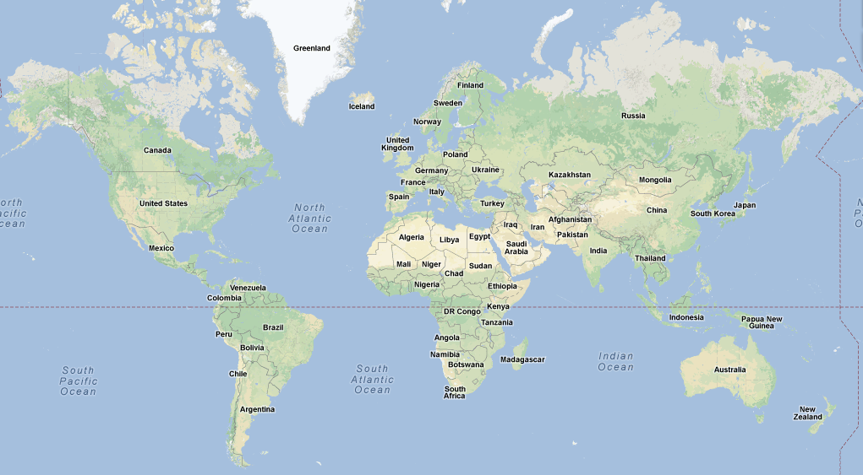
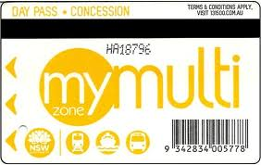
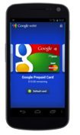
Cubic
1950’s
COINS
TOKENS
MAGNETIC STRIP CARDS
CONTACTLESS
SMART CARDS
ACCOUNT
BASED
TOCs
Sweden
Edmonton
IR
Vancouver
TfL
German Regional Traffic
Operators
Minneapolis Metro
Toronto
MTC
CTA
LACMTA
MARTA
PATH, NYCT, MTA
NJT
SANDAG
WMATA
MDT
Brisbane
Sydney

Slide 3
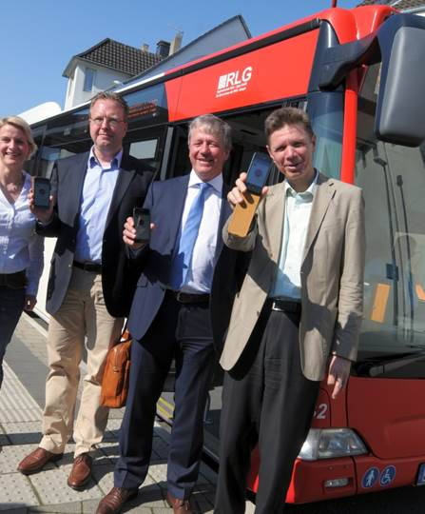
Question 1
Does the vendor have experience with applying new technology platforms (e.g. Bluetooth beacons, Wi-Fi aware and similar) What technologies are available today or in the near future that can enable Ruter’s needs?
Cubic is experienced with applying technology platforms such as Bluetooth beacons and Wi-Fi in the transportation ticketing environment specifically bus.
Cubic participated in a field trial in Soest in Germany in April 2015 with a local bus operator.
Buses were equipped with Bluetooth Low-Energy on-board beacons.
The communication takes place between a mobile phone app and on-board
beacons using Bluetooth Low Energy.
Cubic is currently working with the Duisburg Transport Authority to test a BLE based ticketing system for buses, trams and underground rail. Beacons will be installed on buses, trains and stations.
Cubic participated in a government funded R&D project, called eSiM2020 with the focus to develop a be-in/be-out ticketing solution based on WiFi.

Slide 4
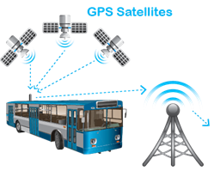
Question 2
How are precision levels of positioning services expected to mature and what possibilities arise as a result of the development?
European Galileo positioning system allows a much more precise positioning service than current GPS.
Utilising precise positioning services, new ticketing systems could entirely rely on position data.
Algorithm based travel resulting in passengers not needing to interact with a ticketing system Sign up and GO.
Advantage: No physical ticketing infrastructure. (Bluetooth beacons or Wi-Fi units etc) on buses, trains and stations.

Slide 5
Question 3
How should an in-vehicle infrastructure consisting new technology (e.g. Bluetooth beacons, Wi-Fi-aware and similar) be set up in order to prepare for efficient administration, monitoring and maintenance?
Passenger WiFi
Video Surveillance
2-8 Cameras per Bus
Event Trigger: Contact closure, Accelerometer, and Audio Trigger
Bus Stop Services
Passenger WiFi services
Bus Real Time ETA information display/Digital Signage
Video Surveillance
Two-way Voice Communication
Onboard Hands-free Client Support
End-to-End QoS to Prioritize VoIP Traffic
Wireless Bulk Data Transfer (WBDT)
Data Transfer Over WiFi in Yard
CAD/AVL software updates, Scheduling, Logging
Passenger Accounting, and Ticketing etc
Fleet Management Services
Telematics and Predictive Maintenance
GIS, GPS Tracking, Geo Fencing
Driver Behavior Monitoring
Real-time Traveler Information
Stop annunciation
Passenger counting
Management reporting
We should consider the
Complete picture
Understand the business case
and design for the needs

Slide 6
Come and see us
Stavanger
October 6th and 7th 2016
Barcelona
November 15th to 17th 2016

Slide 7
Thank You
Jonathan.williams@cubic.com
+353 (0) 879918737

