Slide 1
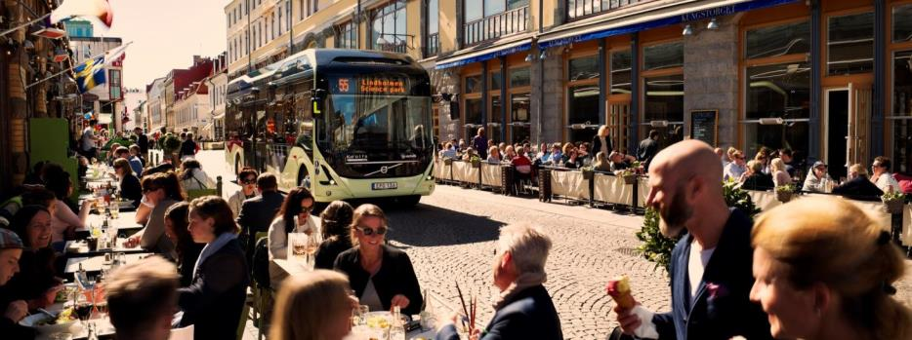
Listen to your City Electromobility By Volvo Buses
Oslo 13.februar 2017
Notes:
Ingroduction on the topic and myself (Trucks telematics)
Telamtics optimizes the usage of the asset – either intreacting with the vehicle or new services (tracking/tracing)
Orienterinf today without telematics is not possible...
Telamtics today- VM, FM, TM
First service- Zone Mgmt
Roadmap on ZM, CM, YM
Pedastrian detection/Autonomus drive
Viricity- Range prediction services

Slide 2
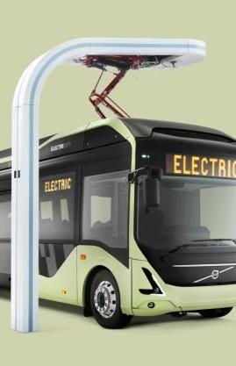
Benytt standard løsning- OppCharge
Total energy savings
Åpen standard
Fysisk integrasjon
Protokoller
Kommunikasjon
Integrasjon mellom leverandørene av busser og ladeinfrastruktur
www.oppcharge.org
Notes:
The Volvo Electric Concept bus was launched in June 2015 when bus route 55 was inaugurated in Gothenburg. It’s a bus route with only electric vehicles.
This full electric bus represents the third step of electrification.
This bus runs on electricity only, offering zero emissions in operation and as much as 80% energy saving, compared to diesel buses.
It will travel the entire route on electricity only, silent and emission-free.
Volvo is the initiator behind the unique ElectriCity cooperation. The cooperation runs from 2015-2018 and involves 14 partners from the industry, the city, the region and the university. ElectriCity is to function as a demonstration arena in the city of Gothenburg with route 55 at the core of it. Here, innovations are to be tested and evaluated with the objective of making public transport more attractive.

Slide 3

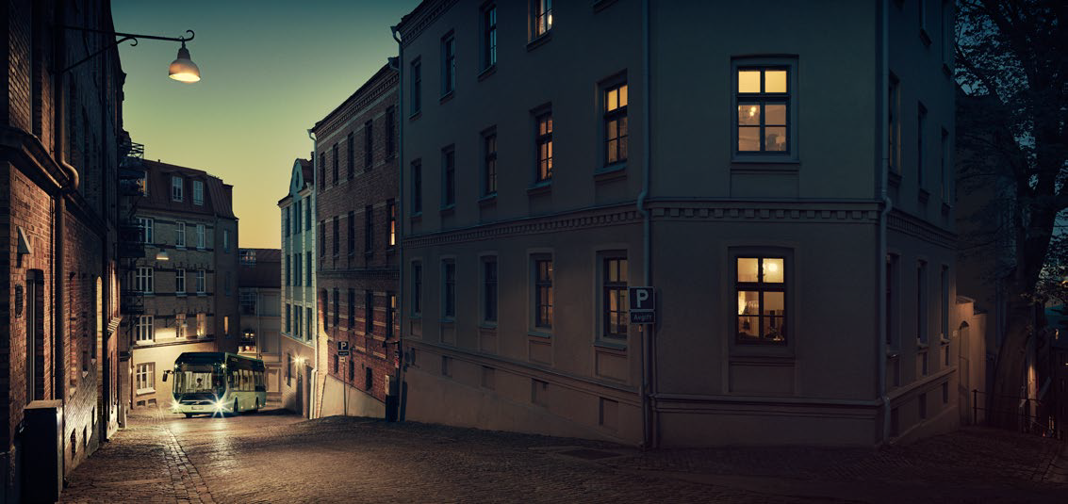

City Planning - Electric buses – a new tool

Slide 4
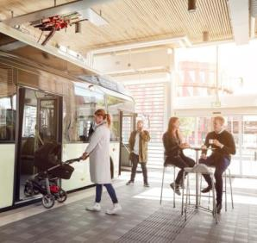
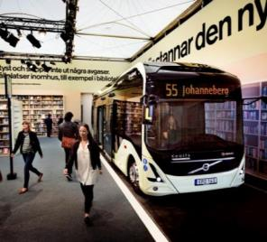
Creating new opportunities for urban planning
Bringing buses closer to passengers. Opening up possibilities bus routes in new areas
Silent mode of public transport improving quality of life and increasing real estate values eliminating noise from diesel or rail solutions
Enabling indoor bus stops in shopping centers, hospitals and living houses improving passenger comfort and safety
Indoor bus stop with cafeteria, Gothenburg
Bus stop in real library during Volvo Ocen Race
4

Slide 5
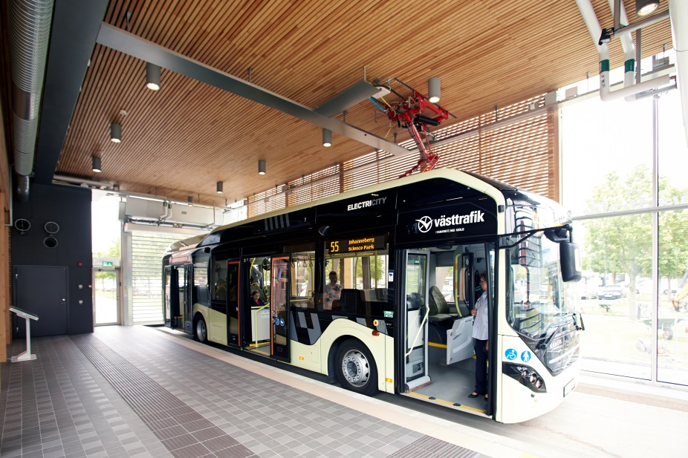

Slide 6
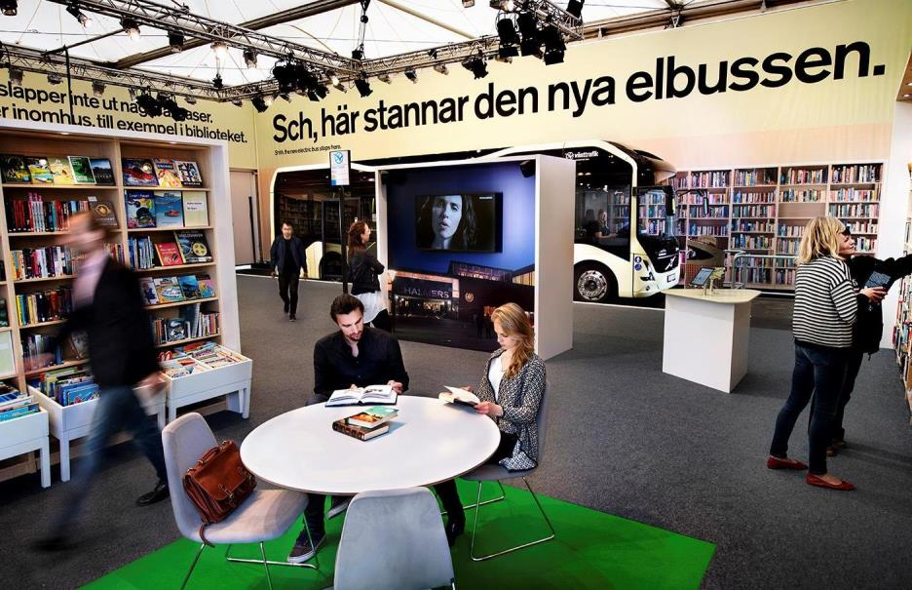
Notes:
This is to show you the opportunities that an electric public transport system opens....
During the recent Volvo Ocean Race stopover in Gothenburg, a pop-up library with an integrated indoor bus stop was created by Volvo and the Gothenburg City library. At the fully functioning library, visitors could borrow books, talk to librarians and sit down and read in the nice, quiet environment.
Every 5 minutes, an electric bus, silent and with no emissions, entered the library, letting tpeople get on and off inside he building, before exiting the building and continuing on route 55.

Slide 7
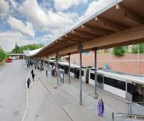
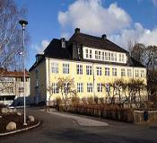

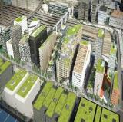
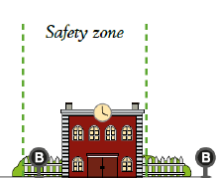
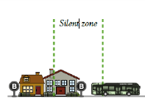
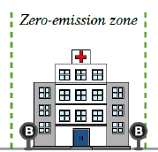
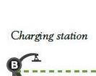

Telematics & e-mobility
Zone Management
Terminal
School
Residential Area
City Centre

Slide 8
System - risks
All types of electric buses utilise much less energy than diesel or gas alternatives. The longer the daily distance, the stronger the benefit.
Compromises are needed
  Passenger capacity ←→ Battery weight
  Driver/bus utilisation ←→ Charging time
  Cost for fast charging stations ←→ Battery cost
  Battery lifetime and running cost
  Reliability
  Reduce risks
  Easy to extend – system to grow

Slide 9
Partner cooperation- ElectriCity Gøteborg
New roles, new cooperations and new opportunities
The partners that are normally responsible for public transport (Västtrafik and Trafikkontoret) collaborate closely with other partners.
The partners that are usually not involved with public transport are involved in developing and building bus stops (Chalmersfastigheter, Akademiska Hus, Älvstranden Utveckling).
Three partners share the responsibility for operating the bus service until the summer of 2018: a publicly owned public transport company (Västtrafik), a bus manufacturer (Volvo) and a transport company (Keolis).
One partner that does not normally supply buses with energy is developing business models that will allow it to receive payments for charging (Göteborg Energi).
Different types of organizations, different culture, different objectives, different legislation, different ambition, different financing - but with one common vision and a high level of trust

Slide 10
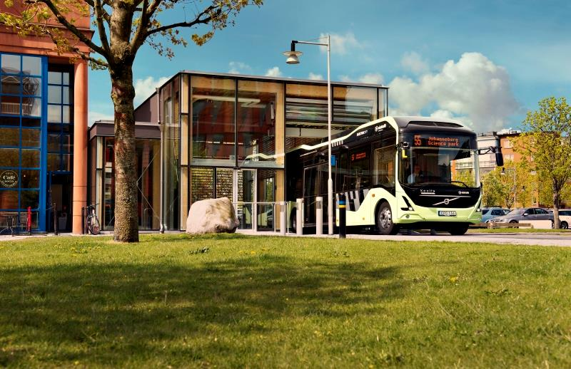
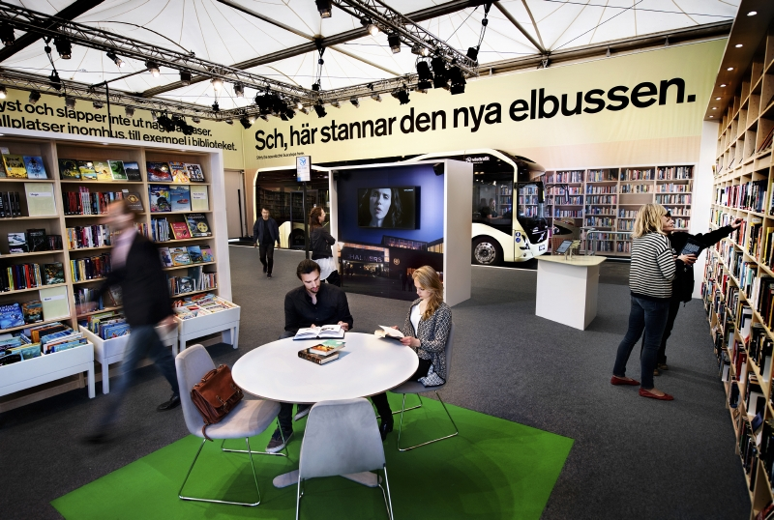
Gothenburg
In 2013 three Electric Hybrids and two charging stations started up running on line 60 in the city center.
In June 2015 Line 55 Electric started up, seven Electric Hybrids, three Full Electric buses and two charging stations.

Slide 11
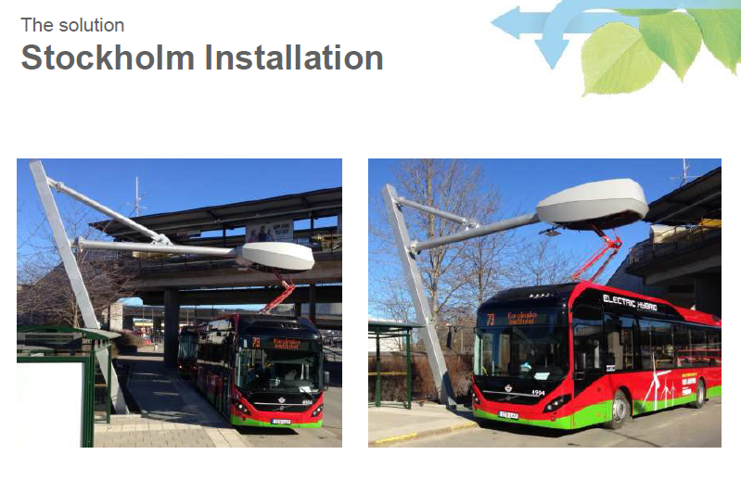
Stockholm
Eight Electric Hybrid Buses are running in operation on line 73 in Stockholm and two charging stations. The traffic start was in March 2015.

Slide 12
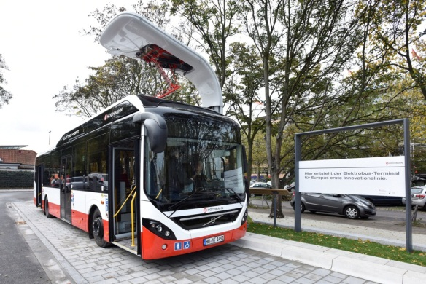
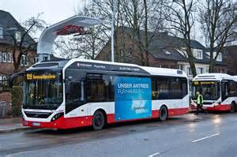
7900 Electric Hybrid inauguration in Hamburg 2014
Three Electric Hybrids and 2 charging stations are running in traffic since 18th of December 2014 on Hamburg innovation Line 109.
https://www.youtube.com/watch?v=FseBmNiqrd0&x-yt-cl=85027636&x-yt-ts=1422503916#t=12

Slide 13
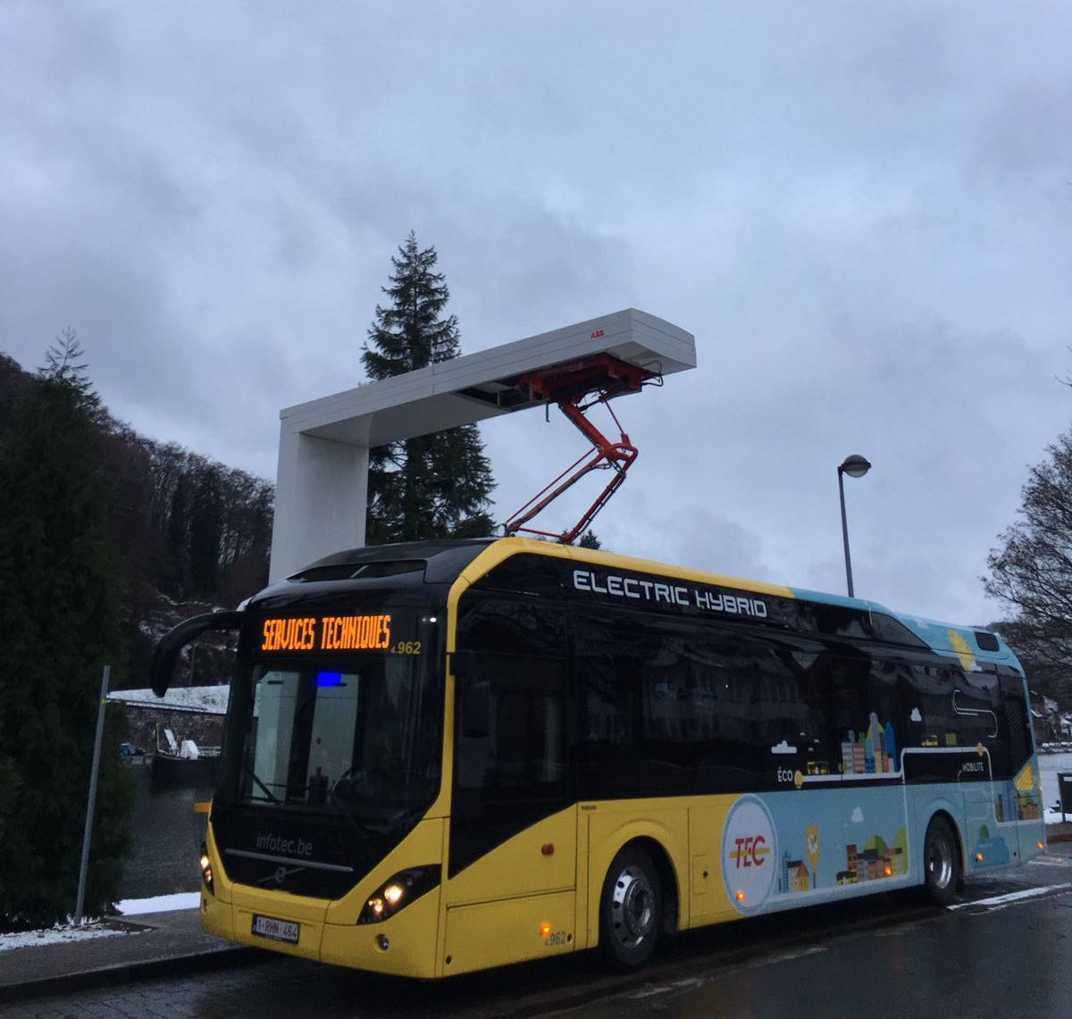
Namur, TEC, Belgium
11 Electric Hybrid buses and 2 Charging stations running in Namur
2017 Q3 traffic start of 90 Electric Hybrids and 8 charging stations in Namur and Charleroi

Slide 14
Luxemburg
12 Electric Hybrid buses and 2 Charging stations running in Luxemburg
4 Electric buses and 2 Charging stations to start up in Luxemburg during spring 2017

