Slide 1
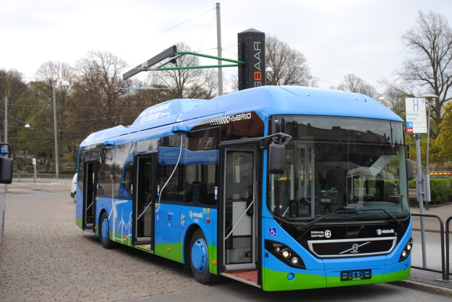
Charging methods
Summary
Rapidly moving technology area
Preferred choice today:
Stationary conductive oportunity charging
Promising development is observed within three areas:
-Induction charging, for stationary charging
-Dynamic charging at part of bus routes (condutive and/or inductive)
-Dynamic charging with infrastruture common for buses cars and trucks
Standardisation, is ongoing but delayed by conservative parts of the industy

Slide 2
Volvo approach
Volvo Bus will offer complete transport systems and take responsibility for the complete system including electric/plug-in buses and charging stations
Volvo Bus is contributing to the rapid development in the field. Volvo Bus will at each point in time offer the most cost efficient charging solution in order to achieve a positive pay-back during the lifetime of the system.
Volvo Bus will use global partners for charging infrastructure and expect the systems to be open also for buses from other bus manufacturers
Volvo Bus will expect any local charging infrastructure to be open also for Volvo Bus and will be prepared to adapt to local requirements where this is required.
Volvo Bus will secure backward and forward compatibility, subject of cost, when new technologies are introduced and supported.

