Slide 1
Reinventing Customer Experiences
Combining digital and physical

Slide 2

Real-time use of information empowers personalized Customer Experiences
Analytics & Automation
Advanced, real-time analytics responding automatically to customers interactions across touchpoints
Personalized interactions
Utilize insights combined with automation to provide relevancy and personalization in every interaction across channels
New digital solutions
Provide new digital solutions to differentiate with easy, seamless and beautiful travel experiences
Data based insight
Combining offline and online behavior

Slide 3

#1
Market Leader
in the Nordics
We create business value for our customers by combining information with insight.
NASDAQ: AFE1V
116 MEUR
Revenue
100+
Large Nordic Customers
1000+
Employees

Slide 4

Reinventing Customer Experiences
Our Multidisciplinary approach
CUSTOMER DATA
Understand who your customers truly are based on data
PREDICTIVE ANALYTICS
Mine and predict the needs and behaviour of individual customers
TECHNOLOGY
Emerging new technologies to sense and serve customers
DESIGN
Create interactions that meaningful, beautiful and personalized

Slide 5

Provide personalized experiences
in every touchpoint
On board
Web
Email
Customer service
Mobile
Social media

Slide 6

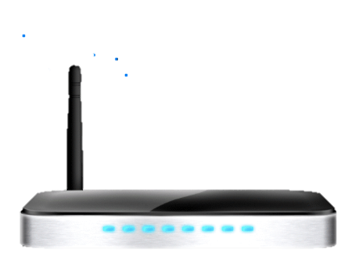
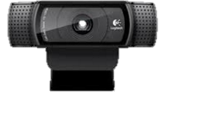
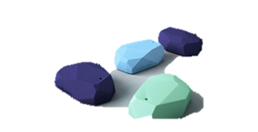
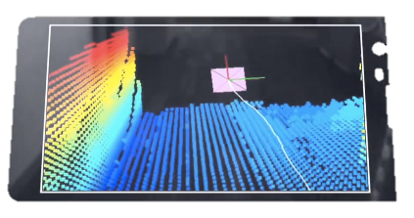
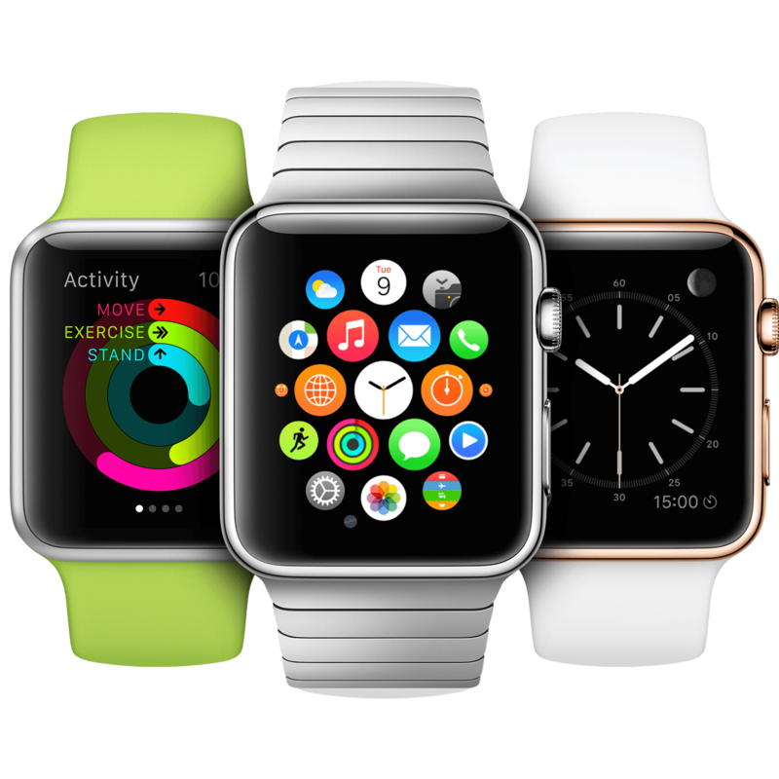
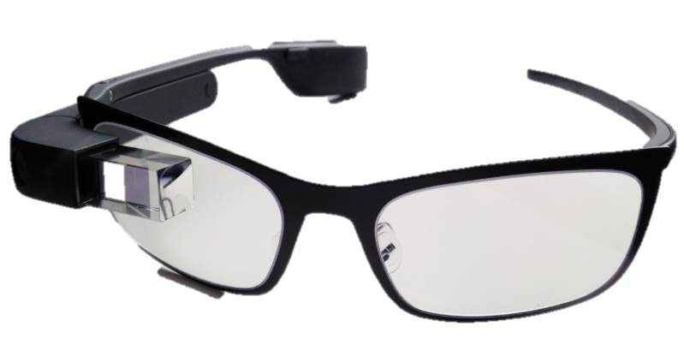
Sensing the world around us
Take advantage of emerging technologies to sense and serve customers

Slide 7

Passenger data collection enables personalized exeperience
Capture traveler history and deliver information and services using multiple channels.
Personalize proactive marketing, promotions and services.
PROXIMITY
Beacons, WIFI,
GPRS, RFID
Push- Ticket is no longer valid. Proactively ask if customer would like to buy new ticket in app
Push - over crowded departures or traffic jam. Advice traveler to take the next departure
Deliver continuous information to travelers
Traveler care program based on surveys about satisfaction
Notes:
Capture traveler history and deliver information and services using multiple channels.
Make a single view of the traveler available to the entire enterprise.
Personalize proactive marketing, promotions and services.
Provide real-time updates before, during and after the journey.
Deliver continuous information to travelers.

Slide 8

REINVENTING CUSTOMER EXPERIENCES
How can we help you?

Slide 9
Creating exceptional end to end customer experiences
Strategy & Design
CUSTOMER EXPERIENCE
STRATEGY
SERVICE DESIGN
CX CONCEPT
DESIGN
UX DESIGN
MYTH-BUSTERS
Analyze & Predict
ANALTICS WORKOUT
CUSTOMER INSIGHT
FEEDBACK & SENTIMENT ANALYSIS
MARKETING AUTOMATION
PERFORMANCE
Sense & Gather
WIFI ANALYTICS
MOBILE & BEACONS
VIDEO ANALYTICS
AUGMENTED REALITY
FACIAL RECOGNITION
SOME ANALYTICS
Integrate
CUSTOMER 360
MASTER DATA MANAGEMENT
DATA INTEGRATION
DATA VIRTUALIZATION

Slide 10

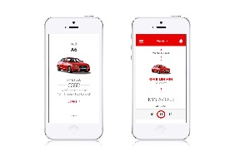

Master data quality is key to all digital services
Matching
Cleansing
Legacy
systems
Shadow database
MDM-
hub
100% identifiable
My apps
People
register
Public
register
Telephone
Directory
Address
Directory

Slide 11




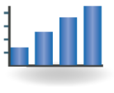



















Big data analytics architecture
Deployed in the cloud for unlimited scalability and performance
What happened?
Why did it happen?
What will happen?
What is the best that could happen?
Nest best action. Optimization.
End user applications.
High business value.
Existing platforms
Big Data Platform
Use cases
DW Portal
Internal Insight
(Business Users)
Deep Analytics
(Data analyst, Data Scientist)
Business applications
(Application of models)
Discovery Exploration
Use predictive models
Data blending, enrichment, transformation
Automated web services to customer or business facing applications.
Data
Warehouse
Data blending
Visualization
Predictive Analytics
Model creation
Reporting and collaboration
Visualization to BI-platforms, publish to business applications
Data Blending / Data Virtualization
Big Data Storage (Data Lake)
Data Sources
Data Sources
Transactional
Social Application User Generated Rich Media Sensor Documents Third Party

Slide 12
Our expertise
Service & Customer experience design
Algorithms
Location solutions
Mobile development
Sensors & IoT
Virtual & Augmented reality
Custom Development, Design & Sensing
the physical
Business intelligence & Data warehouse
Master data management
Advanced analytics
Analytics as a Service
Big data & Cloud
Document and case management
Analytics,
Big data, Enterprise Information Management
Functional &
Software Solutions
Business applications
Functional solutions
Custom development
Enterprise software
Managed services

Slide 13
What happens when you put a data analyst, a designer and a technologist in the same room?
Magic
Bjørn Inge Johansen
Bjorn.inge.johansen@affecto.com
Kjetil Kalager
Kjetil.kalager@affecto.com

