Slide 1
Appuyer sur la touche « Echap » pour revenir au sommaire
HEULIEZ

Slide 2
Heuliez Bus is one of the CNH Industrial brands and the second brand for bus production in CNH Industrial.
Construction Equipment
Commercial Vehicles
Financial Services
Agricultural Equipment
Powertrain

Slide 3
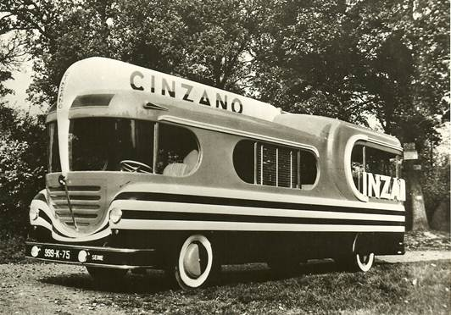
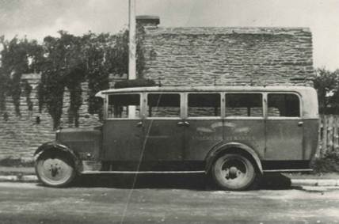
History
1920 Founding of the HEULIEZ Company (horsecarriages)
1952 Advertising vehicles for the Tour de France: SOFIL, CINZANO, ASTRA…
1932 First HEULIEZ coach built with UNIC chassis and a wooden structure
Decade «70» Heuliez Bus focused its production on urban transport buses

Slide 4
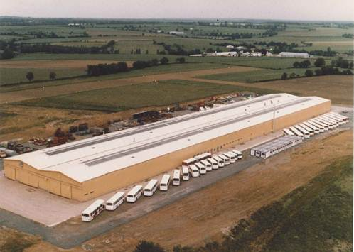
History
1980 Settlement of the Heuliez Bus Company in Rorthais
2011 Iveco member of Fiat Industrial
1999 Renault VI & Iveco merged to combine bus & coach business
2013
Further to merge between Fiat Industrial and CNH Global, Heuliez Bus is now a member of CNH Industrial
1991 Volvo Bus Corp. Entered the capital besides Renault VI, having 75% in total
2003 Heuliez Bus owned for 100 % by Iveco

Slide 5
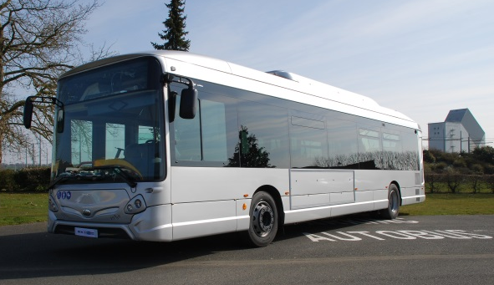
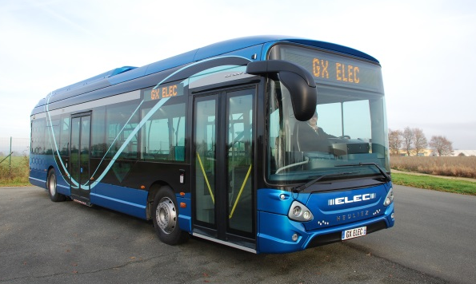
GX Range
Standard 12 m – 2 or 3 doors
Width: 2,55 m
Engine: Tector 7 Euro VI
Power: 286 cv
Gearbox: ZF or VOITH
Integrated starter generator (140 kW)
Electric engine (175 kW)
Lithium-ion batteries (11 kWh)
Electric engine(175 kW)
High energy lithium-ion batteries
Overnight charging
Diesel
Hybrid
Full electric

Slide 6
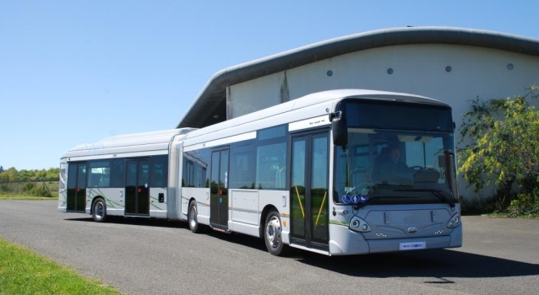
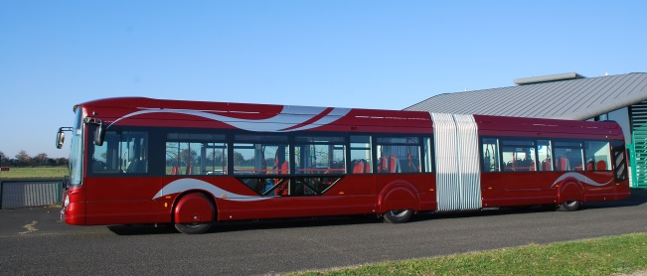
GX range
Articulated 18 m – 3 or 4 doors
Width: 2,55 m
Engine: Cursor 9 Euvo VI
Power: 360 cv
Gearbox: ZF or VOITH
Integrated starter generator (200 kW)
Electrique engine(200 kW)
Lithium-ion batteries (11 kWh)
Diesel
Hybrid
available in 2019
With opportunity charging

Slide 7
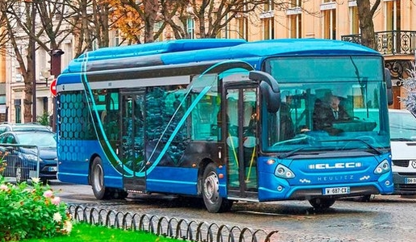
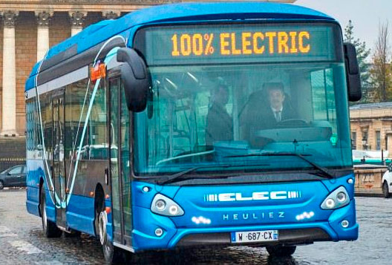
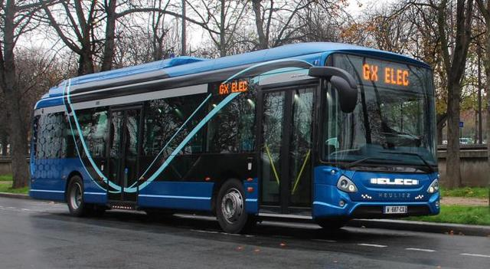
Heuliez GX 12m

Slide 8
GX ELEC road map
2010 : Serial Hybrid project
2012 : Serial production Hybrid
2014 : Electric overnight charge project
2016 : Electric opportunity charge project
2018 : Serial production Electric overnight
2019 : Serial production Electric opportunity charge
Electric portfolio :
12 m Overnight charge
18 m Opportunity charge

Slide 9
Heuliez Bus vision for Ruter – Oslo. (1/2)
Heuliez Bus produces and delivers electric bus in serial production from Q4 2018, Articulated electric buses also available in 2019, with opportunity charge
Production capacity for 100 vehicles is totally compliant
No order yet, but test contracts, such as for Paris / Ratp, Grenoble, Lyon
The charging points must be distributed along several locations along the several routes.
2 charging points per route is recommanded, for instance at both terminus
The on-board batteries will be sized according to the max distance to travel
Testing : in a similar way to trolleybuses or BRT project, there is a phase when all buses are gradualy placed in operation-like conditions, so that the robustness of the system is tested and stressed. This phase would last several weeks due the quantity of buses

Slide 10
Heuliez Bus vision for Ruter – Oslo. (2/2)
Heuliez has already the experience of maintaining from a single contract with 102 hybrid buses of the PTA of Dijon (France)
This contract lasts over 15 years for the maintenance of the hybrid driveline
The local dealer (Heuliez / Iveco Bus) is trained accordingly, additional staff are hired with the appropriate skills
A similar model can be implemented for Oslo
Procurement : buses and their infrastructures can be joint
No commitment yet for being involved in operating the buses
No need for a system test, only inrolling of the busses as they have been tested for almost 4 years before 2020

Slide 11
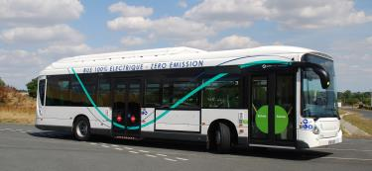
Heuliez GX ELEC 12m
Long-term tests in Paris / RATP
GX 337 Electric 12m delivered to RATP on August 2016, the 31st.
Experimentation followed by a weekly meeting between RATP and HEULIEZ BUS
Activities on September dedicated to perform physical, dynamic and performance check
Maintenance, safety check OK
Dynamic and performance check OK
Start of commercial operation planned from October 2016, the 14th :
Until November 2016 the 11th on line n°21 :
Paris Gare saint Lazare to Stade Charlety -Porte Gentilly
Length 7,8 km - Average speed 10 km/h
From November 14th to December 31st ,2016 on line n°147 :
Pantin’s church to Sevran-Ronsard.
Length 16,1 km - Average speed 16 km/h

Slide 12
Heuliez GX ELEC 12m
Batteries dedicated for long stretch between charge
Over-night : slow charge
Recharge in 3 to 5 hours, depending on power of charge
Slow charge from 50 to 100 kW
Mid-day pause : possibility to have extra stretch capacity at moderate charge :
Add ~ 70 km per 30 minutes of charge
At 150 kW charging rate
Cold batteries
No loss of energy when vehicle switched off
No need to keep the vehicle plugged between recharging periods
No need of internal energy consumption to maintain temperature
Battery safety : matching the newest E.U. standards
Compliant to Norm R100 revision 2, enforced since July 2016
Vibration, Thermal shock and cycling, Mechanical shock & integrity, Fire resistance, External short circuit & overcharge/discharge protection, Over-temperature protection

Slide 13
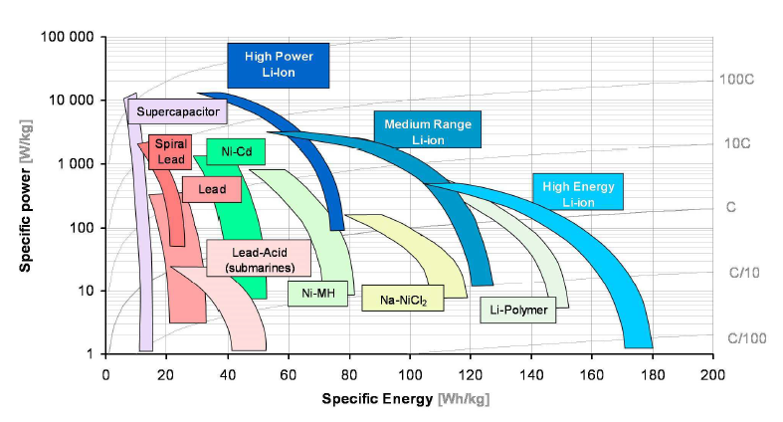
Heuliez GX ELEC 12m
Batterie performances
Extensive tests by EDF laboratories
Li-NMC : one of the most performant chemistry
Highest specific energy of battery pack vs. Sodium or NiMH based cells
GX ELEC

Slide 14
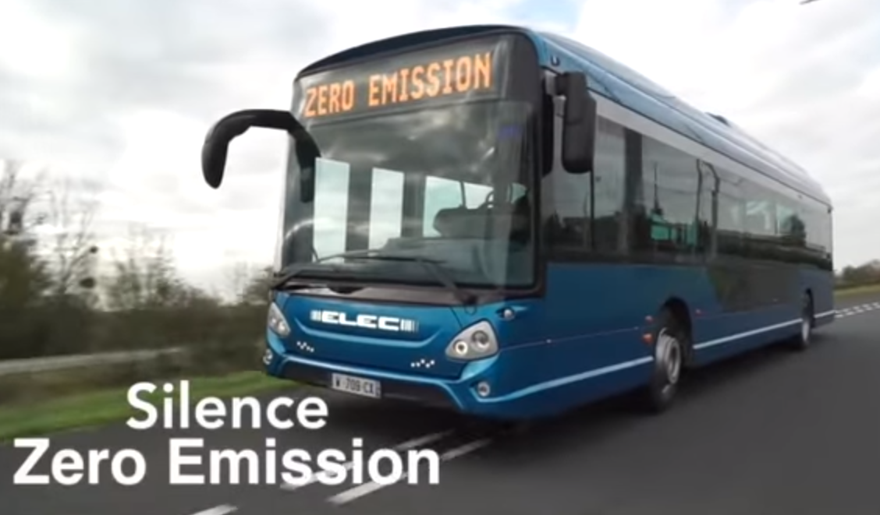
Heuliez GX ELEC 12m

Slide 15
Heuliez GX ELEC 12m
Performances
Passenger capacity
Maxi : Up to 99 passengers
At 11,5 t rear axle load : 83 passengers, with A/C : 78 pass.
Energy consumption : (without A/C , without heater)
Half loaded : 1,05 kWh / km
Fully loaded : 1,35 kWh / km (20 t)
Thermal comfort :
Electric A/C
Electric water heater
Concept of pre-heating of vehicle during over-night charge : additional heater is dual-mode with electric and diesel / biodiesel (HVO for instance)
Durabilty :
Whole vehicle : 15 years
Electric tration : 15 years (BMS, charging system, power converter, motor …)
Batteries : 7,5 years

Slide 16
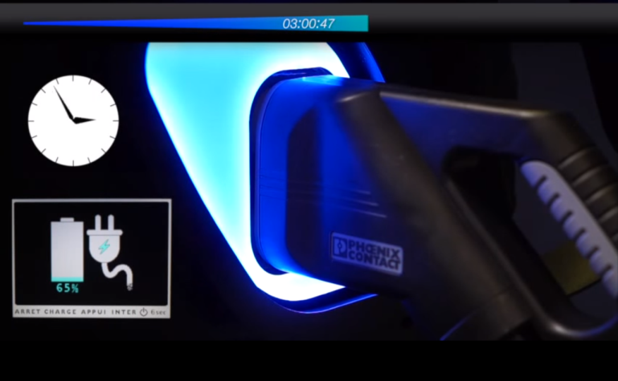
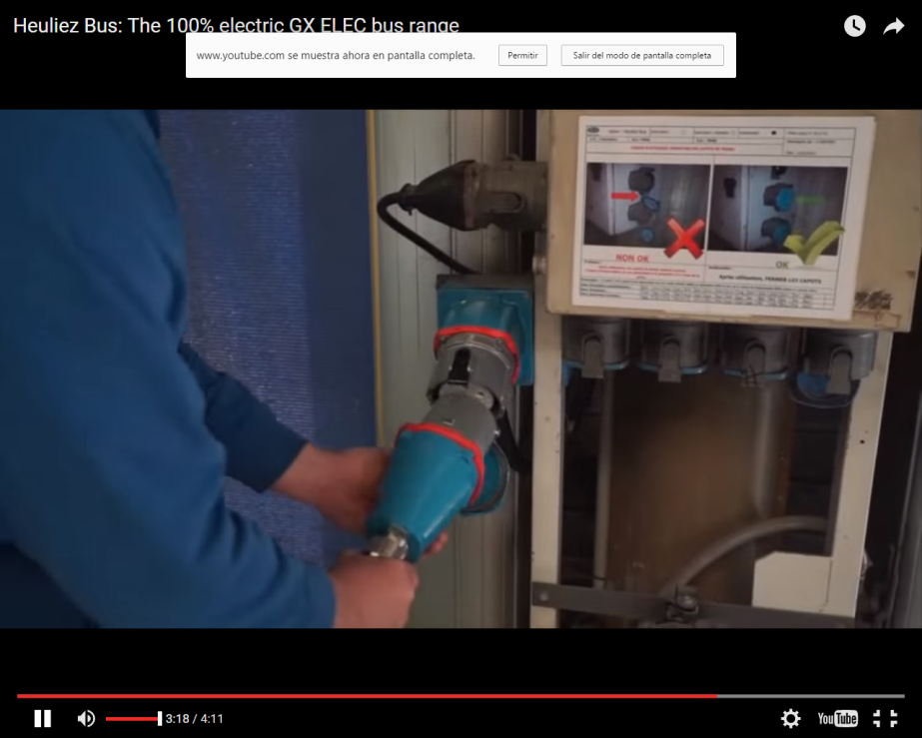
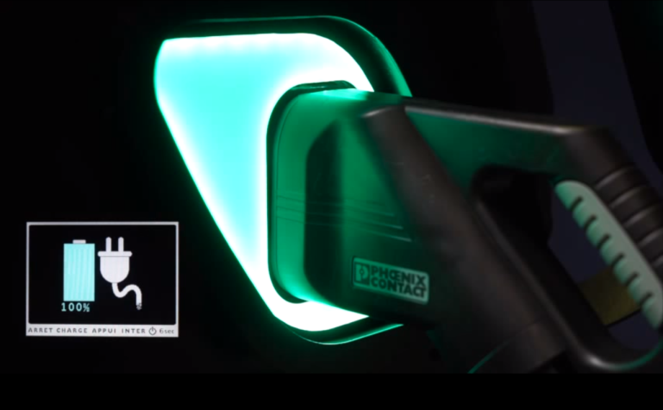
Heuliez GX Eléctrico 12m
Recarga Plug-In
Charging times: 3 - 5 hours depending on the power of the charger

Slide 17
Heuliez Bus values
Creativity
Flexibility
Quality
Participation
Discretion

Slide 18
Thank you for your attention….
S.A. HEULIEZ BUS–LA CRENUERE–79700 RORTHAIS – France
TEL. 33 (0)5 49 81 07 07 – FAX 33 (0)5 49 81 09 91 – wwwheuliezbus.com

