Slide 1
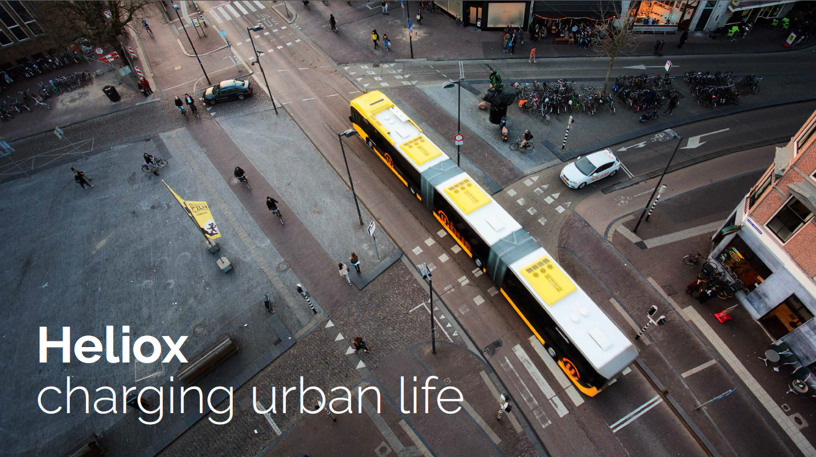
Michael Nuiten
Business Development Manager

Slide 2







Heliox
Founded in Philips (1909)
Independent since 2009
The Netherlands (HQ-Best)
UK (London)
Slovakia
Poland
Hongkong
India
Singapore
Indonesia (Batam)
Melbourne
Headquarters
Development facilities
Manufacturing
Local office/Service location

Slide 3
Heliox
What are the key learning points in a system test? What are the major uncertainties and risks related to the phasing-in of approximately 100 battery electric articulated buses in the city centre in 2020?
Ruter 1st question
Input to create the right plan for operation and charging. KLP
Enough power available on location? KLP
Actual kWh from grid to km on the line. KLP
System quality according expectation/promise? KLP
Centralized or on router opportunity charging? KLP
Permits for the Infra installation within a city Risk
Supplier delivery times Risk
Inform the DSO in time for the requested power on location Risk
Mature bus supplier Risk
user behaviour Uncertainty

Slide 4
Heliox
What is needed to ensure that the startup and operation of around 100 electrically articulated buses in 2020 will deliver an equally good service to customers, as what we have today?
Ruter 2nd question
New Technology, redundancy
Market information: Eindhoven
Stable charging infra
Proven mature bus OEM

Slide 5
Heliox
Which business model should be applied in the test – ie who should own / operate / maintain the various elements of electric bus ecosystem?
Ruter 3rd question
A test that provides the most relevant learning for many of the involved parties
The PTA, PTO & CPO should all join a project. These project can be devided in:
  PTA owning all, PTO delivering the public transport service
  PTA owning the charging infra, PTO owning the buses
  PTO owning all
  PTO owning the busses, PTA the charging infra
  PTO owning the busses, CPO the charging infra
In practise PTO – PTO&CPO
Sufficient flexibility to take into account the rapid technological development
The suppliers responsible for the technological updates & standards
Mode 4 standardization highly recommended
Charging infra by CPO, pay per kW
Lease the infra from a supplier or CPO
In practise the duration of a project is 10+2+2years while the PTO/CPO owns the infra and updates the infra according new technologies & standards.

Slide 6
Heliox
Who should procure the buses and infrastructure for a system test?
Should Ruter conduct separate procurement of electric buses, infrastructure and Bus services, or Should any / all three procurement be merged together?
Ruter 4th question
3 options for the desired solution of your future needs
  Separate tendering of infra + services + buses
  Buses & services merged + charging infra
  The “All in” tender
Outcome = Input Future

Slide 7
Heliox
What size/scope should the test operation have, to provide value as a system test?
How many electric buses, the number of charging points, the number of driven km or hours per year, duration of contract, etc. is needed for generating ‘good enough’ experience to follow up with full scale deployment?
Ruter 5th question
The test
  One full year should be suitable to provide a good view how the pre-operation (Tendering in 3 options, purchasing & installing) & operation itself (operational buslines). Contractwise more years should be a minimum when a financial chapter is part of the project.
  4 buses per line, at least 3 different types of lines with 2 end of line chargers each. Less busses, or charging infra might not provide the right statistical values.

Slide 8
Heliox
How is the market’s expected delivery capability and lead times in 2018-2020
Total time from award of contract to the startup of commercial passenger service with electric opportunity charged buses
Ruter 6th question
Charging infra now
  6 months for big tenders
  Installation of for example 80+ chargers can be done within weeks
Charging infra future
  16 to 20 weeks from order
  Production ramp up foreseen, producing capability is expanding

Slide 9
Heliox
Heliox advice
Heliox Advice
Joined efford of PTA, PTO, OEM, Charging infra supplier & Installer = Highest uptime vs lower TCO
Contact your DSO in time to have the right charging connection in time on the right location
Service contract to gain the highest uptime
Back office to provide insight and billing options OCPP

Slide 10
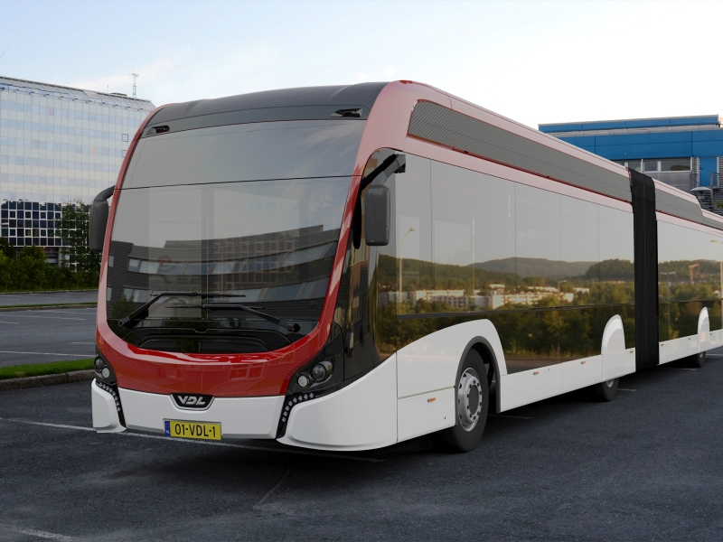

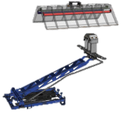

Heliox
PUBLIC TRANSPORT
Global Market Leader

Slide 11
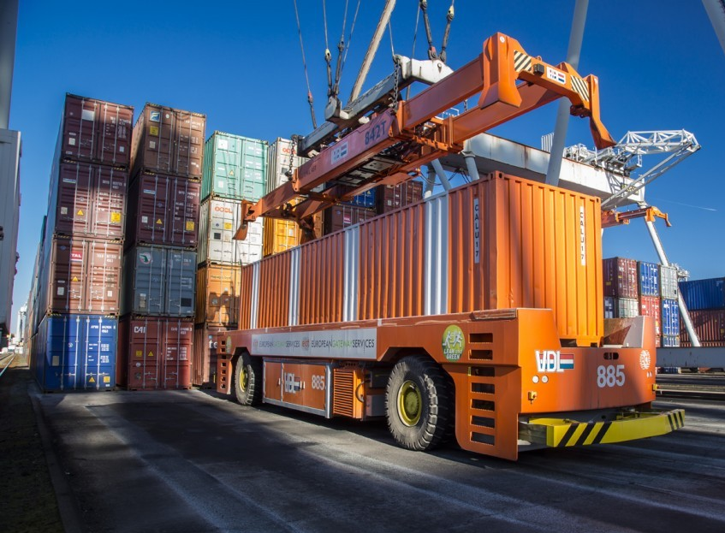
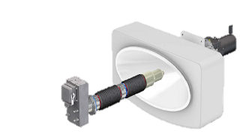
Heliox
PORT EQUIPMENT
Global Market Leader

Slide 12
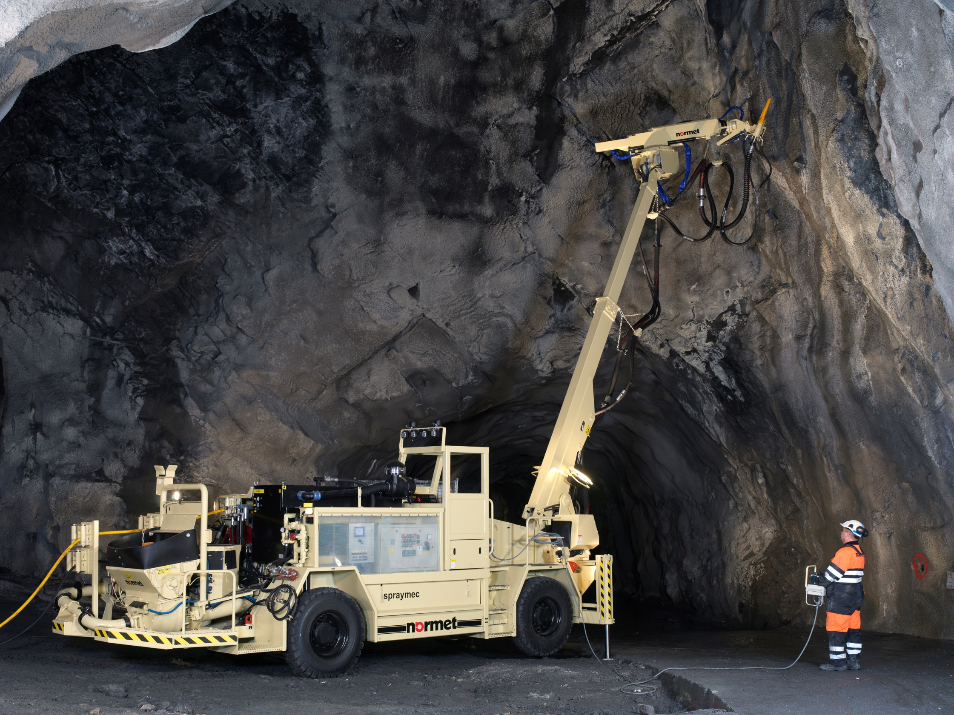
Heliox
MINING

Slide 13
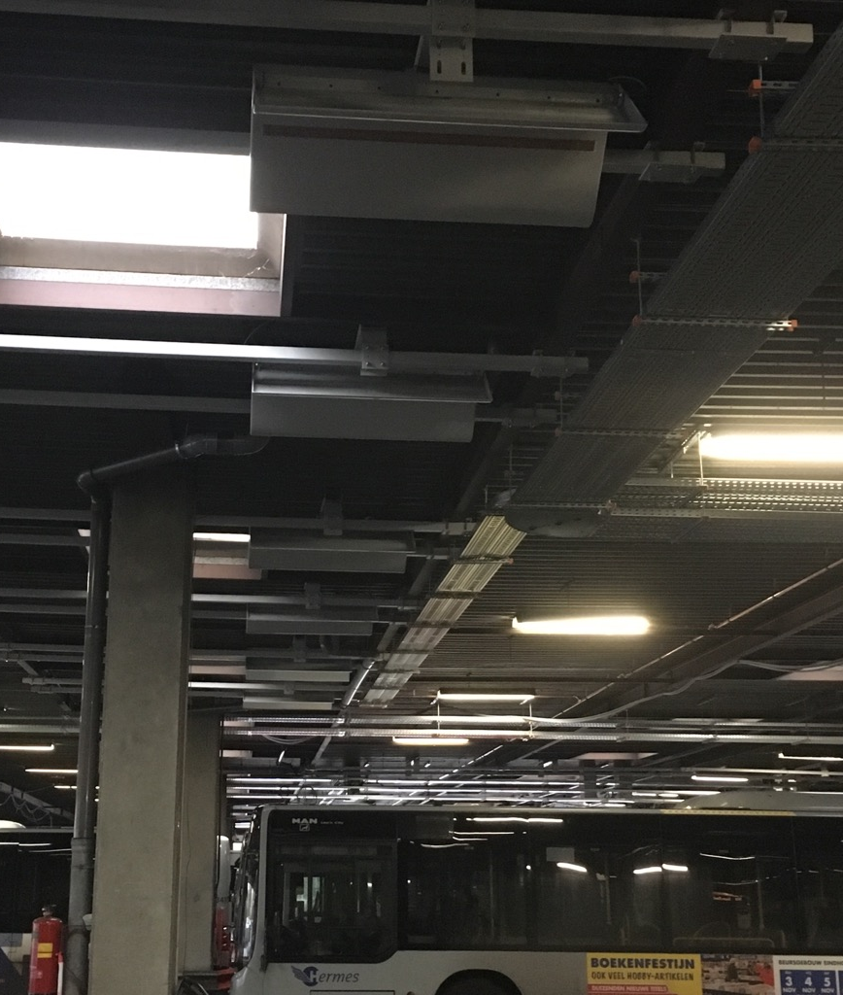
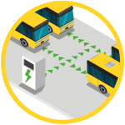




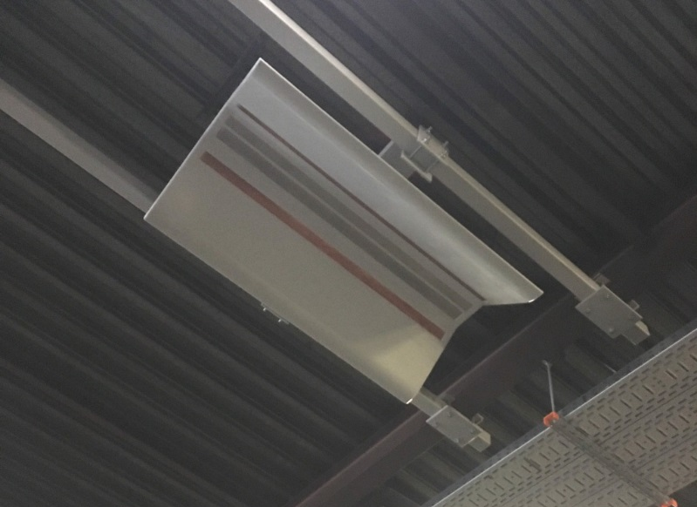

Large scale
depot charging
Eindhoven
43 x 18m busses
5 MW Installed base (Q4 2016)
Largest full operation e-bus project in Europe
Charging by roof-mounted pantograph
Combination of fast & slow charging

Slide 14
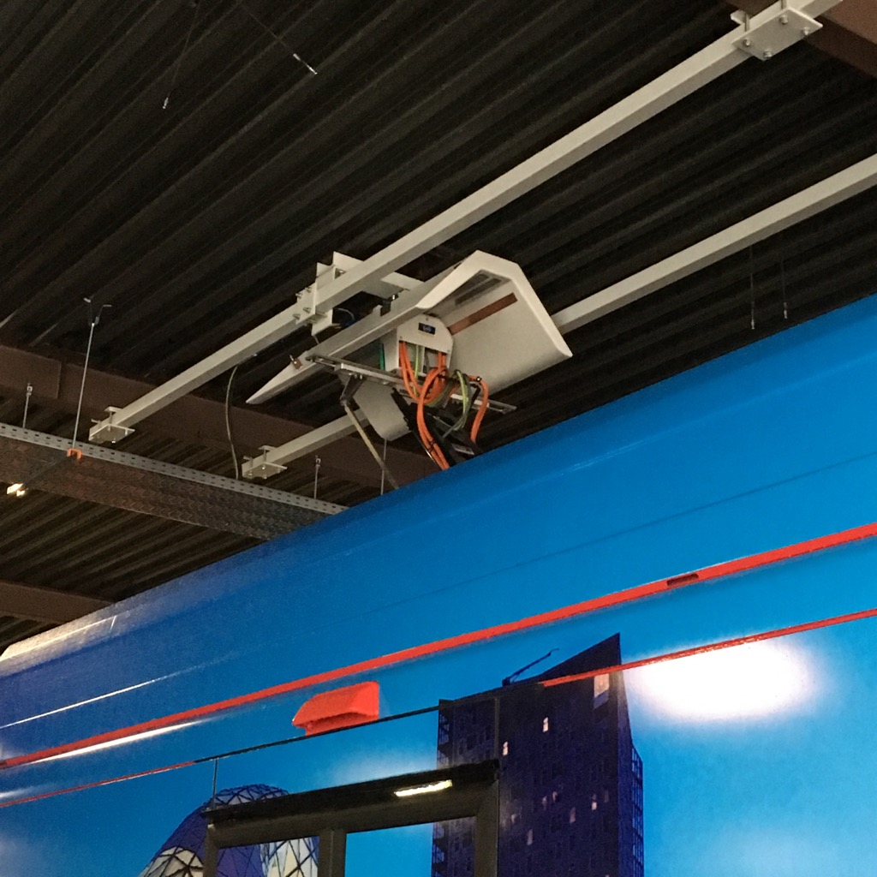
Large scale
depot charging
Eindhoven
43 x 18m busses
5 MW Installed base (Q4 2016)
Largest full operation e-bus project in Europe
Charging by roof-mounted pantograph
Combination of fast & slow charging

Slide 15
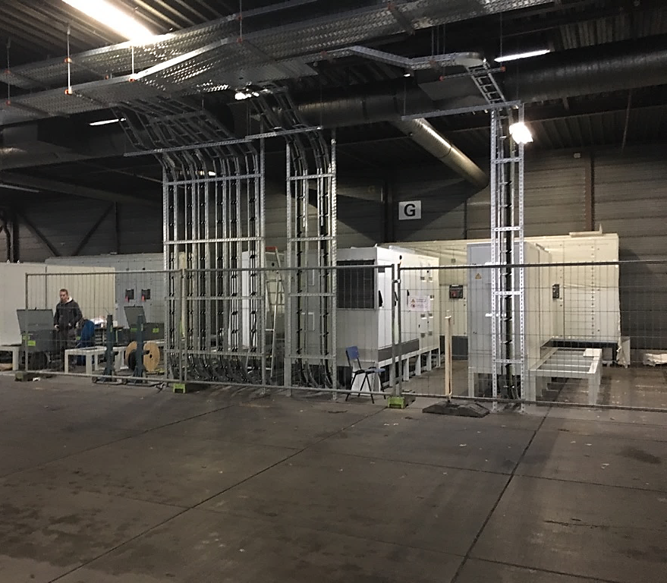
Large scale
depot charging
Eindhoven
43 x 18m busses
5 MW Installed base (Q4 2016)
Largest full operation e-bus project in Europe
Charging by roof-mounted pantograph
Combination of fast & slow charging

Slide 16
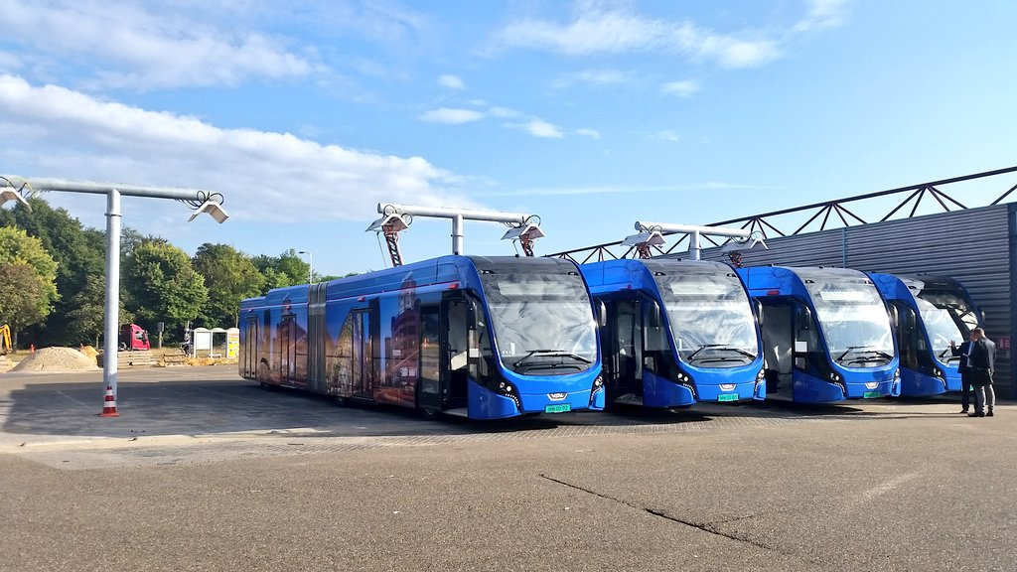
Advantages
depot charging
with contact hoods
Clean area
Lower supply cost
No cable ruptures
No plug ruptures
Less handling
Increased safety

Slide 17

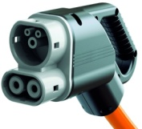
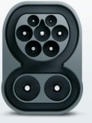
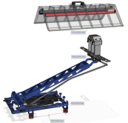
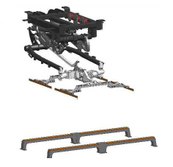
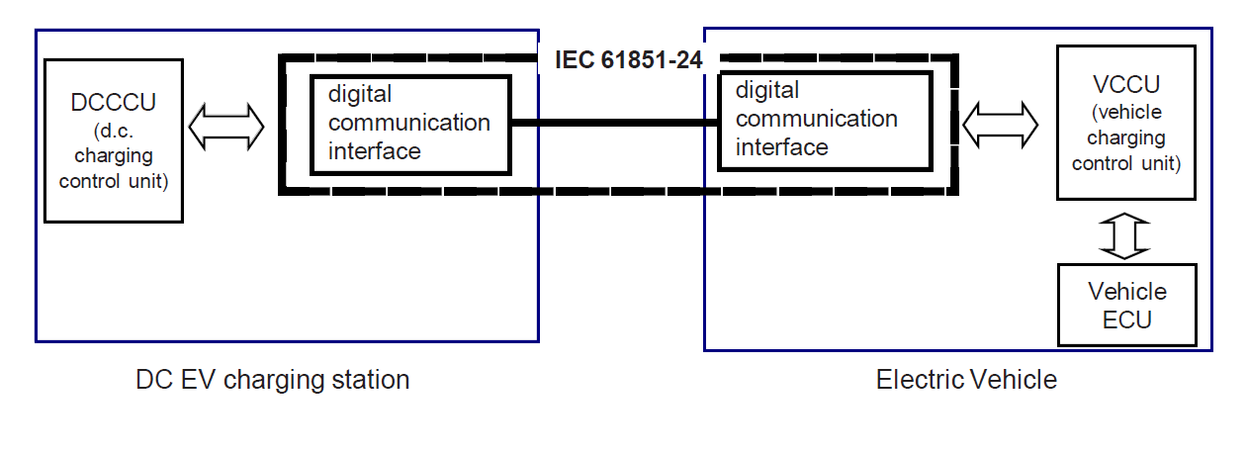
Interoperability
Standardisation
Fast Charging
IEC 15118 (EN61851-23/24 / DIN 70121)
For both CCS & Pantograph
IRIZAR
SOLARIS
VDL
VOLVO
ABB
HELIOX
SIEMENS

Slide 18

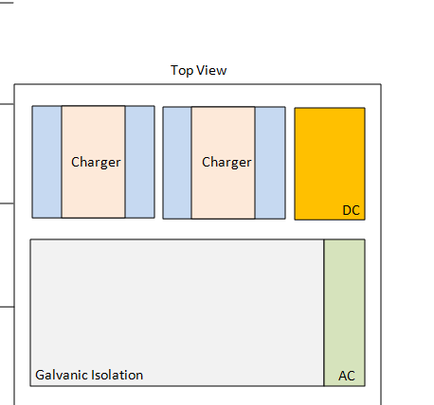
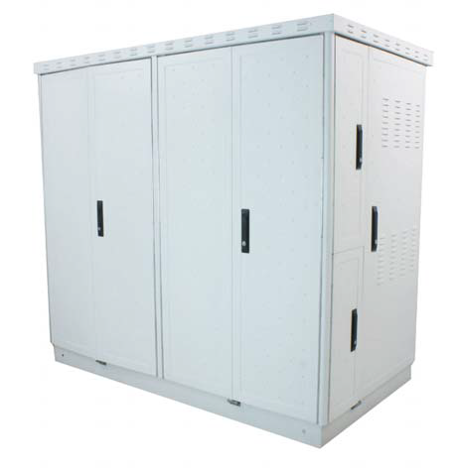
1800mm
Opportunity Charging
2400/4000mm
800/1600mm
Opportunity Charging is Ultra Fast charging at the turn-around location of the bus route and offers a zero impact solution. Without the need of schedule change, electric buses can run all day and a significant passenger capacity increase and cost reduction can be achieved.
300kW | 450kW | 600kW
Heliox Power Curve Technology results in ultrashort charge sessions, that reduce the impact on the timetable to a minimum: within 2-5 minutes of opportunity charging at the end bus stops, you can optimize your electric bus operation.
Implementation is simple and straightforward; the solution is fully scalable and can be introduced route by route. All chargers have the elements required for V2G and smart grid functionality.

Slide 19
Heliox
Reference projects

Slide 20
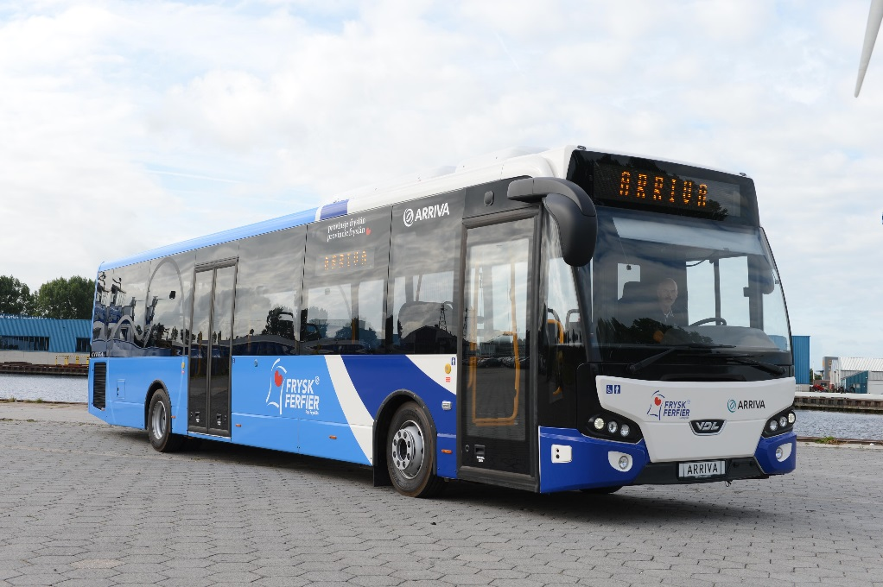
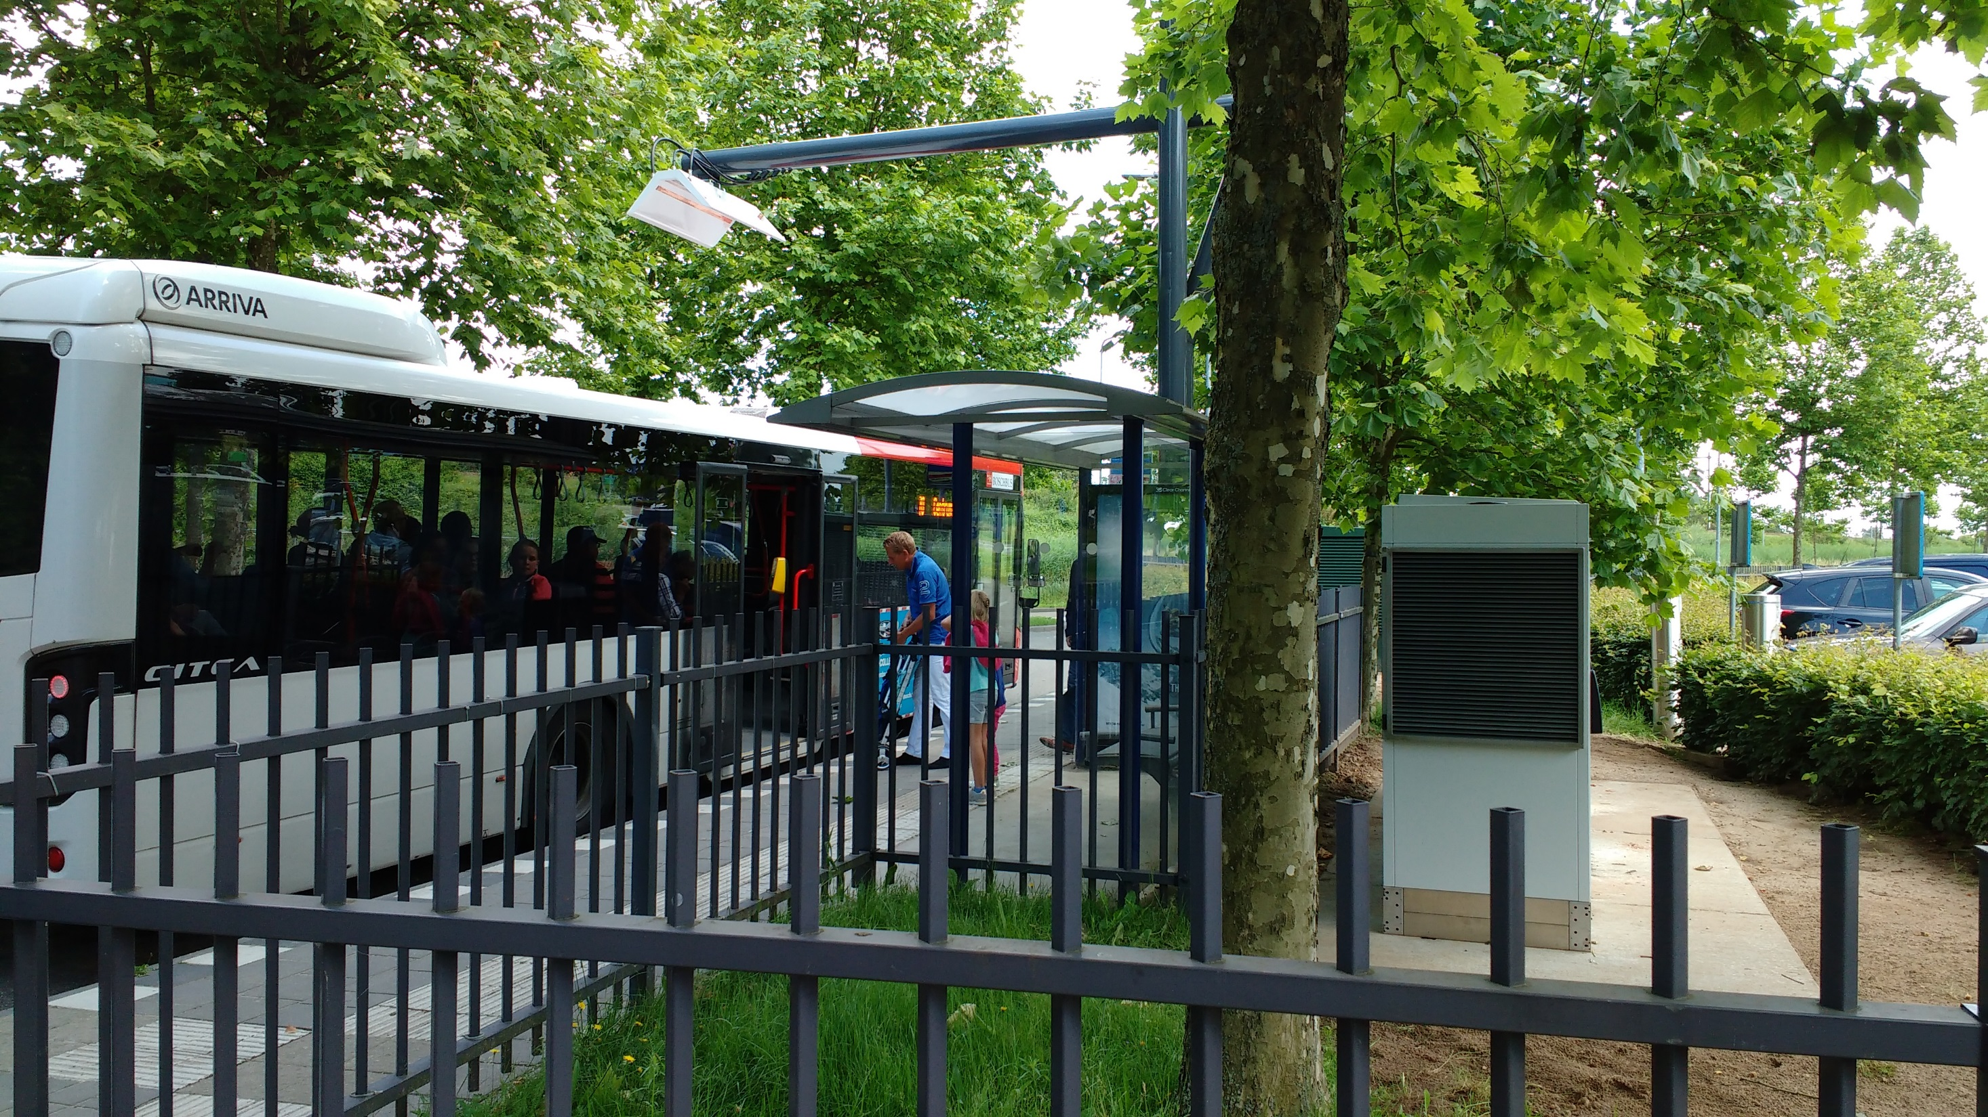


Reference NL
Limburg/Wadden
Largest full operation e-bus project in Europe
~35 x 10/12/18m busses
5 MW Installed base (Q4 2016)

Slide 21
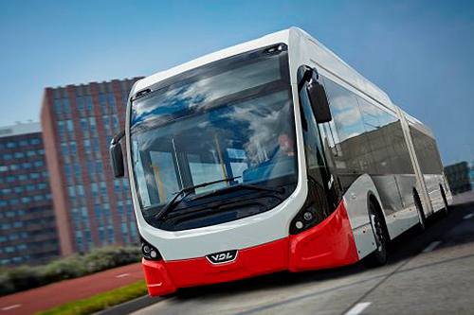
Reference NL
Eindhoven
Largest full operation e-bus project in Europe
43 x 18m busses
5 MW Installed base (Q4 2016)

Slide 22
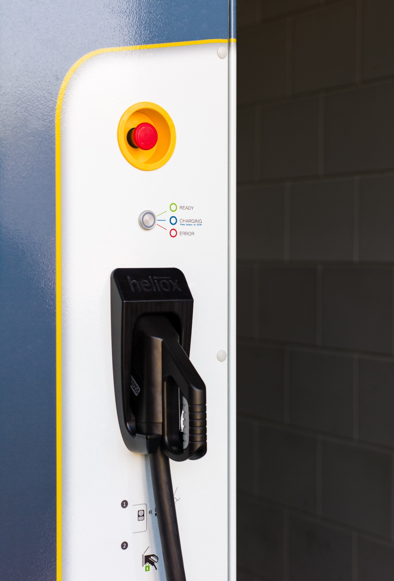

Michael Nuiten
M: +31 6 46 393 009
E: Michael.Nuiten@heliox.nl
I: www.heliox.nl/automotive

