Slide 3
Notes:
Our view is that everything should be as easy to use as Uber

Slide 4
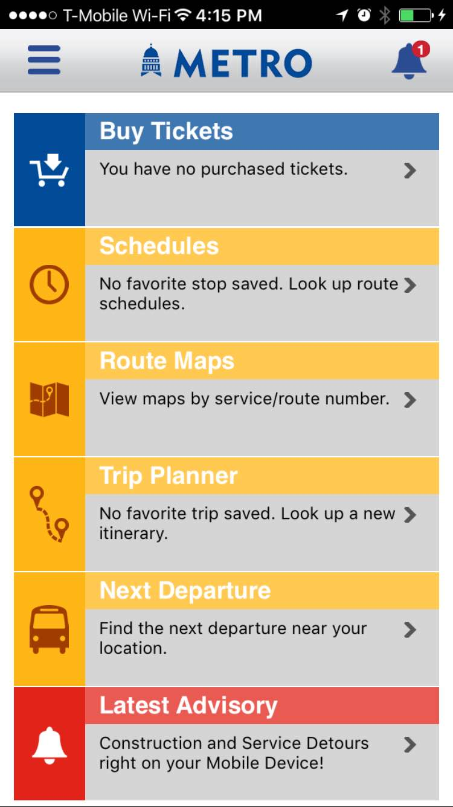
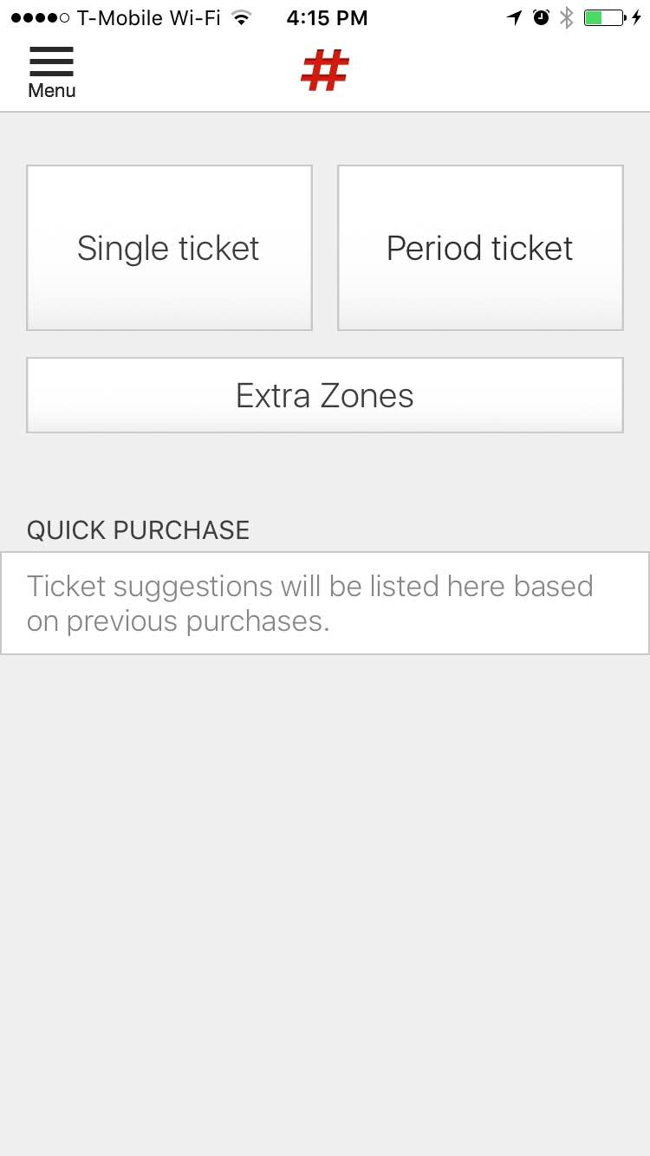
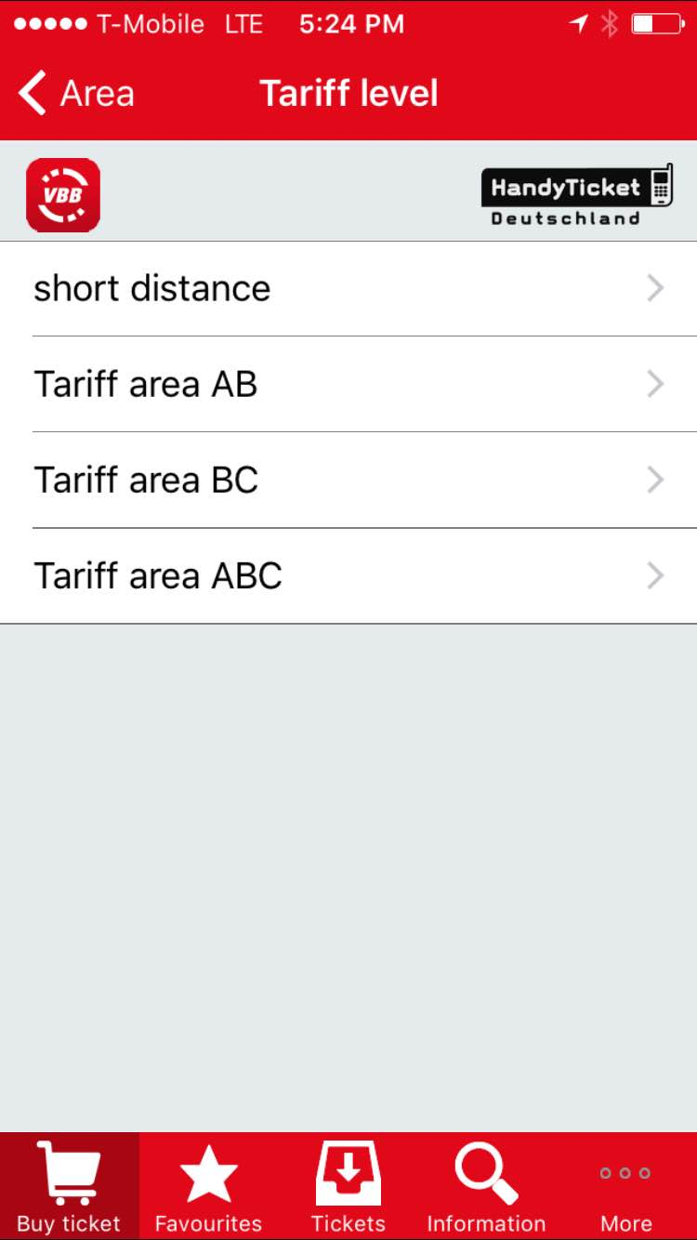
Every Public Transit Agency Has it’s Own Ticketing App!

Slide 5
