Slide 1







E-Bus Activities and Smart energy services for e-mobility
Oslo 13.2.2017
Tammo Voigt

Slide 2
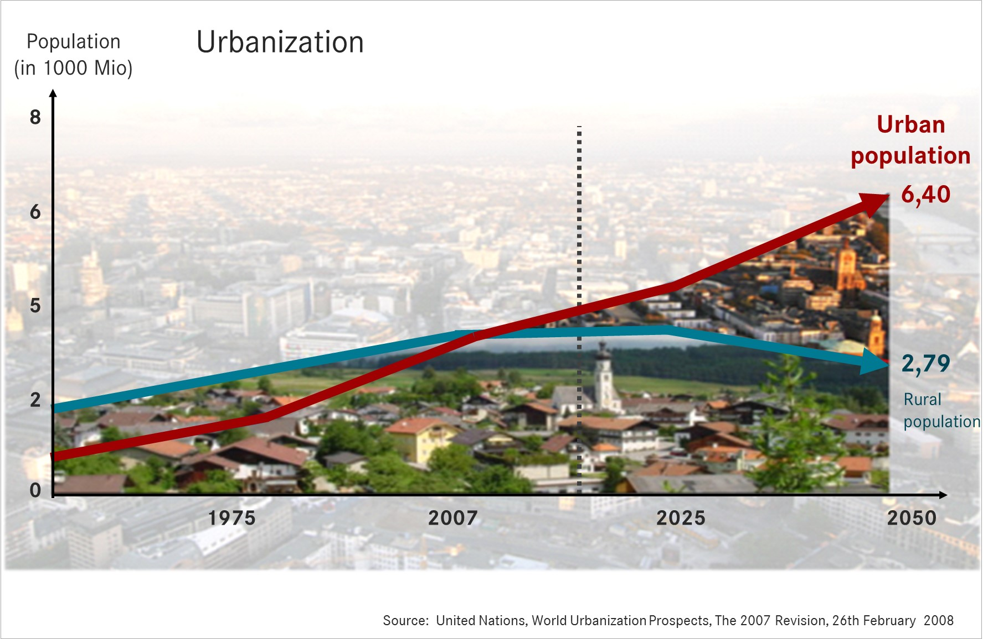
The trend to Mega - Urbanisation is driving the demand for emmisionfree Public transport dramatically
53% of world population live in cities.
Today ca. 360 Million people are living in 23 megacities.
By 2025 more than 630 Million people will live in 37 megacities.
Notes:
As of today already more than half of the world's population live in urban areas.
And urbanization is progressing: in 2050, the share of urban residents will be more than two third.
By 2050, the three megacities of New York, Delhi and Tokyo alone will have to buy more than 40,000 additional buses to be able to transport their citizens.
For years, transport operators have reported growing passenger numbers.
Last year, German transport operators counted more than ten billion passengers in buses and trains for the first time.

Slide 3

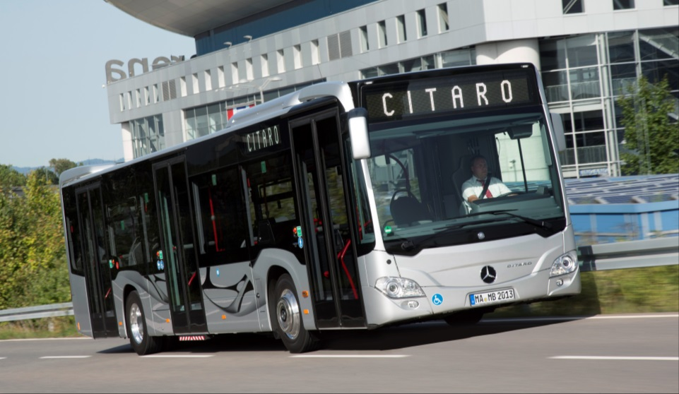
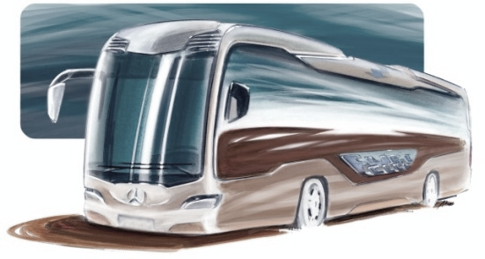

Daimler Buses focusing on TCO optimized vehicles and on emission free driving for city bus application
Nearly Emission Free
Partly Emission Free
Emission Free
Benchmark TCO & fuel economy Euro VI products
Continuous CO₂ optimization
Downsizing
Compact Hybrid
Eco Steering (EHPS)
Only partly emission free driving possible < 30km
Full-size Plug-in Hybrid
Zero emission driving
for city traffic
E-Mobility Platform Citaro
E-Cell & F-Cell vehicles
✓
✓
✓
* TCO = Total Cost of Ownership

Slide 4

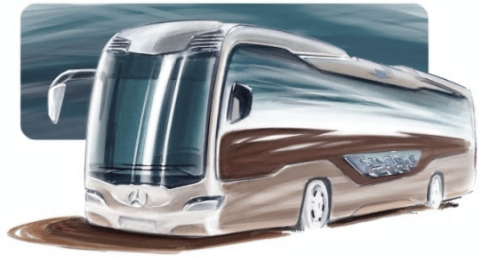
Our requirements regarding maturity level of a marketable product are not yet reached!
Development status 2016
Citaro E-Cell
 | 0% |  |  |  |  | 50% |  |  |  |  |  | 100%
E-drive system
modular battery system
HVAC & thermomanagement
efficient steering system
energy management
system integration
electrical charging system
2018
series production readiness

Slide 5

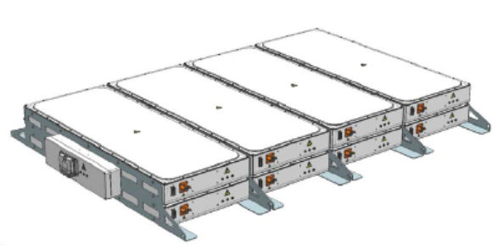
Current perception shows large potentials to raise energy content of batteries with equal assembly space until 2030
energy content with equal assembly space
180%
160%
140%
120%
100%
module strategy 37Ah cell
module strategy 51Ah cell
potential
2015 2020 2025 2030

Slide 6
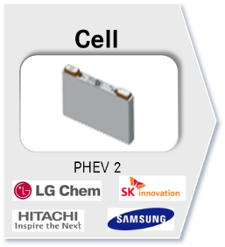
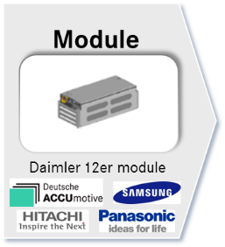
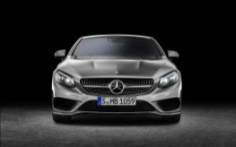
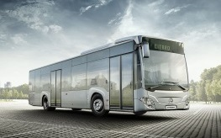
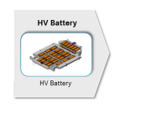
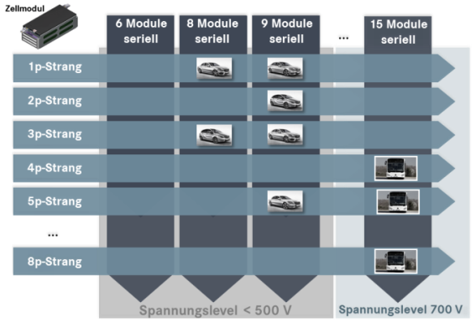
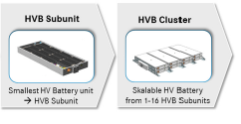
Daimler Buses battery strategy will benefit from the Daimler modules
supplier
Daimler Buses
Mercedes-Benz Cars
Passenger cars
  Each vehicle project with a specified battery
  Volume-optimized approach
Buses
  Derivation of a module strategy (1-16 sub-units)
  Highest scalability (150 – 400 kWh)

Slide 7
Outlook 2025: Battery development will significantly enhance the operation range for a city bus with depot-charging!
+ 40°
30°
F-Cell ?
20°
10°
outside temperatures
300 km
range without
recharging in
operation
- 10°
- 20°
- 25°
reach Citaro E-CELL without recharging in operation
100% of all city bus operations
comfort restrictions
Notes:
Reichweite mit heute bekannten Techn lösungen

Slide 8

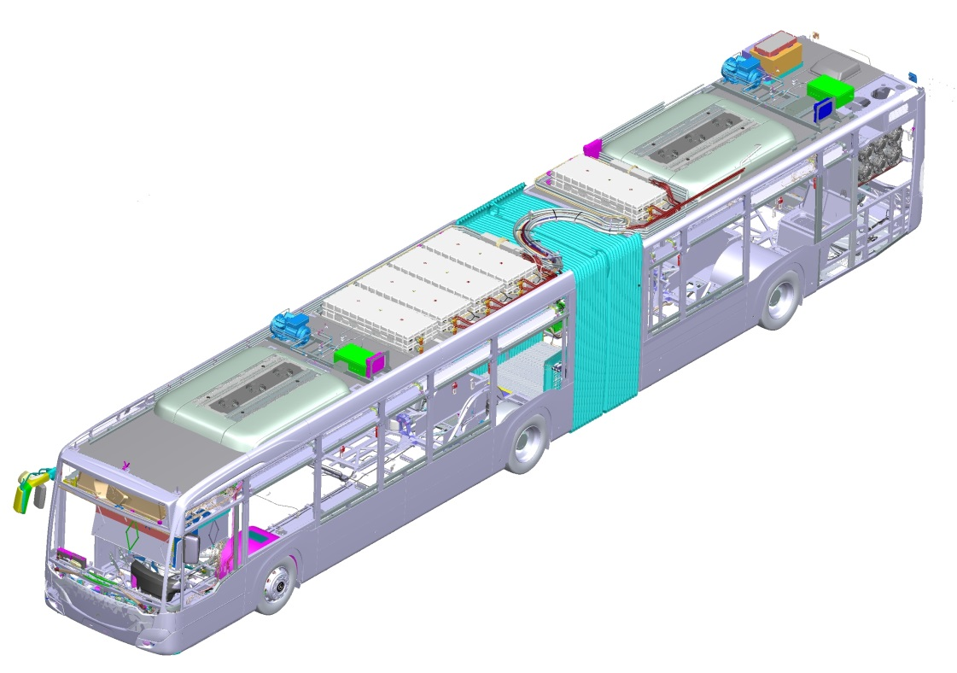
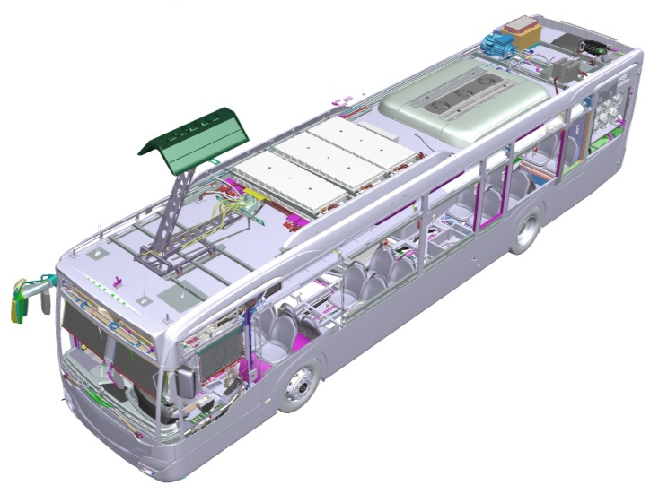
Citaro E-Cell will be different than existing battery buses …
validated & tested
system integration
optimised thermo- & energy management
modular battery
system
System Consulting Electromobility

Slide 9
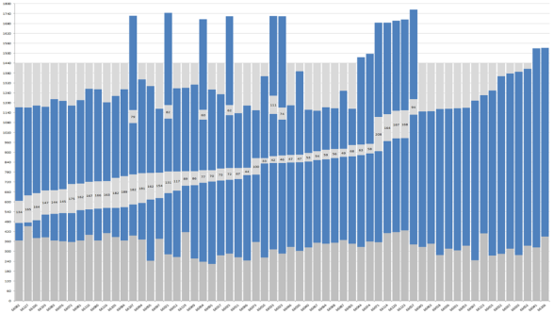
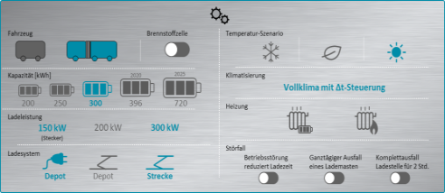
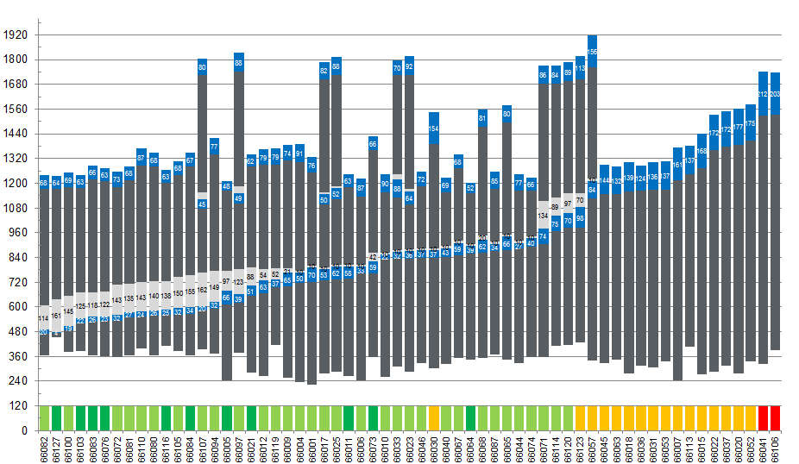
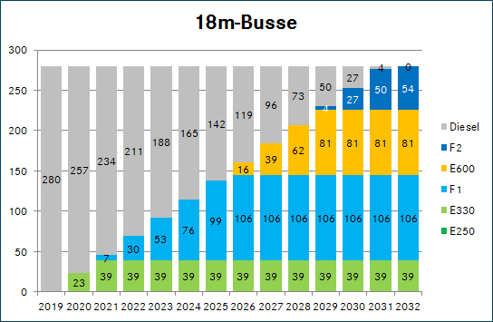
Daimler Buses developed a multi-level approach to initiate solutions
Data Acquisition & Analysis
System lay-out
Proof of concept
“roll-out” scenario
depot & fleet structure
- operating distances
- load profiles
- vehicle cluster
- …
vehicle & infrastructure spec.
- charging power
- battery size
- heating concept
- …
simulation & validation
- energy consumption
- charging scenarios
- TCO
- …
Fleet structure
- Ramp-up scenario

Slide 10















Modular system of energy services allows solutions tailored to customer needs
E-Bus/Van/Truck
Infrastructure
Energy/ V2G
Renewables
Optimized TCO due to intelligent concept and operation
Prerequisite: Purchase of a Daimler e-vehicle.
Infrastructure at depot: Charging stations and grid extension.
Optional stationary battery.
Cost optimization of electricity bill (energy cost, demand charges).
Additional revenues through Vehicle2Grid.
Option to obtain energy from renewable resources.
Value-added services
Software support
TCO simulation
Consulting
Payment options
Sale
Full - service leasing
Pay per use

Slide 11
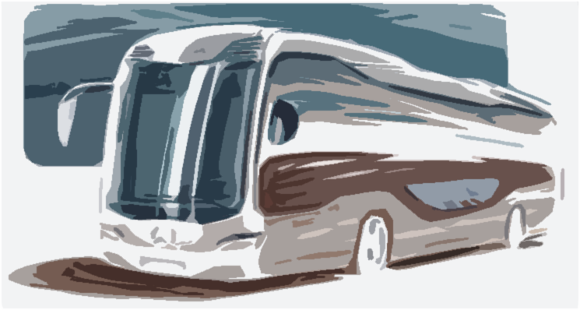




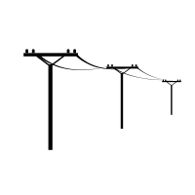















A tailored infrastructure solution for on-site charging including energy storage will be provided to the customer.
E-Bus on-site infrastructure
Required hardware
Required services
On site charging
hardware
Installation service
Groundwork
Stationary battery
Construction management
Connection of battery, charging pole to the grid
Architecture
Software & IT services
On-site infrastructure
Grid extension
Legal and risk managers

Slide 12
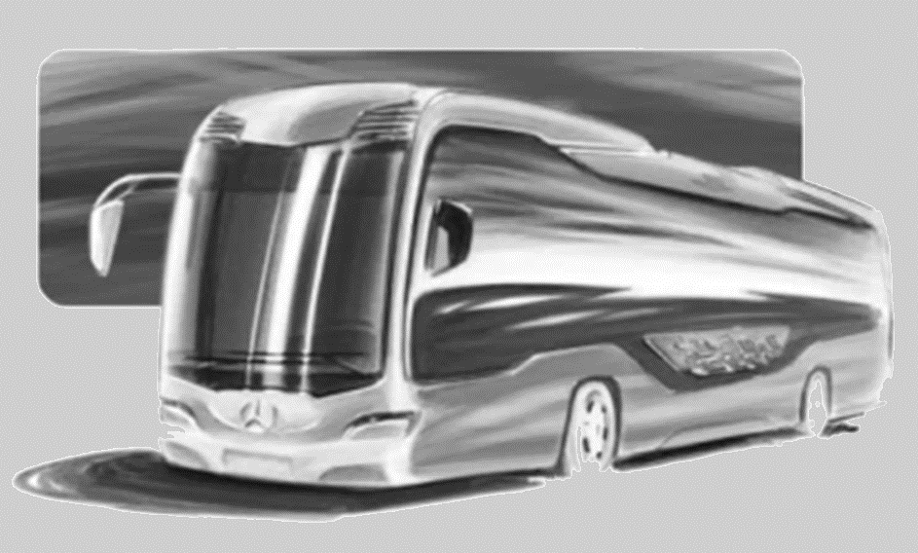
Thank you for your Attention

