Slide 1
System test e-bus
Appendix 4 – bus depots and charging infrastructure
Kristin Mathisen

Slide 2
Should Ruter offer bus depot facilities, when the number of articulated buses in service is only approx 10?
Is the number of buses so low, that it is better that bidders shold rather offer their own solution, without this causing the bidding to become unfair?

Slide 3
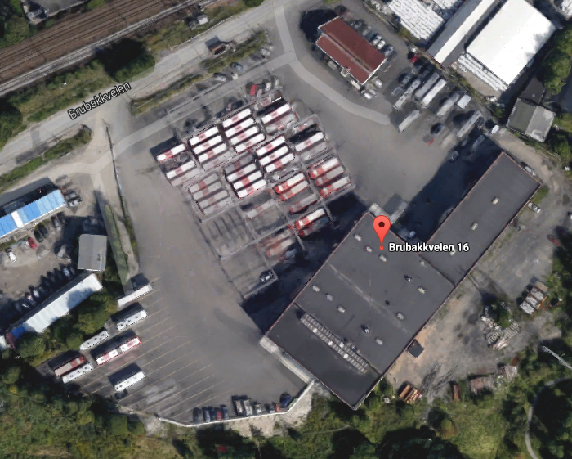
Part of depot Brubakkveien – possible depot which could be offered by Ruter
15,5km2 area
No Ruter bus operations there today
Includes facilities as canteen,offices, changing rooms, garage/workshop, bus cleaning facilities
Possibility for traffic coordinator central
Good location close to Grorud station
Annual operations costs for the comlete depot was approx 2 800 000 NOK

Slide 4
For tendering, should the bidding bus service provider offer charging infrastructure together with the buses, or should Ruter provide charging?
To ensure the stable operations og fair conditions in the tendering process,
does it make more sense that Ruter provides charging infrastructure, or should the market offer a combined solution, including charging infrastructure?
Is the answer different for bus depots and for infrastruture on the road/end stops?

Slide 5
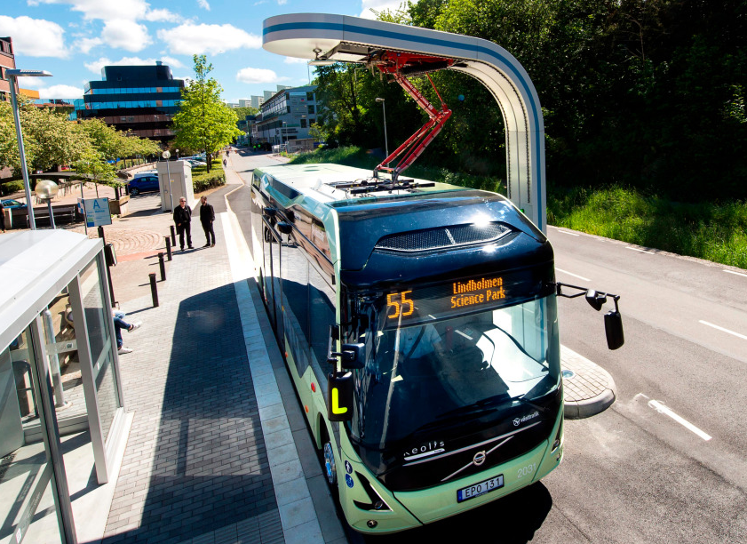
Alternative business models (distribution of responsilities) for charging infrastructure
Model 1:
  Bus operator makes buying descision, takes responsibility for the operation of the infrastructure, and Ruter takes over the infrastructure after contract end
Modell 2:
  Power company takes responsibility for charging infrastructure and sells electricity as a service to the bus operator
Modell 3:
  Ruter procures infrastructure and has operations agremment with supplier
Modell 4:
  Oslo municipality procures infrastructure and has operations agremment with supplier
Modell 5:
  Other options/feedback?

Slide 6
Should the business model be different for the test, vs normal bus service contract tenders with required electric bus services?

