Slide 1
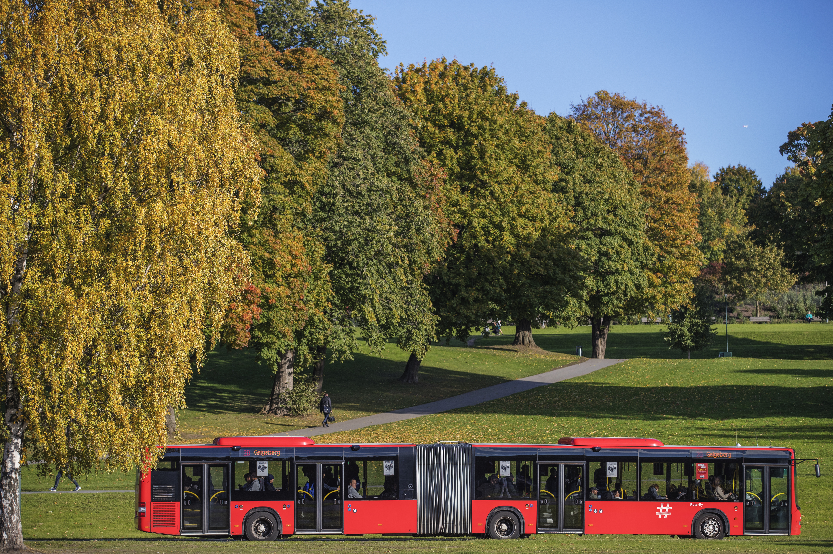
System test for electric buses
Short description of possible test line alternative
Jan Erik Pedersen, Route planner

Slide 2
Background
Choosing bus line / area for test

Slide 3
Hva kan være egnet område for systemtest av batterielektriske leddbusser i Oslo?
Ruter mener at Oslo sentrum/Indre by er sannsynligvis det beste området.
Det har muligheter for ekstra bussoppstilling og lading på endepunktene som kan opparbeides på kort sikt og kan gjenbrukes i en ny Indre by kontrakt fra 2020, eller senere.
Det finnes områder som er lite påvirket av planlagte anleggsarbeider som kan innebære omlegging av linjen.
Det er muligheter til å prøve bussenes kapasiteter og egenskaper under krevende forhold.

Slide 4
Which area in Oslo is best suited for testing battery electric atriculated buses?
Ruter’s current assumption is that Oslo centre / inner city bus lines is the best place to test
There is room for extra buses and charging on end stops, where it is possible to build chargers and re-use these in the coming Inner City lines contract in 2020.
There are areas which are less influenced by construction / road work aktivities which would demand a re-routing of the bus line
It is possible to test the buses under demanding, real life conditions

Slide 5
Ruter’s assumed choice of suitable bus route
The bus lines traveling on Ring 2 are seen as good alternatives. In particular line 20, which is one of Oslo’s main bus lines and operating the heavy bus market along Ring 2
Line 20 starts at Skøyen in western Oslo, going east to Galgeberg, and is operated by 18,7m articulated buses today, with a ‘punctual operation capacity’ of approx 90 pax per bus (quick, easy flow of passengers,no queueing, entry allowed through all 4 doors)
5 minute frequency during rush hours, but the bus line has challenges with buses partly getting stuck in traffic, hence a daily problem with full buses and «clustering»

Slide 6
Market demand on line 20 has grown steeply over the last 20 years
In 1998 line 20 had approx 17 000 entries on a weekday.
In 2000 this had increased to 20 000 entries pr day.
In October 2016 line 20 had approx 35 000 entries on a weekday
The increased demand from 1998 until 2016 then amounts to more than 100 percent. For the last five years, market demand has increased by approx 5% per year.

Slide 7
Main challenges
Predictable accessibility in traffic / commercial speed.
Enough capacity to avoid over-full buses.
Equal capacity of vehicles to avoid clustering of buses (2 or 3 buses approach bus stops simultaneously).
High frequency
Unpredictable accessibility
Very high demand
Do any of these conditions change when electric buses are used in full operation?
Challgenges with keeping:
Good quality, stable traffic
On-time departures

Slide 8
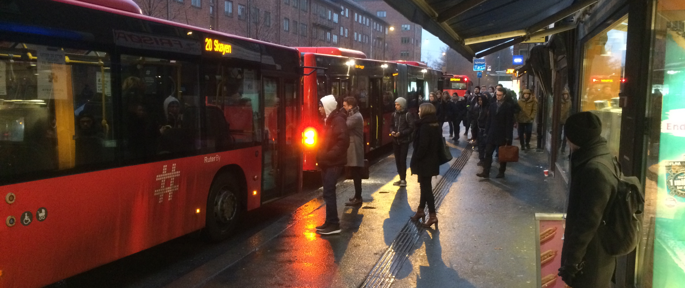
Carl Berners plass

Slide 9
Possible imrovements for today’s biodiesel bus service on line 20
Improve accessibility in traffic, to avoid clustering
Optimizing of bus stops and distance between bus stops
Two alternatives to make service capacity meet market demand:
  Alt A: Increased frequency of 18,7 meter buses
  Alt B: Increased size (length) per bus, keeping same frequency

Slide 10
Which solutions are recommendable and necessary, to prepare for a full scale roll-out in the Oslo Inner City contract (100+ buses)?
Does it make sense to add a new bus line along Ring 2 for testing (same ende stops as line 20)?
Which other solutions are available to gain necessary preparation and learnings?

Slide 11
System test e-buses
Suggestion for operation setup of dedicated e-bus test line along Ring 2

Slide 12
Description of possible new bus line (system test)
Skøyen st. – Drammensveien – Halvdan Svartes gate – Kirkeveien – Griffenfelds gate – Marcus Thranes gate – Christian Michelsens gate – Trondheimsveien – Finnmarksgata – Kjølberggata – Åkebergveien – Jordal gata .
Mainly same route as line 20, men ikke via Sagene og Thomas Heftyes gate.

Slide 13
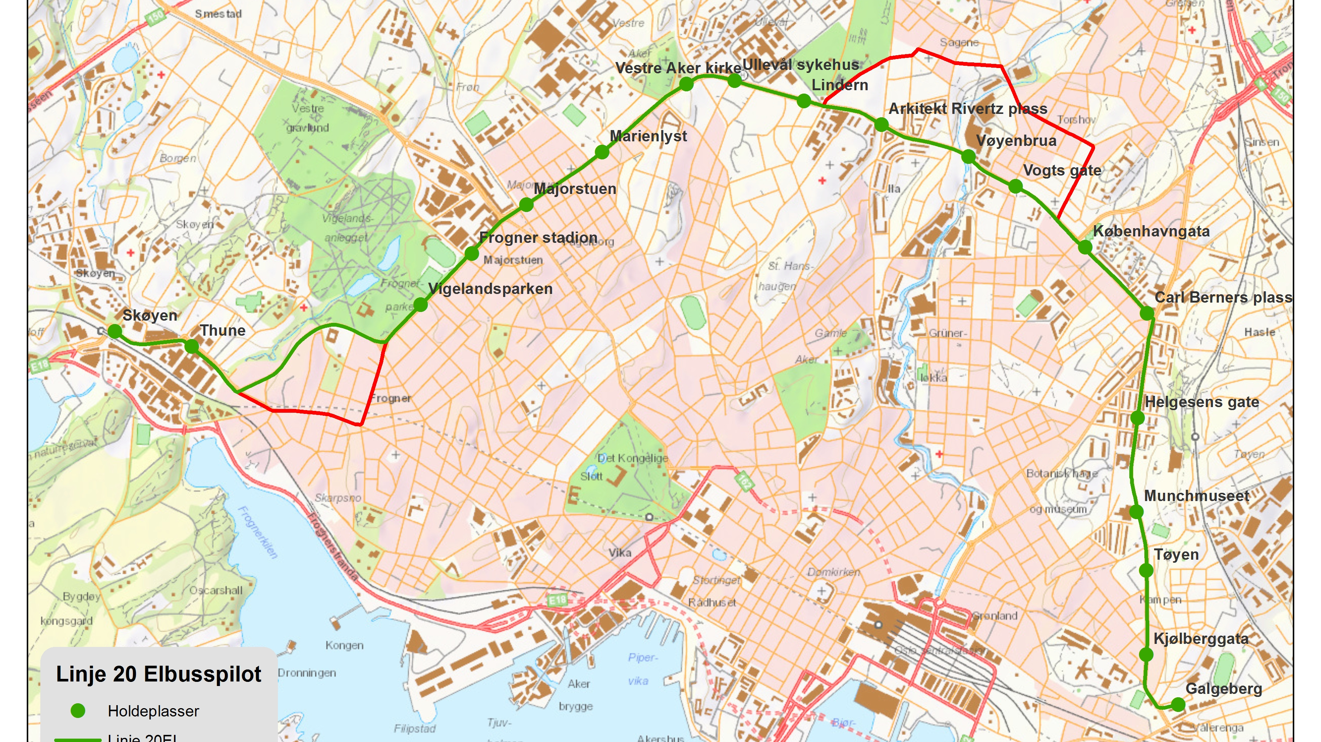

Slide 14
Key numbers and test service framework
Route length: approx 30 mins, 10km in both directions
Frequency daytime: 10 minutes until 21:00
Frequency after 2100 and early morning on weekends: 15/30 minutes.
Time at end stops incluing charging time: approx 15 minutter.
Number of buses in service daily: 9

Slide 15
Bus stop capacity when shared by more lines:
Bus stop capacity and coordination with lines 20, 21, 28 and new high frequency test line is a challenge where these lines use the same bus stops.
Capacity on some bus stops which are critical to the existing heavy bus services line 20, 21, 28, have the rest of capacity exhausted by other low frequency bus line services (line 33, 345, 435, 363 og airport buses).
Possible solutions:
  Increased capacity on bus stops like Carl Berners plass and Københavngata
  Move other bus lines which interfer with the high frequency bus service

Slide 16
Possible operational challenges in an e-bus test
Which uptime / frequency of operation disruptions must be considered in the service planning?
Which measures should be planned to keep the service for the customers running?
Does it make sense to consider not charging at every end stop during operation during rush hours, allowing 0 mins turnaround time when needed?
  Is it beneficial to fast-charge only at one end of the route, or
  Plan for part of the fleet being overnight charge buses?

