Slide 1
Mikko Rämö, DevOps Manager
Mikko Rämö, DevOps Manager

Slide 2
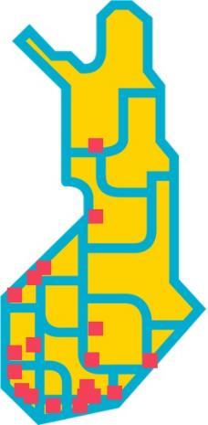
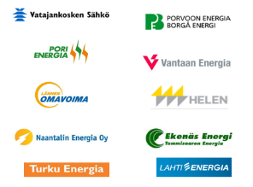
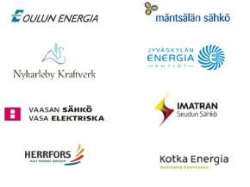
VIRTA BACKGROUND
VIRTA offers complete turnkey solutions for managing electric vehicle charging services. Established as a start-up by 18 electricity utilities, Virta enables B2B vendors to make business from EV charging services with comprehensive end-to-end cloud-based and open interfaced IT solutions.
2017
- ≈ 700 charging stations, up to 400kW - 10+ operative countries - 40 B2B users (charging point owners)
- ≈ 2 000 B2C users
- 18 Energy company investors

Slide 3
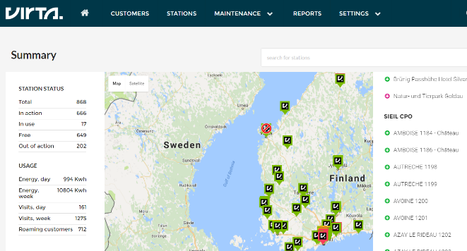
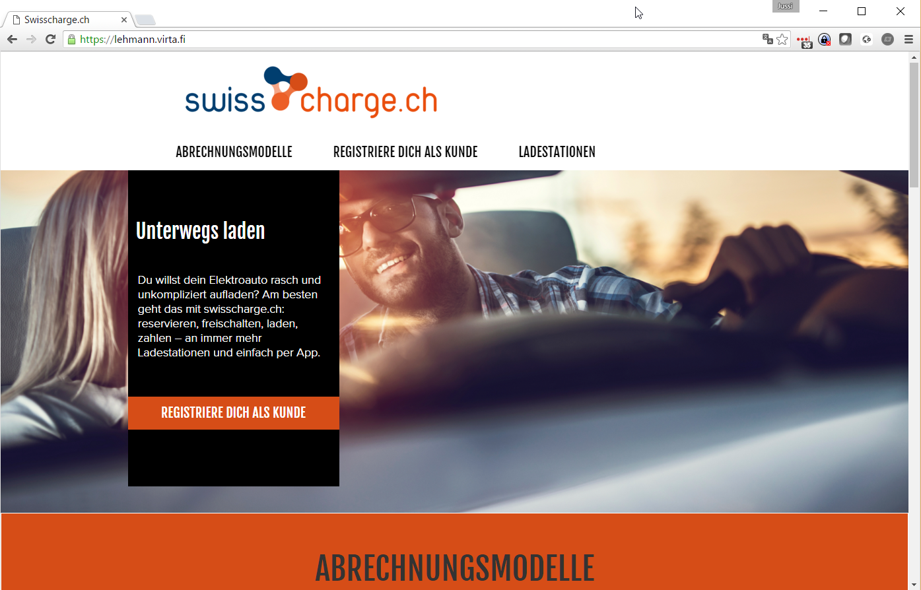
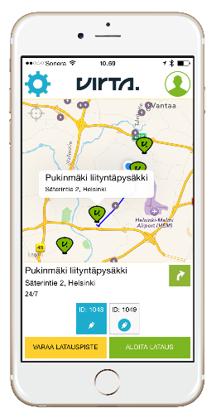
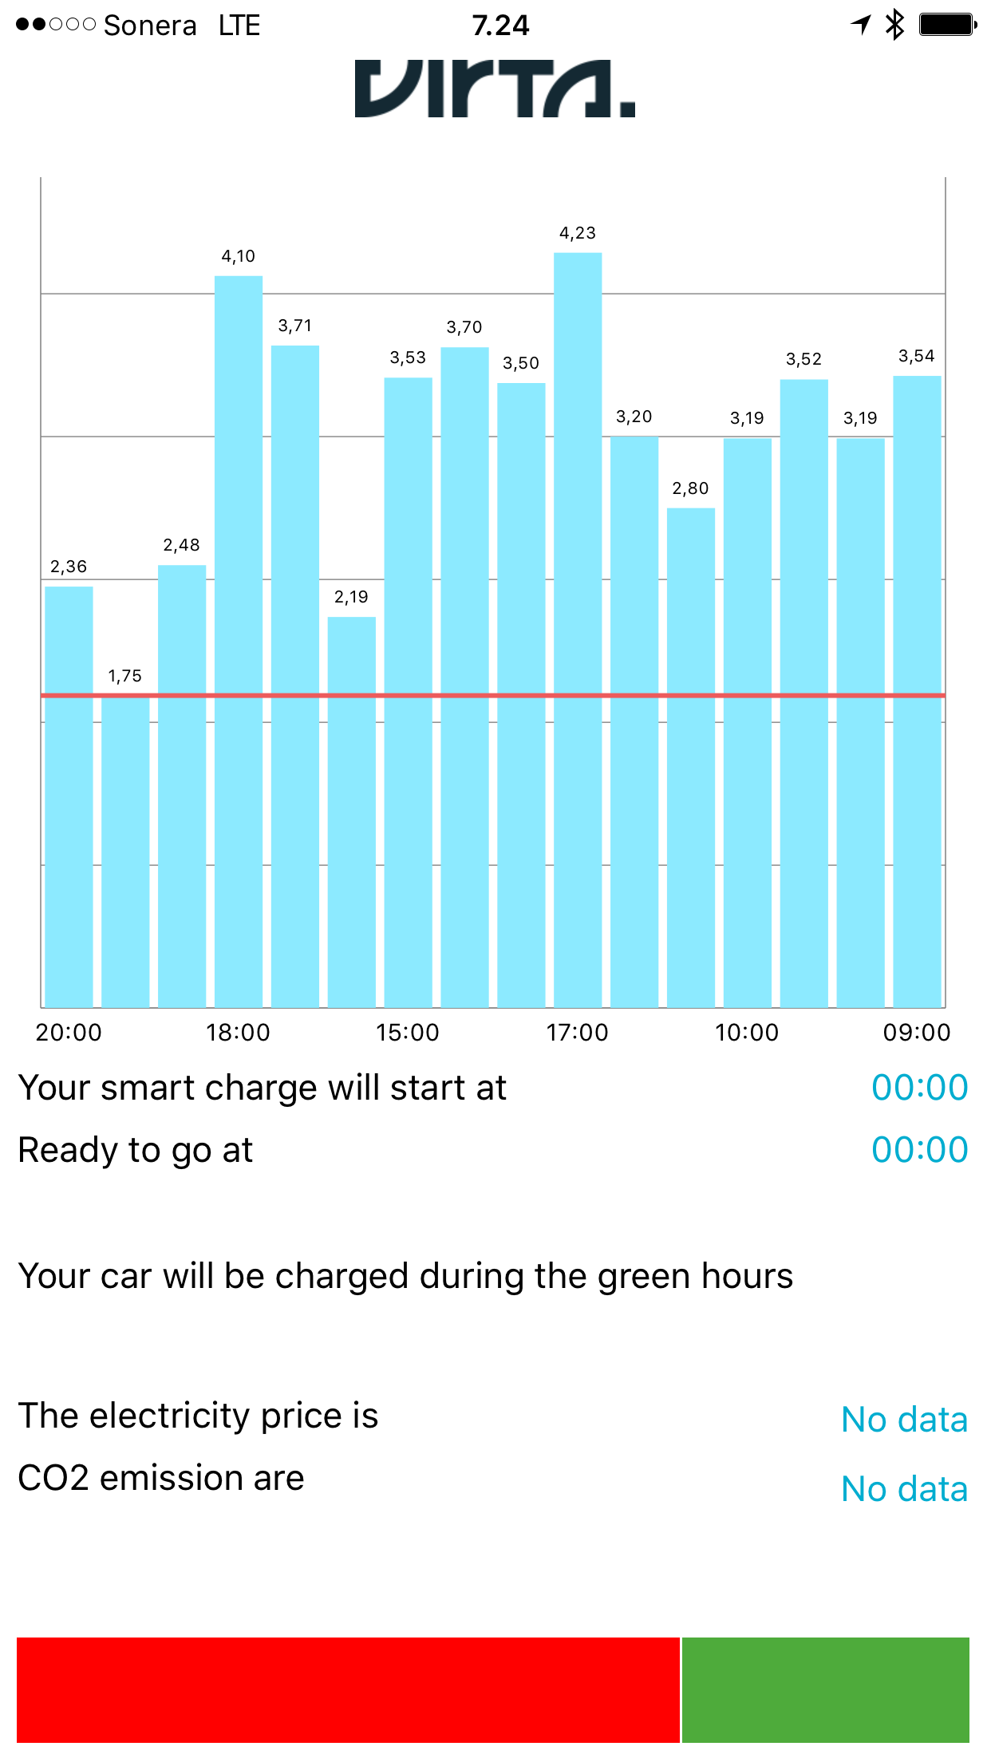
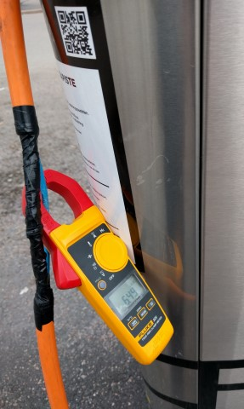
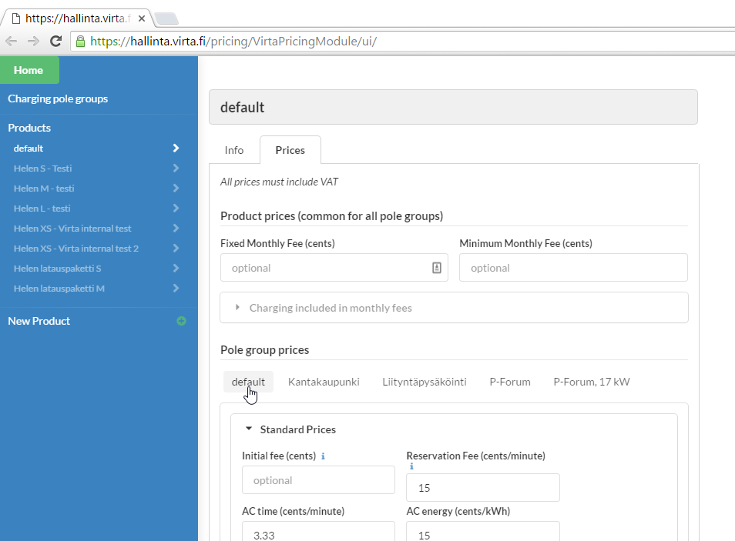
Overview of services
1. Charging station management system
2. White label sales channel
for end users
3. White label mobile apps
for different platforms
5. Energy management options for DSOs and TSOs
4. Advanced payment system
with different pricing options

Slide 4
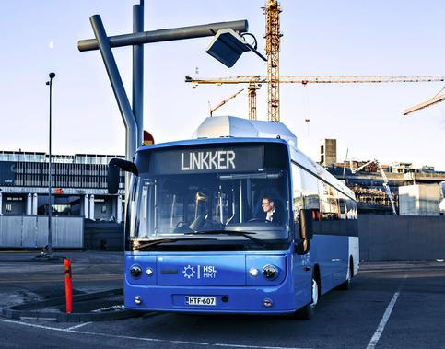
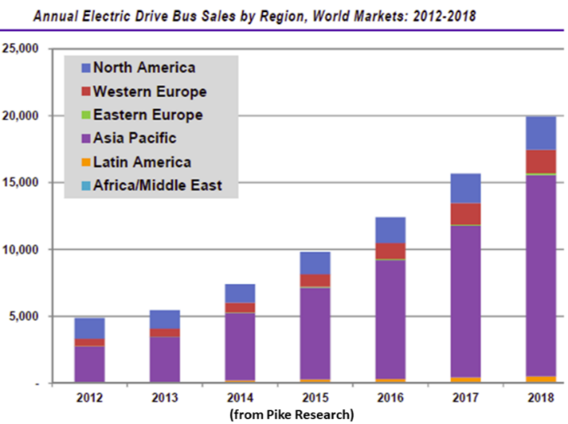
eBuses
Virta’s system have been designed to serve needs of
a) infrastructure owners and
b) end-users in electric vehicle charging domain
Virta technical systems are scalable and modular. They include functions such as network management tools, reporting, end-user or vehicle authentication and different payment options.
Virta has during late 2016 implemented it’s services to electric bus charging providing infrastructure management tools, reporting and payment services (i.e. invoicing of used electricity from bus operator).
Electric busses and their chargers are new technology with same challenges as early electric passenger cars and chargers had.
The investors have interested in the performance of their operations and will need tool to monitor this.

Slide 5
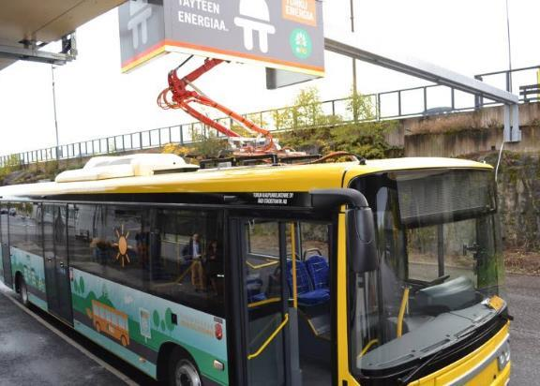
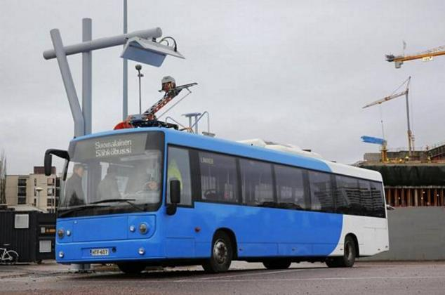
On-going projects with Virta technology
HKL (City of Helsinki transportation): System services for infrastructure management and invoicing of several 300-400kW opportunity chargers during 2017-2018. Number of busses to be 12 units (2017)
Turku Energia, e-bus charging: Systems services for infrastructure management to 2pcs 300kW opportunity chargers and 6pcs 50kW depot chargers serving in total 6 electric busses (2016-2017).

Slide 6
Why are backend system services needed?
Following aspect should be considered priorities when launching eBus service:
Monitoring of charger performance, charging cycles in different conditions. These will have impact to bus route design for future with end-user impact.
Maintenance alerts and error notifications need to be addressed timely in order to minimize downtime.
Maintenance history needs to be built for the whole duration of charger lifecycle. Maintenance history will help in warranty related matters and stakeholder performance thus helping to lower costs.
Target is to reach maximum reliability and economical performance of e-bus operation and charging
Efficient, flexible backend system is needed for multiple stakeholder use

Slide 7
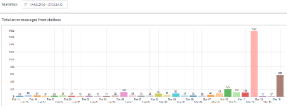
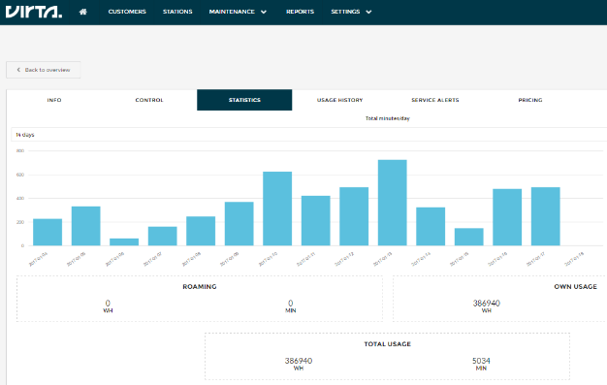
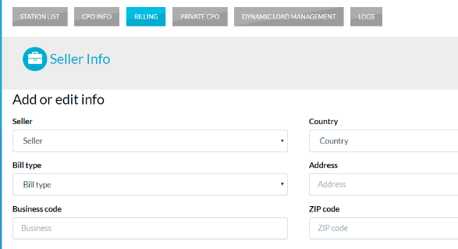
ONE SLIDE solution OVERVIEW for eBus projects
1. CONTROL SYSTEM FOR CHARGING NETWORK
2. STATUS MONITORING, ERROR HANDLING
3. BUSINESS INTELLIGENCE
4. PAYMENTS AND INVOICE HANDLING

Slide 8
RUTER conference
Some key points in the eBus system testing
Redundancy both in charger HW (modularity, scalability and service like hot-swap/automatic fault isolation) and communication (dual-modem, Ethernet etc.)
-> Increase overall system (buses, chargers and back-office) reliability and interoperability
Multiple stakeholders: spreading know-how/learning, getting used to eBus concept
Statistics/business intelligence (usage per day/visit/group, service/out-of-operation data, billing…)
Queuying / prioritization (departure times, routes, SOC…)
During the test phase there should be one owner for the whole project in order to move on efficiently
Chargers, infrafrustructure handled with energy company (most common in Finland)
As an example during test phase buses could be rotated between line/bus operators to gain experience and knowledge
To start with 2-3 lines, 10+ no. of buses, several pcs of chargers (preferred high charging event frequency per hour per charger)

Slide 9
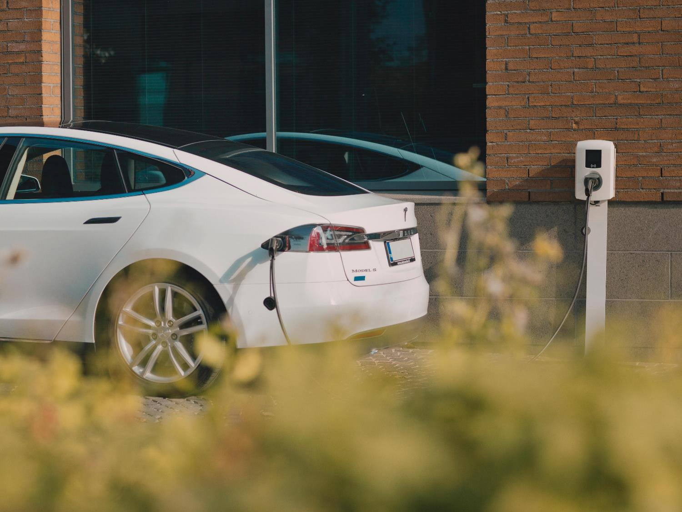
Mikko Rämö, DevOps Manager
mikko.ramo@virta.global
+358 40 167 97 67
virta.global

