Slide 1
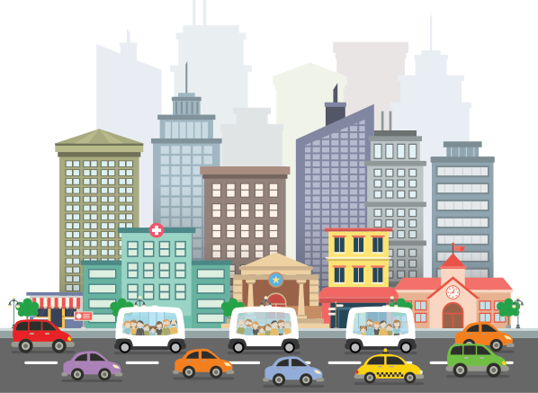
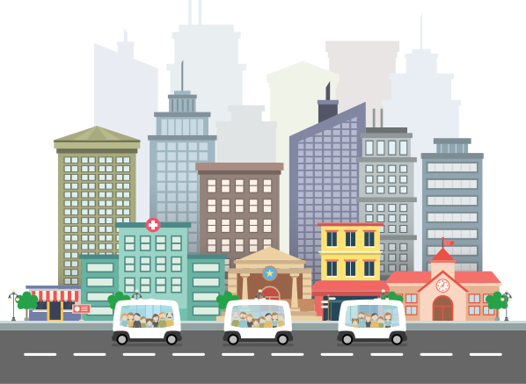


SHARED DRIVERLESS TRANSPORTATION
Reclaiming cities for the people

Slide 2

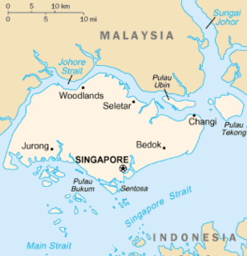
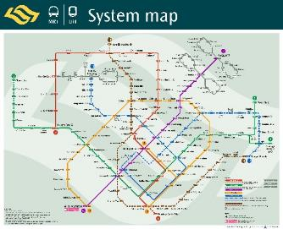
EasyMile’s Vision
Observations
For decades, in Singapore, policy makers and urban planners have promoted public transportation
They have developed a clean, safe and cheap public transportation system

Slide 3


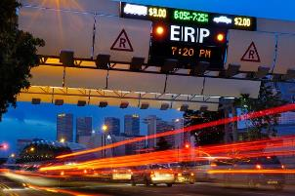

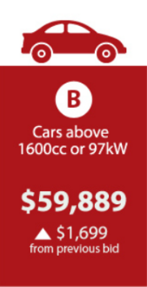
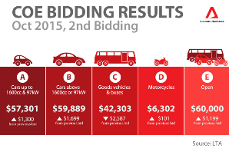
EasyMile’s Vision
Observations
The City has made usage of private car extremely expensive
=
Notes:
Governments have implemented a range of measures to manage car ownership and usage, Making usage of private cars really expensive.
These include :
Road taxes and Electronic Road Pricing (ERP)
Vehicle Quota System (VQS) and The Certificate of Entitlement (COE)
Anyone wishing to buy a car or motorcycle has to bid for a Certificate of Entitlement (COE). Each month, a certain number of COE's are released but they have become so expensive that it is cost prohibitive to own a car (around $60.000 cost for a COE) - Expensive car parks

Slide 4
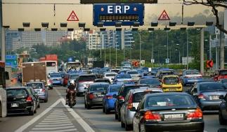
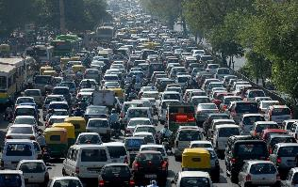
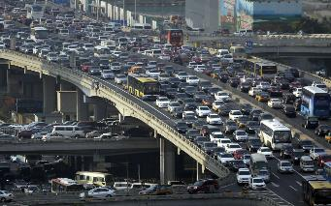
EasyMile’s Vision
Observations
And yet traffic is increasingly congested
- Why ?
Because cars remains the only seamless door to door solution for urban mobility
Notes:
And yet traffic is increasingly congested
- Why ?
Because cars remains the only seamless door to door solution for urban mobility

Slide 5

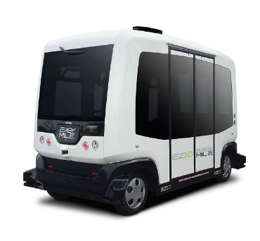
EasyMile’s solution
An Autonomous Road Transport Solutions
EasyMile’s alternative response :
Pairing shared last mile autonomous vehicles with other public transportation systems
Notes:
The alternative response as per EM point of view is :
Pairing shared last mile autonomous vehicles with other public transportation systems

Slide 6


EasyMile’s solution
An Autonomous Road Transport Solutions
Need to go from your house to your office ?
You just have to order a journey from your smart phone
The App tells you that in 3 minutes a shared autonomous vehicle will pick you up at your doorstep
Off peak hours, the App proposes a premium service if you do not want to share your shuttle
Notes:
Making a booking for a door to door journey
You keep your liberty of moving because you can leave whenever you want to go where ever you want. You are not bond to a schedule and you do not depend on free parking slots.

Slide 7






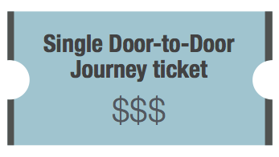



Unique Multi Modal System
EasyMile’s solution
An Autonomous Road Transport Solutions
Notes:
Because the AV and the buses are supervised by a unique multimodal system that takes care of your entire journey and monitors the whole fleet of vehicles, you will not have to wait 15’ at the bus station or worry about missing your connection
And because the multimodal system handles your entire journey, you no longer have to pay separately each segment

Slide 8


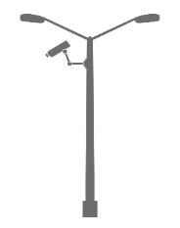


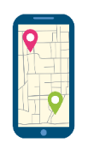
EasyMile’s solution
An Autonomous Road Transport Solutions
based on our EZ10 Driverless solution
Supervision System
EZ10s or other
kind of vehicles
Third party
software
Traffic light or
infrastructure sensors

Slide 9
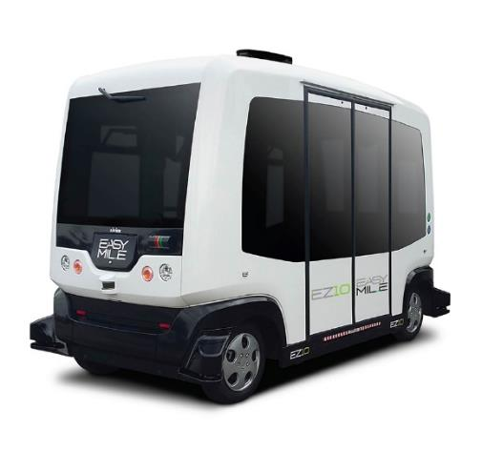
EasyMile’s solution
EZ10 vehicle overview
Driverless electric vehicle
Can carry up to 12 people
Access ramp
Moves autonomously
Different location technologies
No infrastructure required
Obstacle detection
3 operation modes

Slide 10
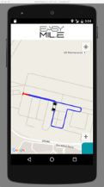
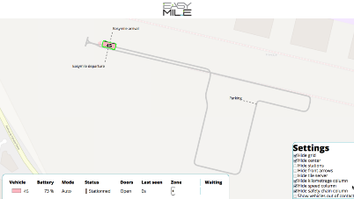
EasyMile’s solution
Supervision specifications
Monitor all vehicles in operation
Interface with site’s sensors, lights and barriers
Interface with third parties software ( smart apps included)
Data analytics tools

Slide 11
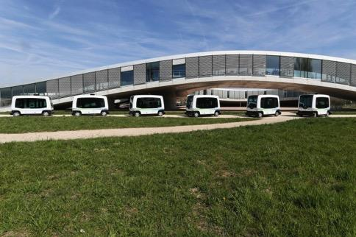
EasyMile’s solution
Main benefits
Available 24x7x365
Can operate on fixed schedule or on-demand (taxi mode)
Agile: 4.5m turning radius, can ride in both directions
No infrastructure needed for navigation
Interoperable with other means of transportation
Cost effective
Zero carbon emission

Slide 12

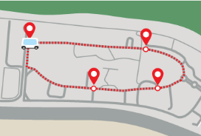
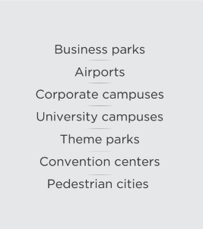

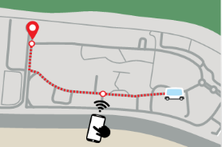
Short term application
Immediate possible applications
3 modes of operation
Short distance within confined sites
Metro or Bus mode
On demand mode

Slide 13


Medium term application
Projects we are focusing on

Slide 14
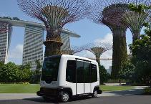
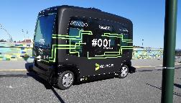
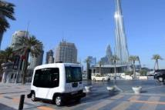
Where we are implenting now
On January 2017, World Leader
+80 000 km travelled +80 000 passengers transported with EZ10
32 vehicles 46 demo done worldwide
- 4 vehicles in USA + 20 Demonstrations planned
- 5 vehicles in Singapore ( 2 in in Gardens and 2 in Mindef, 1 in Changi airport)
- 1 vehicle in Dubai with RTA and Omnix international
- 1 Vehicle in Australia, Darwin Marina
- 5 vehicles in Nordics ( 2 in Sweden with Nobina & Ericsson, 1 in Norway, 2 in Helsinki with Metropolia and Nokia)

Slide 15
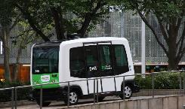
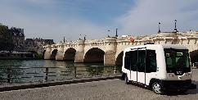
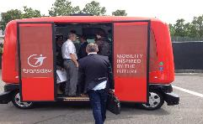
Where we are implenting now
On November 2016, World Leader
- 2 vehicles in Japan with DENA
- 1 vehicle in a Netherlands demo tour
- 4 vehicles in MOLTS
Multinational Operators for Local Transport Services
( RATP, Transdev, DB, first Group)
- 6 vehicles in First Tier OEM and lab
( ------, Bosch, Continental AG,
institut Pascal, TuDelf )

Slide 16
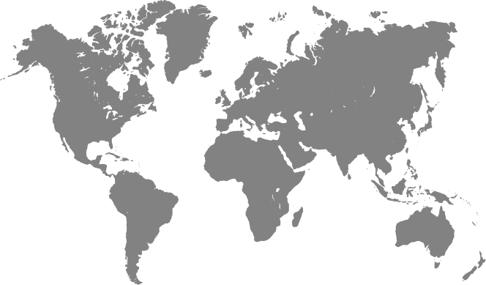















EZ10’s Milestones
2014
2015
Paris Motorshow
Launch of the vehicle
October 2014
Michelin Challenge
Bibendum
Chengdu, China
November 2014
CityMobil2
EPFL
June 2015
Vantaa
Finland
July 2015
ITS Bordeaux
October 2015
v1
v2
v2.3
v2.4
2014
2015
2016
2017
Assembly Line
Q1, 2017
2016
Gardens by the Bay
Singapore
Live operation
July 2016
Sophia Antipolis
France
February 2016
Metropolia
Helsinki, Finland
August 2016
Ooststellingwerf
Netherlands
September 2016
Bisop Ranch
USA
November 2016

Slide 17






EasyMile’s Milestones
Value Added
Partners
Headcount
Japan
0 to 60
in 2 years
Offices
Singapore
Toulouse office (HQ)
Singapore (APAC HQ)
Middle East
Test Beds in France & US
(Francazal & GoMentum Station)
Set up of US office
(Q4 - Denver)

Slide 18




A strategy based on partnership
Core Business
  Develop technology components
  for both indoor and outdoor
  autonomous navigation
  Develop know how to integrate
  autonomous software into a robot
  Develop methodologies and
  processes to deploy safely and
  efficiently fleets of AVs

Slide 19

A strategy based on partnership
Create Partnerships with
Manufacturers to Develop AVs

Slide 20
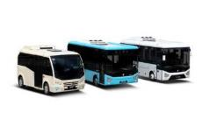

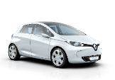
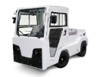
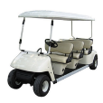

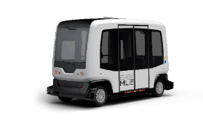
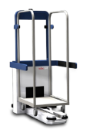


A strategy based on partnership
EZ Transport
Airport area vehicle,
Dense Traffic
Forklifts
Rural area
& high speed
Tow trucks
Product / Market Mix
Indoor
Smaller, roofless,
Low cost and
pedestrian friendly
Scrubbers
EZ10
V2
AGV
EZ10
CURRENT
FOCUS
EZ Vehicle Range
Technology Licensing

Slide 21








A strategy based on partnership
  Transportation Operators:
  Mobility as a Service,
  ticketing, etc
  Network Providers
Play an
Active Role
in the
Ecosystem
of
Autonomous
Mobility
  Policy Makers:
  Legal framework,
  norms, etc
  Automotive Suppliers:
  Lidars, radars, cameras,
  IMU’s, etc
  Certification Bodies
  Insurance Companies
  Architects, urban planners,
  and engineering firms to
  adapt the city to new mobility

Slide 22

SHARED DRIVERLESS TRANSPORTATION
Reclaiming cities for the people
by Clément Delbouys, Area Sales Manager, EasyMile
Photo credits
Singapore Traffic Congestion - Straits Times
Disabled Parking - Straits Times
Commuters vs bus vs cars - Australia Cycling Promotion Fund
COE prices - Channel News Asia
SMRT train - Calvin Teo

