Slide 1
Our way & our vision
Zero-Emission Public Transport:
Total system - providing total turn-key solutions
Affordable/attractive - efficient & profitable
Business model - partnership

Slide 2
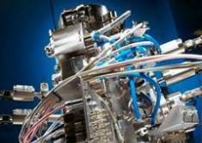
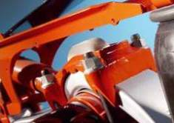
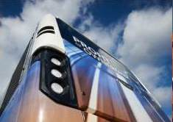
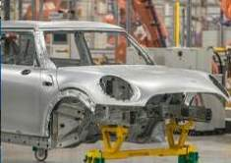
VDL group
Subcontracting
Finished products
Buses & Coaches
Car assembly
Metalworking
Plastics processing
Mechatronic systems
& system supply
Surface treatment
Automotive;
suspension systems
Heat exchangers
Production automation
systems
Container handling
systems
Coaches
Public Transport buses
Mini & midi buses
Used vehicles
Parts & services
Production of passenger
cars for third parties
87 companies, 19 countries, 10,623 employees
Notes:
87 companies
19 countries
Export 77%
1,200,000 m² production area
10,623 employees
VDL's business activities are divided into 4 divisions:
The subcontracting division includes a large number of subcontracting companies that manufacture high-quality products from metal and plastic. Each company has its own specialty and makes optimal use of the collaboration with the sister companies. In this manner, VDL has every specialty at its disposal.
A number of the VDL companies develop and manufacture a wide range of products for both the industrial and consumer markets. These companies fall under the finished products division.
The core activities of VDL Bus & Coach consist of the development, manufacturing, sales and after-sales service of a wide range of buses, coaches and chassis modules and the purchase and sale of used vehicles.
Within the car assembly division passenger cars are assembled for third parties. This takes place at VDL Nedcar in Born (NL). From the second half of 2014, MINIs will be produced here for BMW Group.

Slide 3
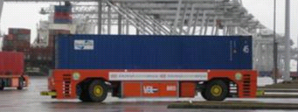
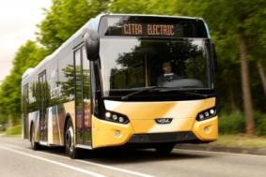
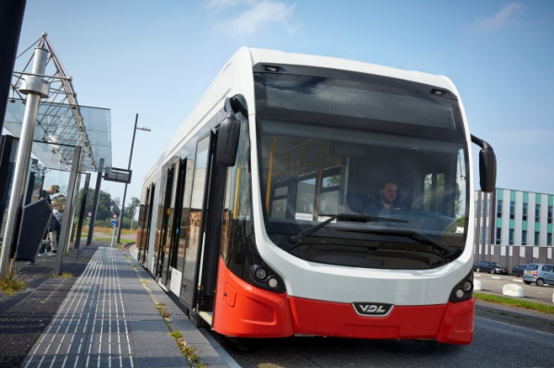
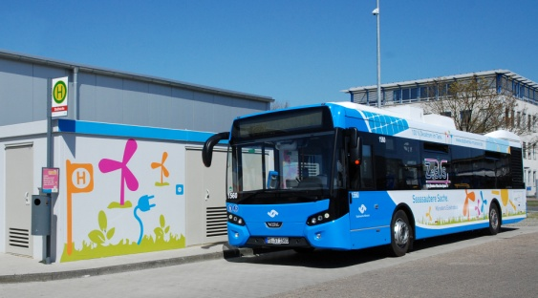
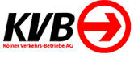
VDL experiences - presence
VDL experiences - past
More than 10 years and 20 million kilometres with E-drives in 12 m to 26 m (PT)
Serial Hybrid
Diesel Serial Hybrid
Battery Bus
Trolley
15 of SLF-120 Electric with
opportunity charge
8 of SLFA-181 Electric with opportunity
Charge, Delivered 10/2015
5 of SLF-120 Electric with opportunity
charge ,Delivered 4/2015

Slide 4
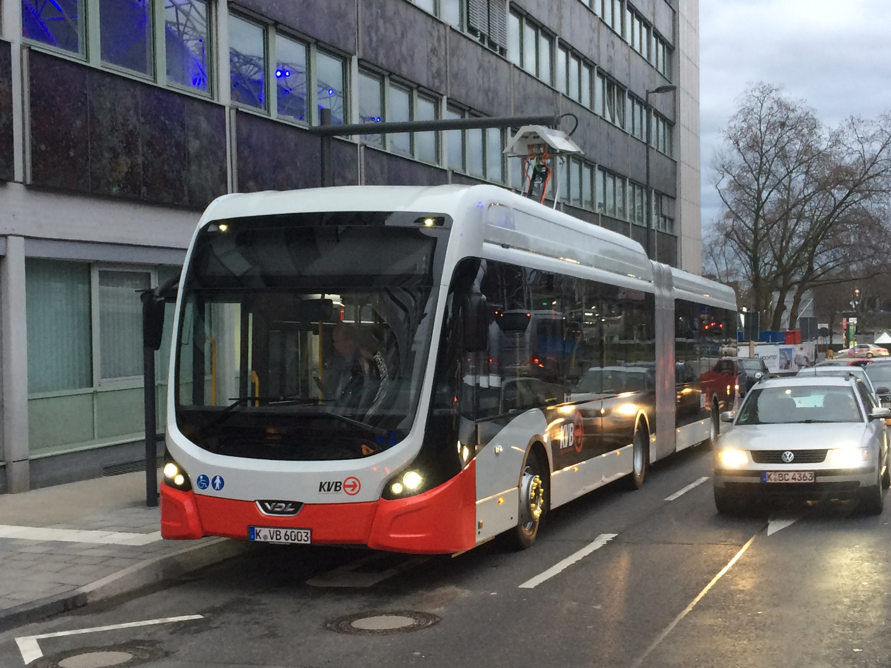
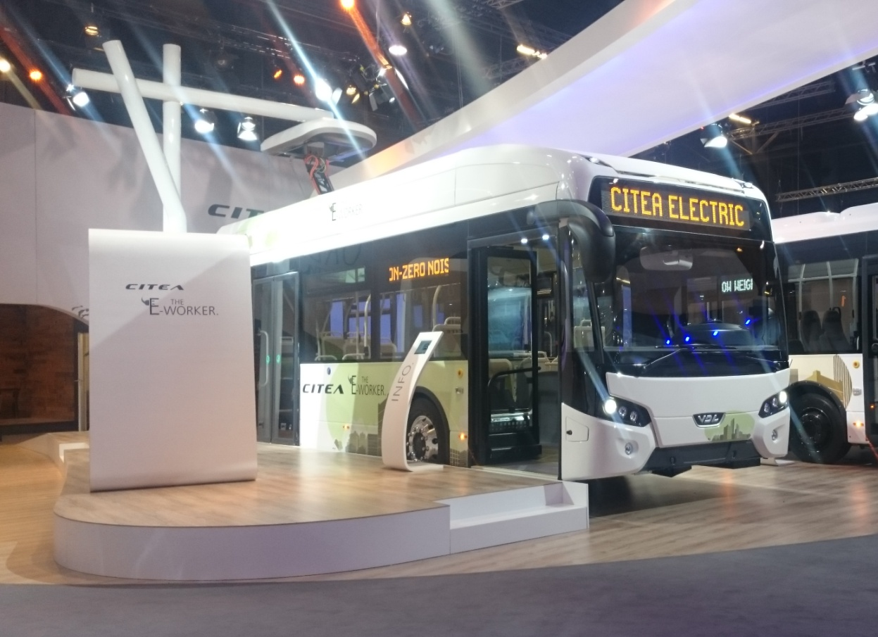
From the fair-grounds
To our streets

Slide 5
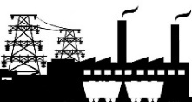
Thank you!
Any questions?
power transfer
works
feeding station
feeders
depot
Ted Stridsberg, VDL Bus&Coach Nordic
t.stridsberg@vdlbuscoach.se
Henning Løvstad, VDL Bus&Coach Norway
h.lovstad@vdlbuscoach.no
Eckly Hendriks, Project Manager E-Mobility VDL
e.hendriks@vdlbuscoach.com

