Slide 1
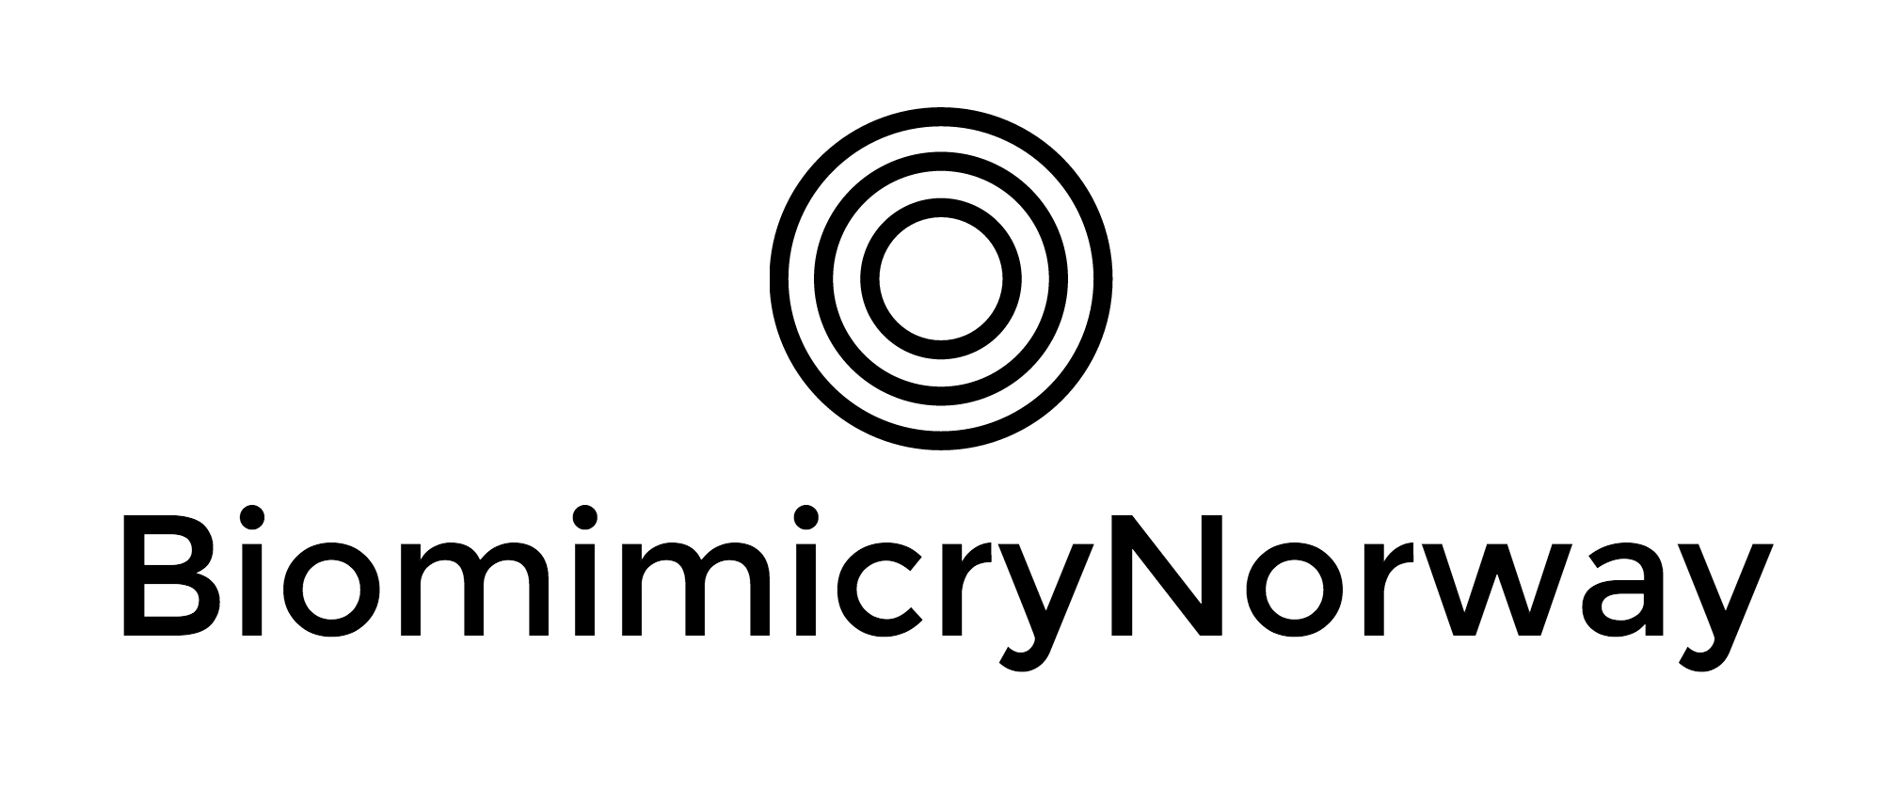
Nature-Inspired
Transport Network
Michel Wolfstirn

Slide 2
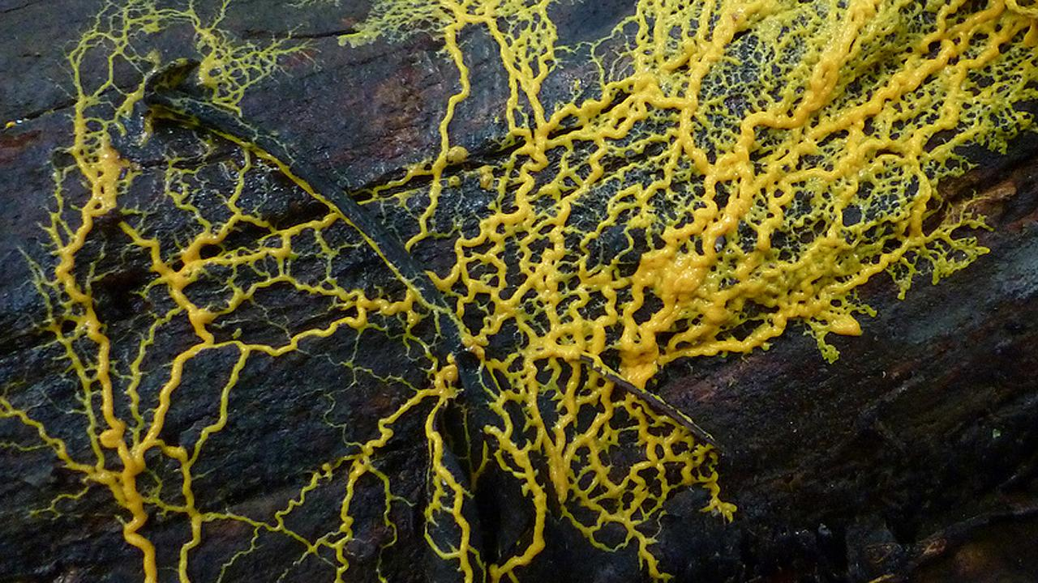
Notes:
Slime mold. Used to map out the most efficient network between nodes.
https://asknature.org/strategy/cytoplasm-seeks-efficient-routes/#.WHFchLbhCRs

Slide 3
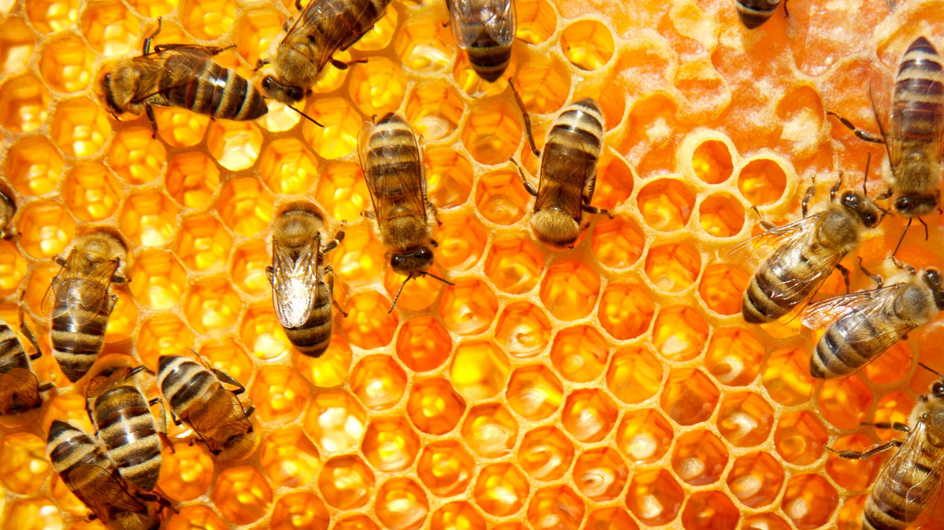
Notes:
For social insects, teamwork is predominantly self-organized. Coordinated primarily through the interactions of individual colony members, the insects can solve complex problems even though each interaction may be very simple.
To understand the power of self-organization, consider how ants find the shortest distance to a food source simply by laying and following chemical trails. For example, two ants leave their nest in search of food and venture off on separate paths. While walking, they release a trail of pheromones (chemicals) that the other ants in the colony can detect. The ant that takes the shorter route doubles back to the nest more quickly, adding more pheromones on top of those already left on the first passage (away from the nest). This reinforcement of pheromones leaves a higher concentration for other ants to sense, and as a result, other members of the colony detect and follow this more distinct trail of pheromones, as well.
In the same way, termites, with no supervision, collectively build mounds with ambient internal temperatures and comfortable levels of oxygen and carbon dioxide. Although science has yet to fully explain the exact mechanisms through which these architecturally efficient mounds are created, several models indicate that termites are more likely to deposit soil particles where other individuals have just placed particles, due to the presence of short-lived pheromones.
Self-organization enables a swarm of social insects to carry out complex tasks through the collective duties of individuals within the colony without being centrally controlled. The collective effort of the whole group is the only means by which the group is able to sustain itself and grow as a community.

Slide 4
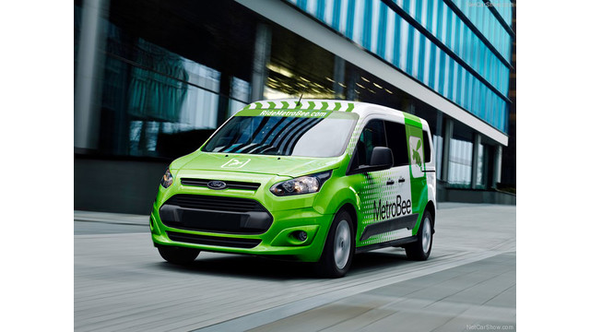
Notes:
MetroBee
http://www.masstransitmag.com/press_release/11434007/ca-metrobee-offers-a-solution-to-the-last-mile-by-bringing-transit-right-to-commuters-front-door
“To develop this transit solution we simulate the behavior of a colony of bees.” explained Edelberg. Our vehicles work as a swarm to most efficiently service the greater community. The hive is a mass transit hub of any mode, i.e. Rail, Rapid Bus, and Ferries. MetroBee is uniquely designed as an extension of mass transit and part of a larger transit eco-system. Great cities of the future will succeed, only if growth is balanced by a reduction in the amount of cars on our streets.”
With this app-based solution, a system comprised of multiple shared ‘bee’ vehicles collect passengers to service the metro station ‘hive’, displacing traffic congestion at a rate of approximately 40:1. Critical to the success, is keeping a 15 minute guaranteed ride to the station. This time promise is fundamental to commuters choosing a mass transit option over their personal cars. The system is a new model for mobility, not a bus, taxi, or limo service, but a colony of nimble shuttle vehicles that bring riders from their door to and from transit hubs

Slide 5
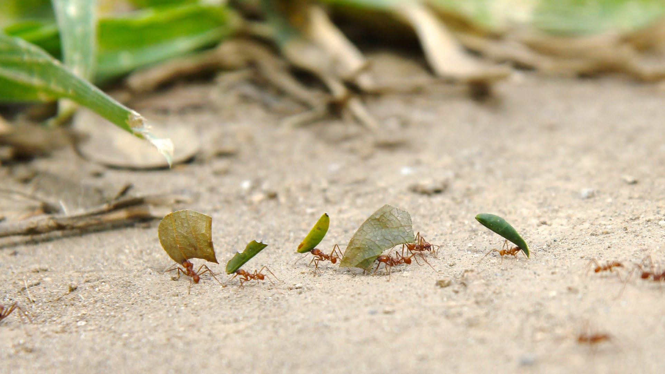
Notes:
Vehicle routing by ant colony optimisation
Within ant colonies, each ant has a specific role. In the leaf-cutter species, foraging ants are tasked with collecting leaf fragments and bringing them back to the colony. One may think that a forager would collect the largest possible payload. However, high payloads are not shown to result in more efficient transport. Instead, foragers generally carry loads well below their maximum potential. Load size is influenced by two factors: a more manageable workload for processor ants, and the speed of other foragers.
When foragers return to the colony, they pass their loads to the processor ants. Processors collect the material and distribute it among the colony. There are more foragers than processors. If every forager brought large of loads to the colony, the processors would be overwhelmed by the volume of leaves coming into the colony and fall behind. As a result, materials would not be distributed throughout the colony in a timely manner.
Foragers also carry small loads in order to maintain a consistent speed in relation to other ants. Foragers travel to and from their colony in a single file line, also referred to as unilateral transport. This is because foraging ants travel by following the chemical scent of the forager directly in front of them. It’s as if ants travel down a one lane highway, where passing is illegal. Because smaller loads mean faster foraging and bigger loads mean slower foraging, if one ant chooses to take a larger than average load it will slow down the entire group. This can have a serious effect on the colony as a whole.

Slide 6
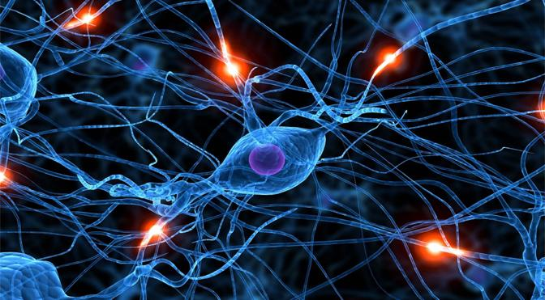

Slide 7
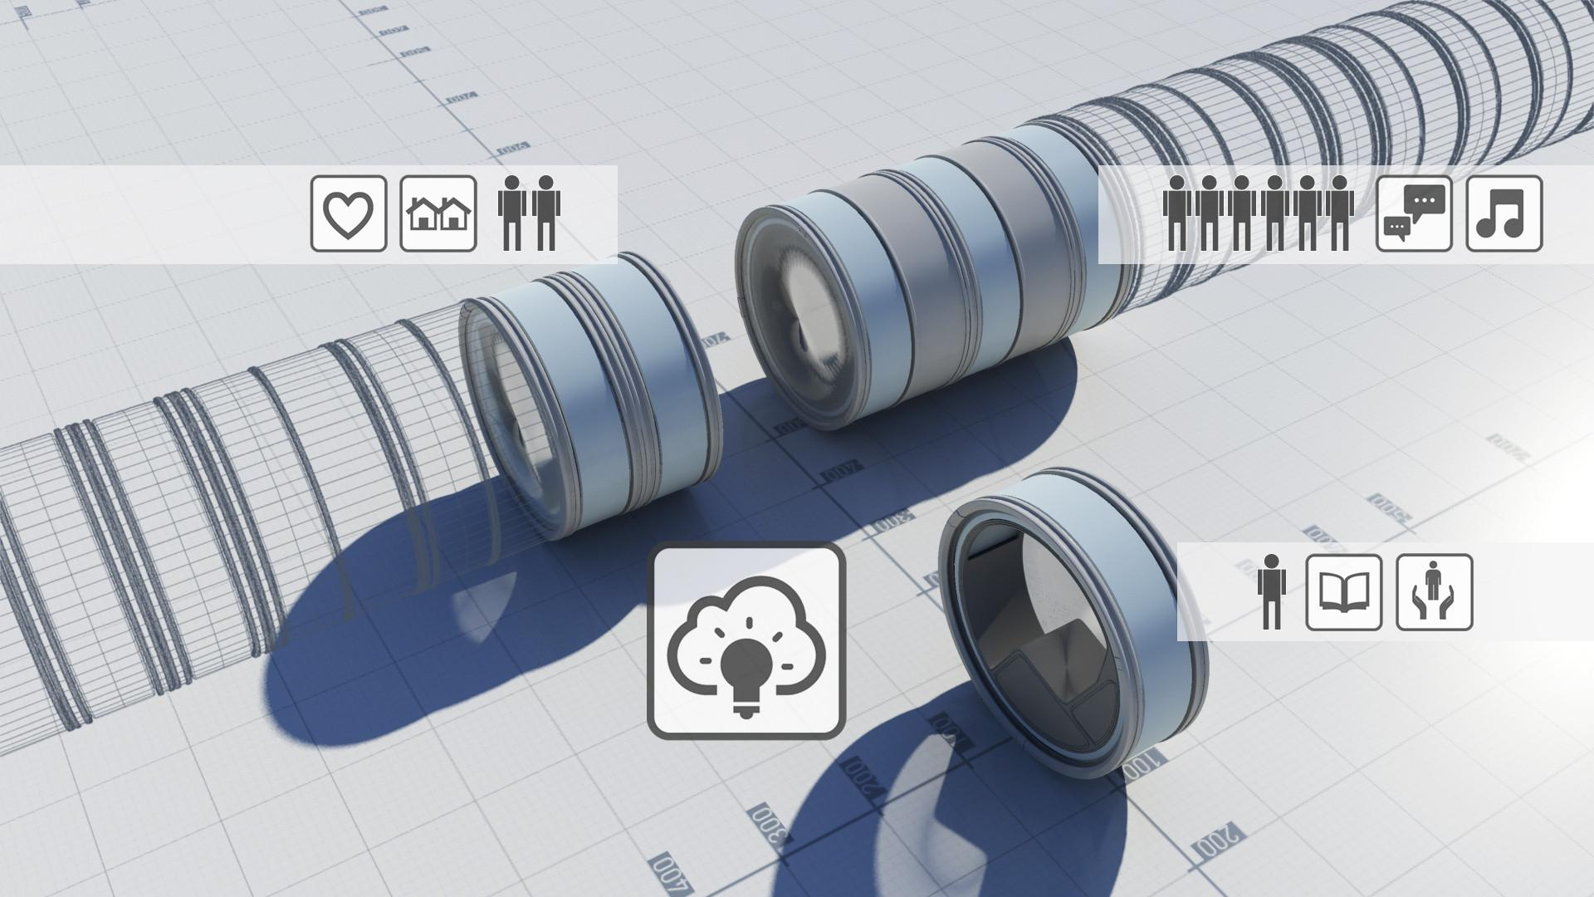
Image © Audi Urban Future Initiative
Notes:
Audi Urban Future Award 2014 - Entry: Flywheel
http://www.archdaily.com/583601/audi-urban-future-award-2014-team-berlin-s-flywheel-could-revolutionize-personal-mobility
http://audi-urban-future-initiative.com/blog/moving-faster-through-the-city
Borrowing a concept from the elevator industry known as "destination control." This technology allows an increase in efficiency by having passengers program in their desired floor upon calling the elevator, allowing an algorithm to calculate the most efficient path.
Team Berlin's proposal argues that once self-driving cars become a reality, Destination Control could be applied to personal transport, with cars which follow the same route grouping together and the precision of the self-driving systems allowing them to drive bumper-to-bumper, thus taking up less space on the road and easing congestion.
All this would be enabled by a central, city-wide processor which receives information via networked infrastructure within the city, thanks to "Car-to-X" technology, and informs the vehicles of possible routes thanks to the reciprocal "X-to-Car" technology. The team behind the proposal points out that one-third of Berlin's traffic lights are already enabled for this technology, and therefore the infrastructure required for their proposal is not so far from being a reality.
The human nervous system controls our metabolism and adapts processes in cells. Nutrients move all around our body, packaged in tiny bubbles – “just in time,” as it were. Dynamic coupling mechanisms provide “intermodal” assistance here to prevent hold-ups or delays: A breakdown in transportation would have fatal consequences for humans. The team is convinced that there are lessons for urban mobility in this. The ideal traffic guidance system would be able to take passengers to their destinations seamlessly by means of individual and collective modes of transport – always one step ahead of a traffic log-jam.
"When the operation of transportation systems in a city is strictly separated, waiting times at stops and bottlenecks on the streets automatically arise," says Max Schwitalla. "We want to combine the advantages of individual urban means of transportation and close the gap in connections to the last mile. To do this, we build on the existing infrastructure."

Slide 8
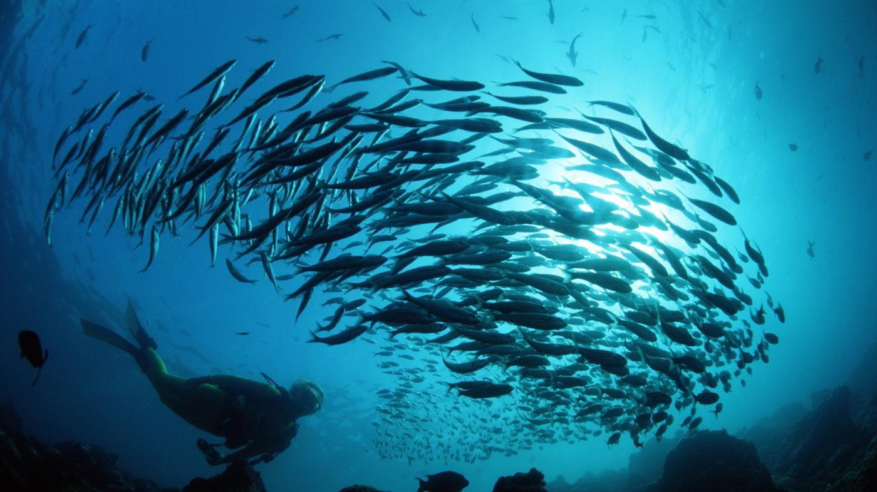
Notes:
Collision avoidance with mosquitofish
Large groups of mosquitofish can move together with little physical contact between individuals. This is because the individual fish coordinate their acceleration and deceleration. The fish accelerate toward a neighbor that is far away from or behind them, and decelerate when a neighbor is directly in front of them.
"Fish responded to the position of their neighbors through short-range repulsion and longer-range attraction rules... mosquitofish actively changed their speed in order to avoid or move toward neighbors," one study by Herbert-Read et al. found. "Perhaps the most surprising finding of our study is the extent to which the single nearest neighbor dominates social interactions."

Slide 9
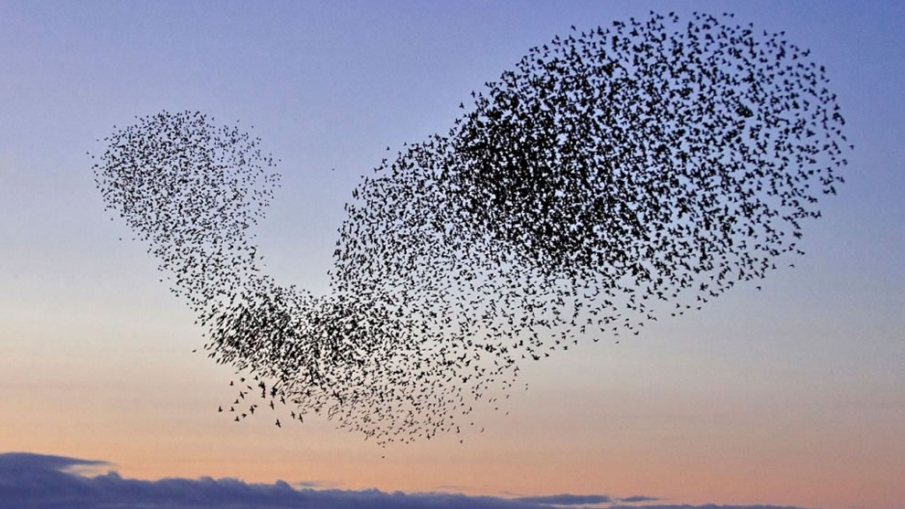

Slide 10
How BiomimicryNorway can help Ruter
Bringing some wisdom and science from nature into:
Transportation network layout
Vehicle communication strategy
Last Mile solutions
Research, Engineering & Design
Supporting suppliers in the development of novel solutions
Access to a global network of biomimicry experts from various fields

Slide 11
Michel Wolfstirn
Biomimicry & Circular Economy Consulting Services
+47 9255 7654
michel@biomimicrynorway.com
www.biomimicrynorway.com

