Slide 1
Morten Torp
Director Mobility Scandinavia
Avis Budget Group

Slide 2
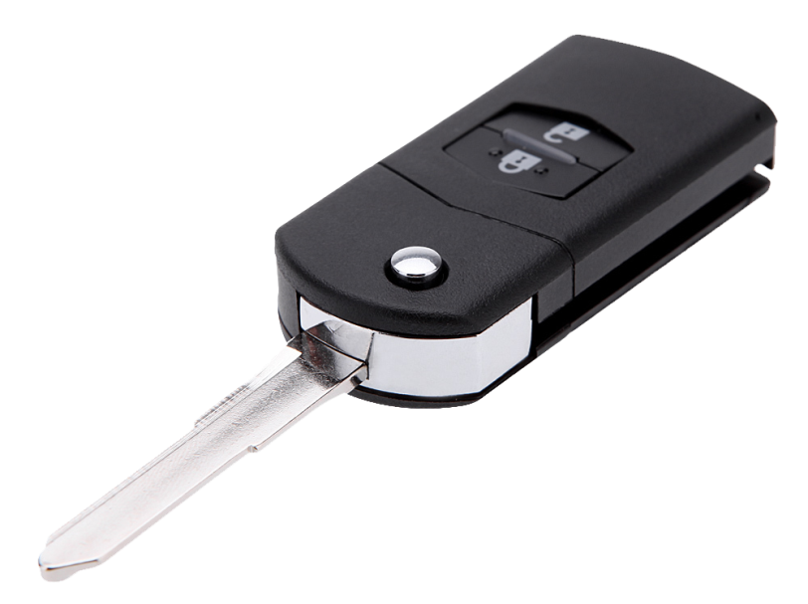
Average usage of private cars
23 hours - 30 min parked

Slide 3
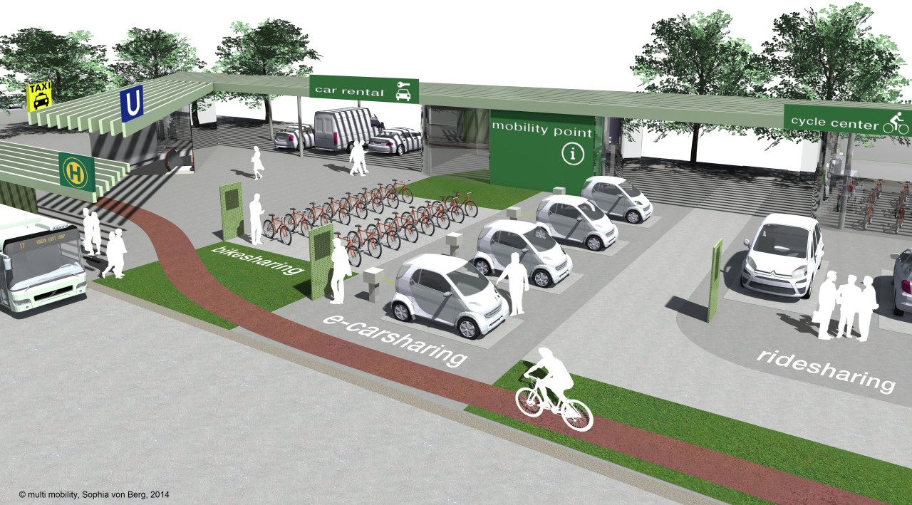

Slide 4
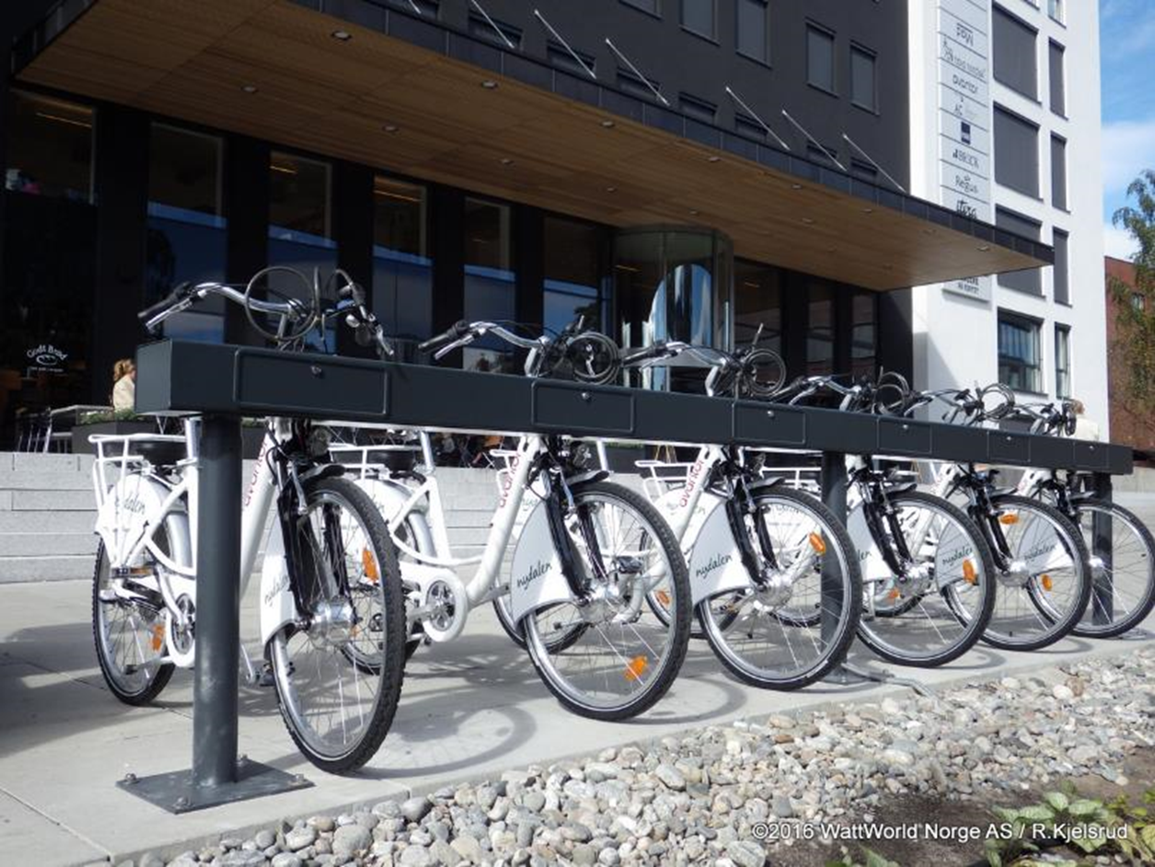
Avis tilbyr også EL sykler sammen med Watt World

Slide 6
EV
(Electric Vehicle)
E-Ferry
LEV
(Light Electric Vehicle)
Seamless Mobility
(People + Parcel)
A-Bus
(Autonomous Bus)
E-Bike
Energy Trading
(Infrastructure + Micropayment)
IoT + Charging Hubs
Metrobus
Integration Planning
and Design
(Modeling + Innovation Lab)
Connected Community
(Citizen Empowerment +
Urban Authorities)
ICT Platform
(Data Exchange and AI)
Storage
Positive Energy Buildings
IoT + Charging Hubs
Seamless Energy
Waste Heat Recovery
Positive Energy Districts and Zones
RES
(Renewable Energy Systems)

Slide 7
Plattform for kombinert bookingsløsning for bil, sykkel og LEV
Kombinert bookingsløsning med buss, bane, bil, sykkel og LEV
Utvikle smarte ladeløsninger – energi
Teste ut autonome løsninger LEV og andre
Teste ut autonome løsninger for lett cargo frakt

Slide 8
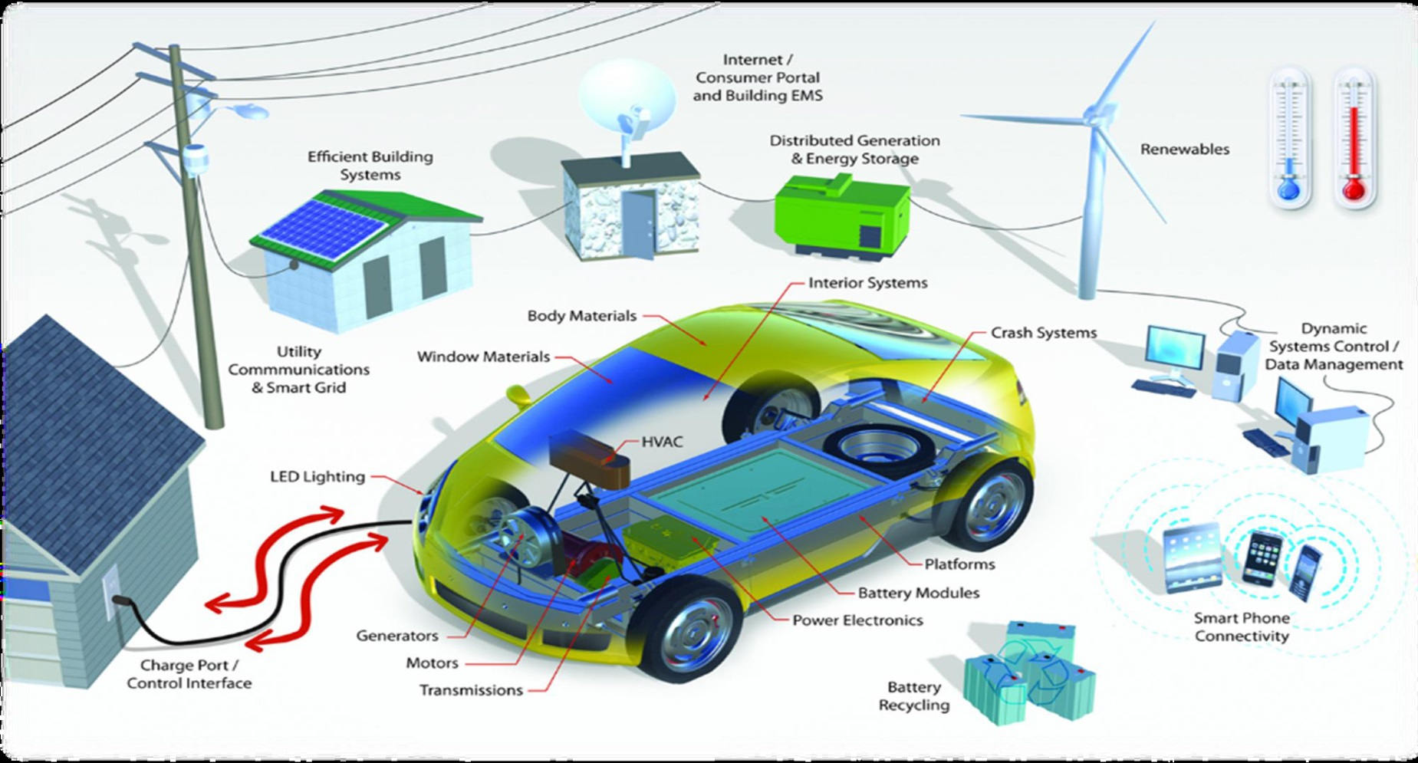

Slide 9
@2016 Avis Budget Group CONFIDENTIAL, DO NOT DUPLICATE OR DISTRIBUTE

