Slide 1
Requirements for electric buses
Dialogue conference on electric buses, 13th february 2017
Øystein Fjæra, senior advisor, contract management

Slide 2
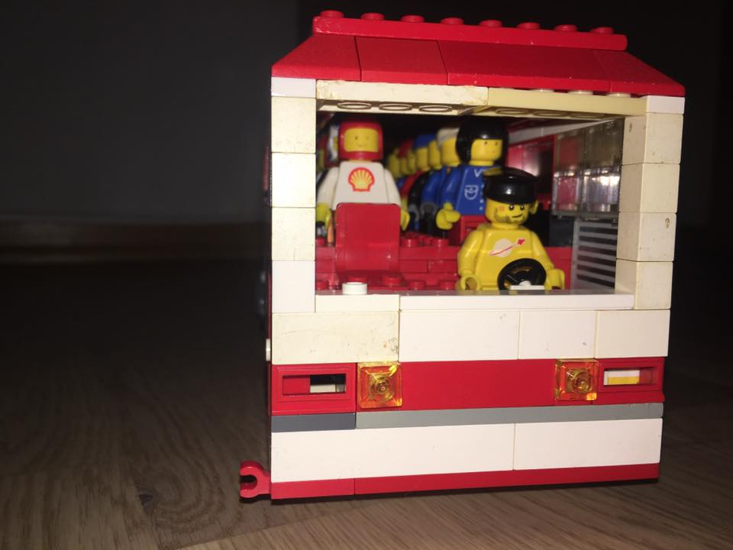
How are the buses of the future?
Foto og konstruksjon: Sindre Hognestad

Slide 3
Does ruter need to use different quality- and functional requirements for electric buses?

Slide 4
Which advantages (excluding the obvious) do the electric buses give for the passengers?

Slide 5
Can the introduction of e-buses give innovative interior solutions, which can increase passenger capacity?

Slide 6
Auxiliary heater running on electric power, og biofuel?

Slide 7
Some requirements stay: Passenger comfort and USB charging sockets

