Slide 1

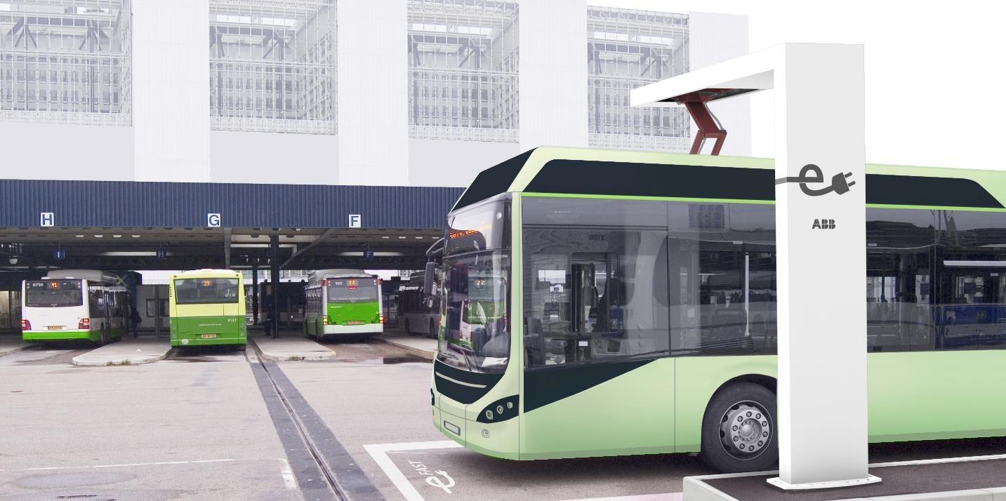
Dialogkonferanse, Ruter 13 feb 2017
2015
Arne Sigbjørnsen, Sales Manager EV & eBus charging Norway
ABB Global Product Group Electric Vehicle Charging Infrastructure

Slide 2
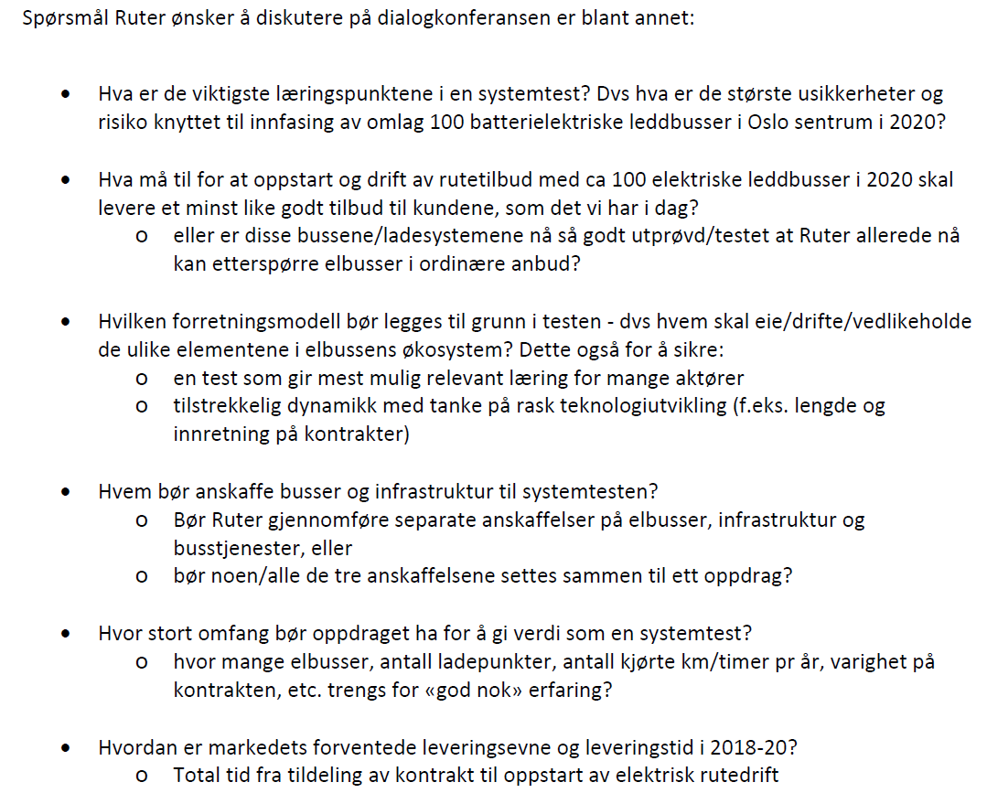
Spørsmål fra Ruter

Slide 3
Spørsmål fra Ruter
Hva er de viktigste læringspunktene i en systemtest? Dvs hva er de største usikkerheter og risiko knyttet til innfasing av omlag 100 batterielektriske leddbusser i Oslo sentrum i 2020?
  Industrien i dag er fortsatt relativt umoden. På grunn av den bratte veksten vi forventer vil det trolig være ulike former av læring. Det er også mange nye aktører inn i markedet. Ettersom dette er ny teknologi vil alle interessenter måtte få utprøvd kvalitet og ytelse i de kommende årene.
  Hovedutfordringen vi ser er standardisering av ladegrensesnitt. Vi ser markedet konvergerer mot CCS2 lading for lading over natten (depot).
  For opportunity lading OppCharge er utfordringen å få fart og tilpasset i flere land (> 12 allerede).
  Det neste er å ha validering og sertifisering av alle parter som støtter åpne standarder. Vi mener dette bør være et uavhengig testinstitutt. En tredje part som TÜV eller NEK.
  ABB har etter mange års erfaring med billading sett hvor viktig tredje part validering og sertifisering er for å sikre interoperabilitet.
  Snakker buss, ladeutstyr, nett (cloud), operatør samme språk?

Slide 4
Spørsmål fra Ruter
Hva må til for at oppstart og drift av rutetilbud med ca 100 elektriske leddbusser i 2020 skal levere et minst like godt tilbud til kundene, som det vi har i dag?
  eller er disse bussene/ladesystemene nå så godt utprøvd/testet at Ruter allerede nå kan etterspørre elbusser i ordinære anbud?
  Vi tror det ville være bra å teste ulike løsninger fra ulike leverandører på en mindre skala for å få lære av og å være i stand til å gjøre sammenligninger av hva som tilbys.
  ABB mener at dagens teknologi på pantograf lading er godt igang og OppCharge standarden legger til rette for fremtidig implementering og kompabilitet. Kundene vil være like godt eller bedre fornøyd med elbuss enn dagens diesel busser (mindre støy, muligheter for innendørs stasjoner).
  Innen 2020 vil dette kunne implementeres i storskala (100+).
  God planlegging av ruter og kapasitet på nett er ekstremt viktig

Slide 5
Spørsmål fra Ruter
Hvilken forretningsmodell bør legges til grunn i testen ‐ dvs hvem skal eie/drifte/vedlikeholde de ulike elementene i elbussens økosystem? Dette også for å sikre:
  en test som gir mest mulig relevant læring for mange aktører
  tilstrekkelig dynamikk med tanke på rask teknologiutvikling (f.eks. lengde og innretning på kontrakter)

Slide 6






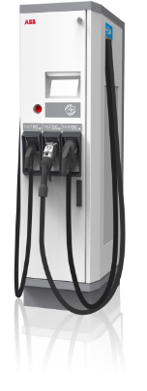










Our view - Three Keys to EVs
Demand response
Distribution system management
Using alternative energy sources
Grid-side
Functionality
Connected Services
OpenADR
SEP2.0a/b
Integration platform (APIs)
Authentication and billing
Subscriber management
Operational B2C services
OCPP
OCPP
Consumer
Functionality
Charger
Management
Functionality
POIAPI
ISO15118
Hardware and software
Charge(r) management
Charge(r) maintenance
Notes:
Different areas that are linked to EV charging.
All areas have different information interest
This can’t be handled locally at the charger. Therefore we have implemented a cloud solution
Cloud solution is a platform that uses open API’s (preferred to use standards)

Slide 7

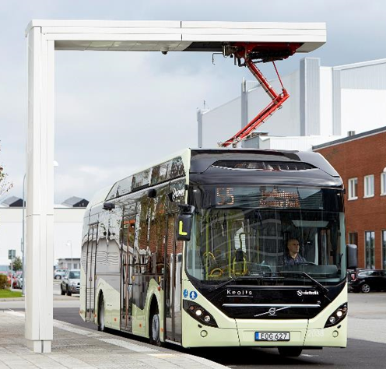
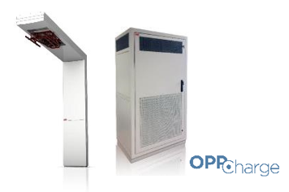





Our view - Three Keys to eBuses
Demand response
Distribution system management
Using alternative energy sources
Grid-side
Functionality
Connected Services
OpenADR
SEP2.0a/b
Integration platform (APIs)
Authentication and billing
Subscriber management
Operational B2C services
OCPP
OCPP
Consumer
Functionality
Charger
Management
Functionality
POIAPI
ISO15118
Hardware and software
Charge(r) management
Charge(r) maintenance
Notes:
Different areas that are linked to EV charging.
All areas have different information interest
This can’t be handled locally at the charger. Therefore we have implemented a cloud solution
Cloud solution is a platform that uses open API’s (preferred to use standards)

Slide 8
Spørsmål fra Ruter
Hvem bør anskaffe busser og infrastruktur til systemtesten?
  Bør Ruter gjennomføre separate anskaffelser på elbusser, infrastruktur og busstjenester, eller
  Ja, vi mener at separate anskaffelser bør være modellen. Selvfølgelig nivået av standardisering spiller en rolle her. På denne måten vil alle interessenter kunne fokusere på sin kjernevirksomhet og gjøre det de kan best, uten ekstra margin påslag.
  bør noen/alle de tre anskaffelsene settes sammen til ett oppdrag?
  Ved valg av proprietær løsninger er det mer fornuftig å gå for en leverandør som tar seg av alt. Ulik praksis på dette rundt om i verden men trenden er at buss og ladeinfrastruktur splittes og standardisering velges fremfor proprietære løsninger.

Slide 9
Spørsmål fra Ruter
Hvor stort omfang bør oppdraget ha for å gi verdi som en systemtest?
  hvor mange elbusser, antall ladepunkter, antall kjørte km/timer pr år, varighet på kontrakten, etc. trengs for «god nok» erfaring?
  Piloter der en kan teste ut ulike teknologier, leverandører og topografi er en fordel for å minske risiko.
  Minst 10 busser med minimum 2 opportunity ladere (eller 10 depot ladere for lading over natten).
  Bør erstatte en/flere av rutene som til vanlig opereres av dagens dieselbusser

Slide 10
Spørsmål fra Ruter
Hvordan er markedets forventede leveringsevne og leveringstid i 2018‐20?
  Total tid fra tildeling av kontrakt til oppstart av elektrisk rutedrift
  ABB er i prosess med øke produksjonenen og korte ned leveringstider for lade infrastruktur for elbuss og den vil gå ned over tid.
  Faktorer som er avgjørende er tilgjengelighet på nok effekt på endestopper og eventuelt depot, samt regionale/kommunale godkjenninger (f. eks plassering og design) og ikke minst leveringstid på elbusser og nettstasjoner.

Slide 11
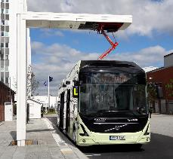
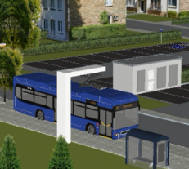



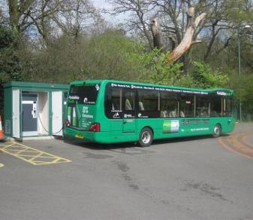
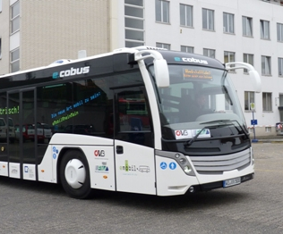

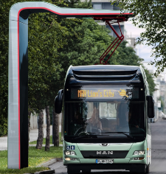

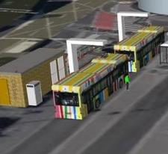
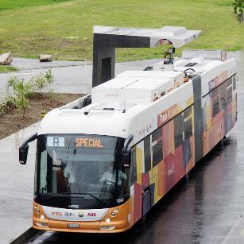
ABB eBus charging
Namur, BE
TEC
3 x HVC 150P
Gothenborg, SE
Volvo Busar
2 x HVC 150P
Coventry, UK
Mike de Courcey
100kW Connector
based
Offenbach, DE
Cobus
50kW Connector
based
Luxembourgh, Lu
MDDI & Sales Lentz
2 x HVC 300P
Munich, DE
MAN Truck & Bus
Inverted panto
Overnight &
Opportunity
charging
Luxembourgh, Lu
Ville de Luxembourgh
4 x HVC 150P
Geneva, CH
Hess
TOSA
Notes:
PV=PhotoVoltaic FIT=Feed In Tariff DC Bus=battery connected in DC side AC Bus=battery connected to AC LoM=Loss of Mains

Slide 12
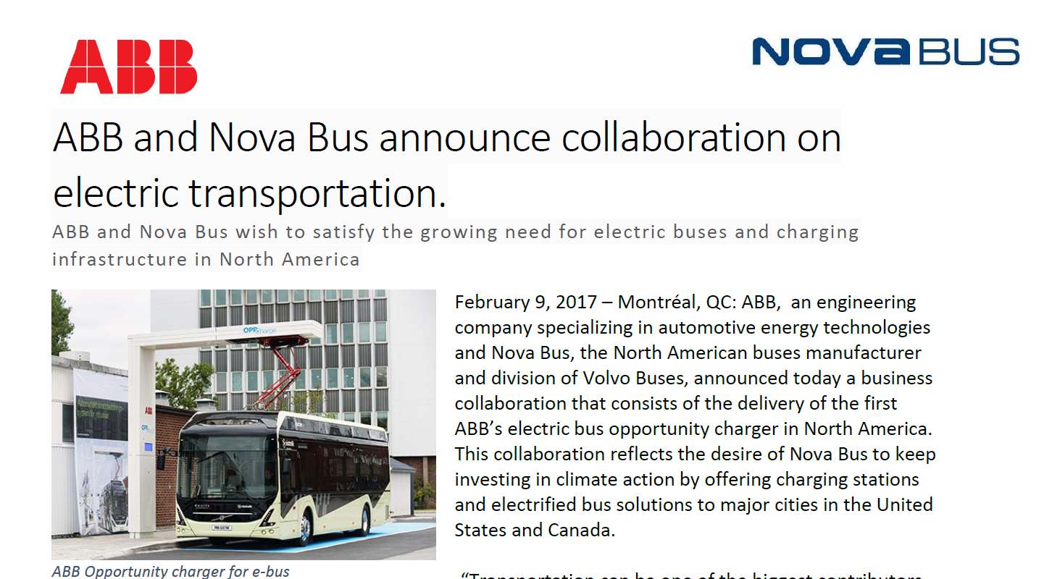
ABB eBus charging

Slide 13


eBus charging
Standardization

Slide 14























Open industry standards are key to success
Industry is working on global standardization
Standardization
Goals Safety Automotive quality Interoperability Prevent technology lock-in Reduce cost Attractive for end customer | Passenger cars (2011) CCS-1/2 connector | Electric buses (2015-2016) Overnight charging (CCS-1/2 connector) and Automated Connection System
Supported by: EN/IEC 61851-23 ISO/IEC 15118 DIN70121
Industrial quality power cabinet
150kW, 300kW & 450 kW modular
Redundancy per each 150kW module
400-850 VDC
Galvanic isolation
Remote management
Automated connection system
High power DC transfer to bus
Wireless communication to bus
Based on
  EN/IEC 61851-23
  ISO/IEC 15118
ABB
ABB

Slide 15

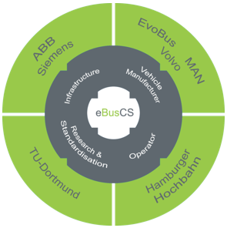

Example of standardization initiatives eBusCS project
Objective:
The main goal of eBusCS is to support a standardized solution approach for eBus Charging Systems in close cooperation with different technical committees like ISO/IEC as well and application & user forums like VDV and UITP.
Includes standards for:
  Opportunity chargers (Automated connection System)
  Depot charging
Time line: Oct 2015 till September 2018
Website: www.ebuscs.net
Project Partners:
ABB AG EvoBus GmbH Hamburger Hochbahn AG MAN Truck & Bus Siemens AG TU Dortmund Volvo AG

Slide 16
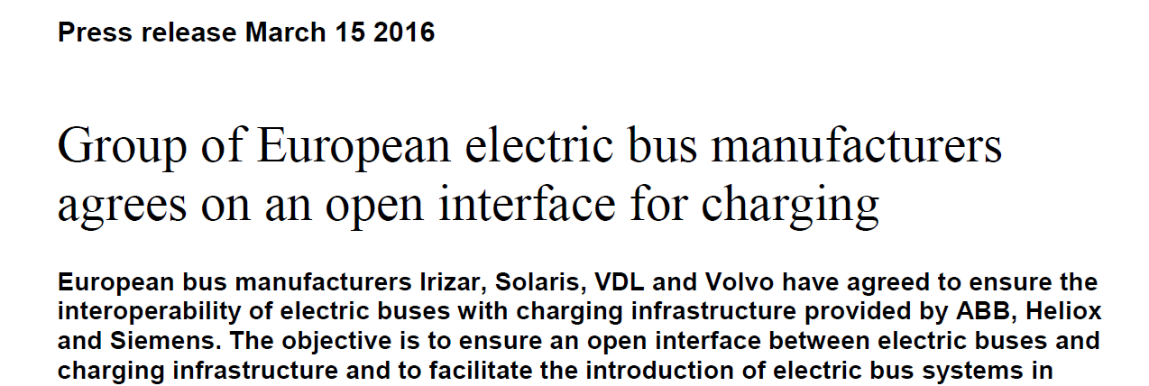
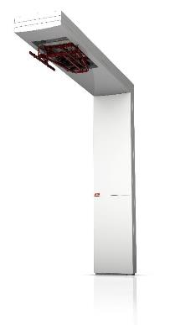
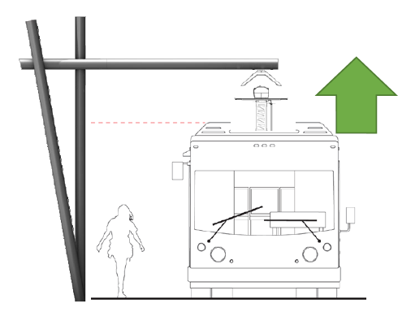
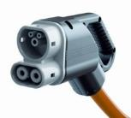
Open industry standards are key to success
Industry is working on global & EU standardization
ABB
Depot charging =
CCS-2 connector (DC 20-150kW)
Opportunity charging v1 =
Inverted pantograph with DC
Opportunity charging v2 =
Pantograph on bus

Slide 17
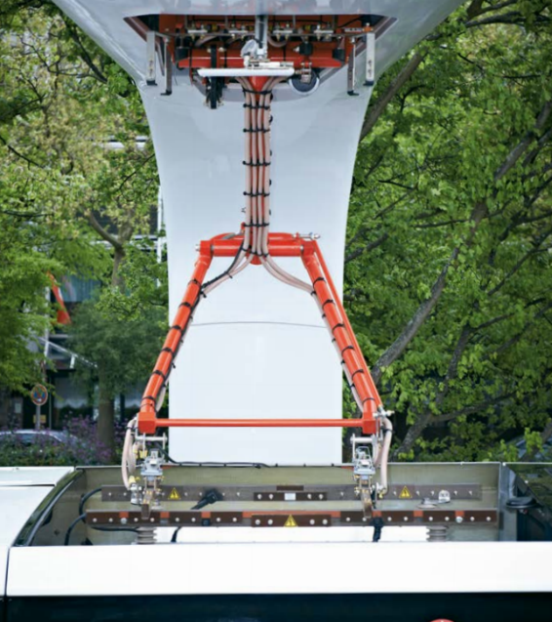
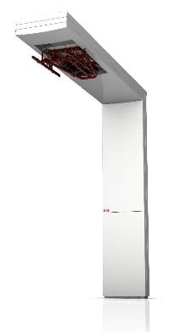



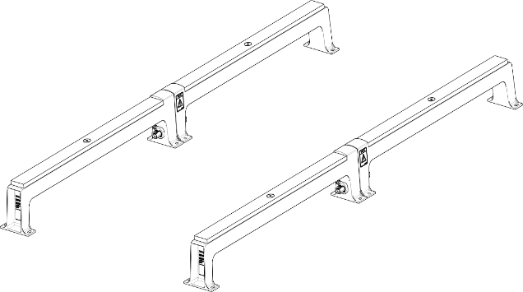
An easy-to-implement open standard
What is OppCharge?
offboard
onboard
4-poles: plus, minus, ground, pilot
  Charging is done according to:
  EN/IEC 61851-23
  ISO/IEC 15118
  DIN70121
  (aka CCS-2)

Slide 18
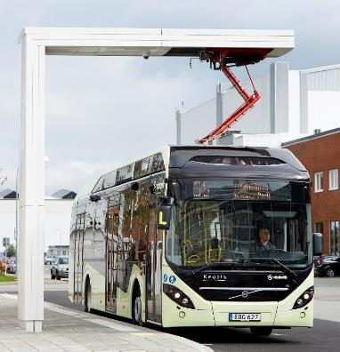
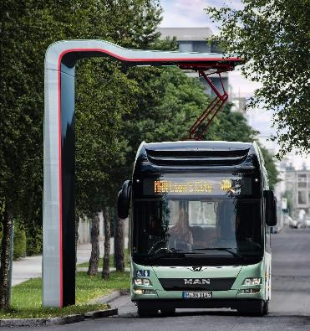
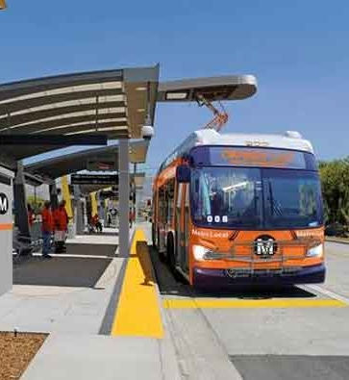
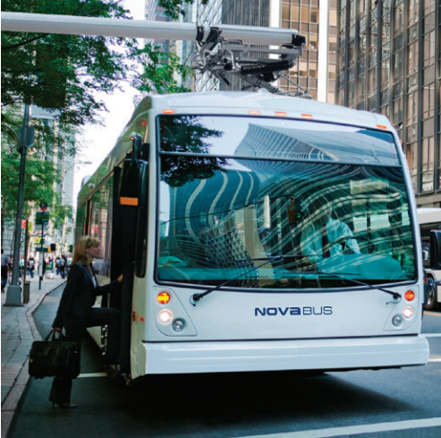
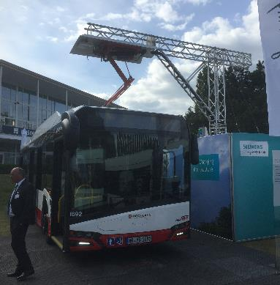


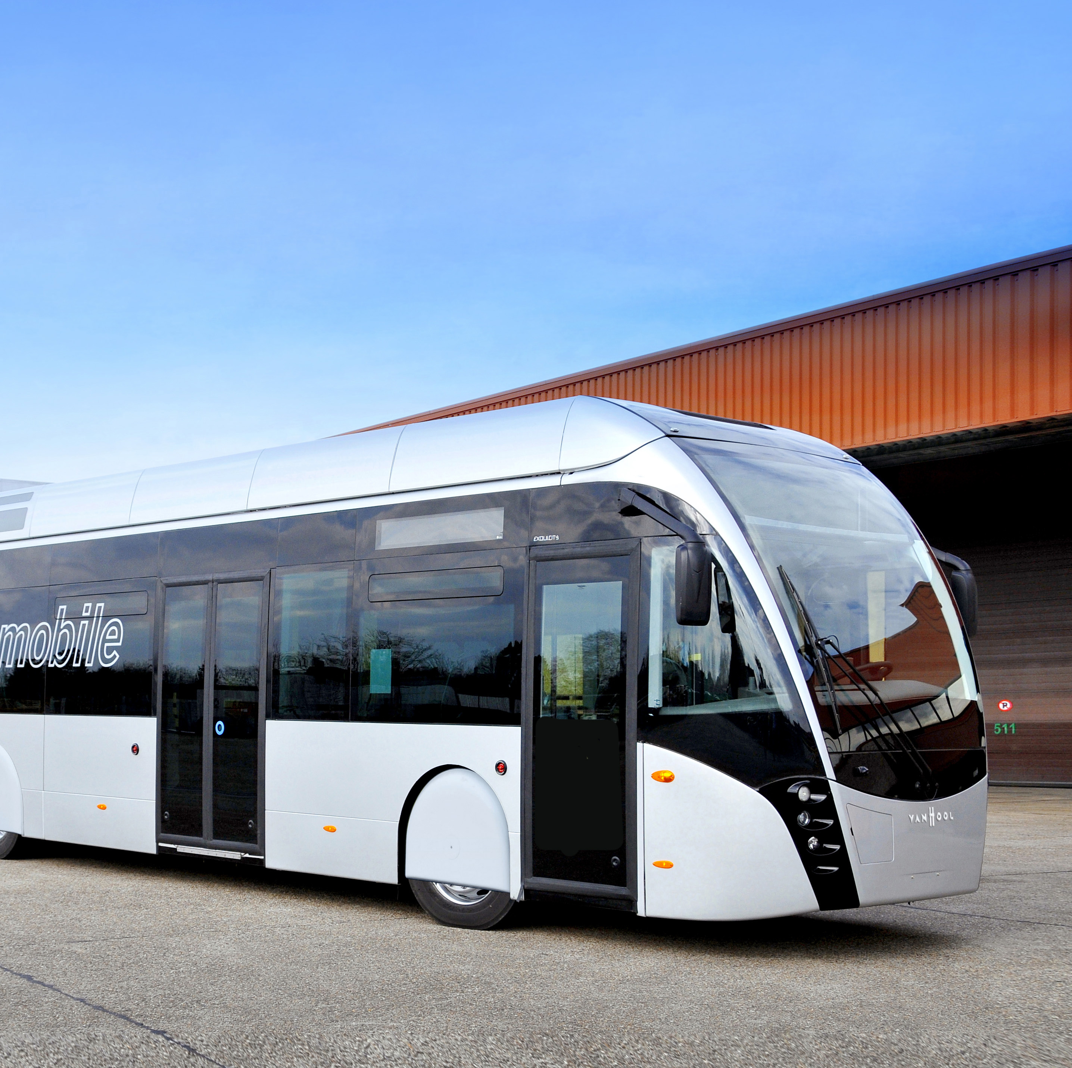
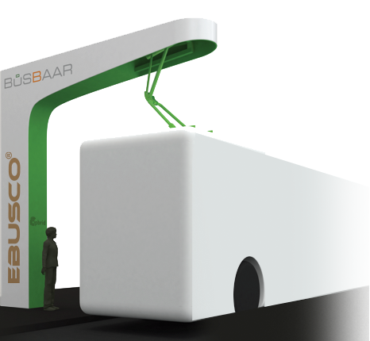


Support of inverted pantograph growing rapidly
?
?

Slide 19
eBus charging
Service concept

Slide 20
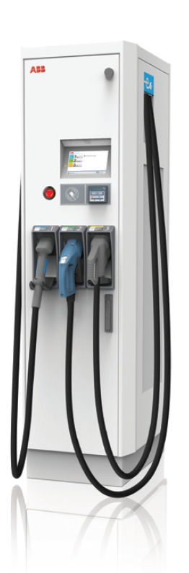
EVCI Global Service
Service Concept
User and Charger Support
Owner, Operator and Service Partner
Local Technical Support
Responsible for SLA
Support all charger related cases with ABB web Modules
Escalate cases to GTS
Tools: Helios
Local Service ABB
Global Technical Support
Global Technical Support Network Operation Center
Develop solutions and offers based on experience from 5000+ chargers serviced world wide
Support all escalated cases with ABB web Modules
Located in The Netherlands
Support all driver and charger related cases with ABB web modules and APIs
Escalate cases to Local Service ABB
Tools: Driver Care, Charger Care, OCPP and APIs
Optimum Charger Availability
Case Handling and Escalation Path
ABB Web Modules

Slide 21
EVCI Global Service
Service Concept
Owner, Operator and Service partner
Optimum Charger Availability
Site operator
Manage contact with driver
Manage charge infrastructure and payments
Monitor charger status
Basic remote diagnostics (Driver Care)
Extended remote diagnostics (Charger Care)
Escalate cases to Local Service ABB
Manage the recommended spare parts logistics
Solve 100% of driver related cases without Local Service ABB support
Tools: Driver Care, Charger Care, OCPP and APIs

Slide 22
EVCI Global Service
Service Concept
Local Service ABB
Optimum Charger Availability
Manage and delivery SLA
Warranty case handling
Local parts logistics
On-site support
Preventive Maintenance
Support all charger related cases
Solve 80% of all charger related cases without escalating cases to Global Technical Support
Advanced remote diagnosis
Escalate cases to Global ABB Service
Tools: Helios

Slide 23
EVCI Global Service
Service Concept
Global Technical Support (GTS) and Network Operation Center (NOC)
Optimum Charger Availability
Develop improvements based on expertise and experience from all 4,000+ chargers serviced by ABB
SLA and Business model definitions
Maintain and updated diagnosis tools, solutions and service instructions
Proactive monitoring of all chargers serviced by ABB
Training & certification
Spare parts availability
Software updates and upgrades
Support and maintain all connectivity infrastructure
Support all escalated cases with ABB web Tools

Slide 24
EVCI Global Service
Business Case
Customer with advanced Service capabilities
Typical Customers: Large Charging point operators, Utility Companies and Public transportation
  Extensive on site presence and professional service team
  Trained and structured back office
  Large Installed based spread across large regions
  Willing to lead on Service Solutions
  Chargers with highest priority
  Business model based on selling charging sessions and Public Transportation
Service Needs: Tailored Service Solutions
  Advanced Service team support
  Repair and commissioning Training
  Diagnostics training
  Fast Support for field service team
  Spare parts
  Business management tools
  Service tools and access to charger know-how
Charger Care Offering:
  Proactive monitoring
  Remote Advanced Diagnostics and Training
  Fast support for On site presence
  Access to service instructions, real time data and diagnostics solutions
  Updates and upgrades
  Tools: Driver Care, Charger Care, OCPP and APIs
Offering Value:
  One Service Partner covering all needs
  Chargers and network monitored 24/7
  Support and tools for developing his own service solutions
  Training and certification of field service team
  Certain of charger compatibility with new cars
  Service solution completely integrated to the business model

Slide 25
eBus charging
The ABB offering

Slide 26
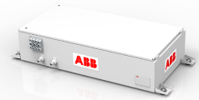


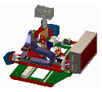





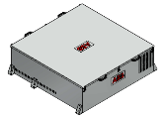
ABB is well positioned for the emerging eBus market
ABB e-bus solutions portfolio
Traction
TOSA
EV Charging
Traction and Auxiliary Converter
Energy
Transfer
System
Traction
Batteries
Flash Charger
Opportunity
Charger
Overnight
DC Charger
Traction
Motors
Trolley Frontend
DC-DC Converter

Slide 27




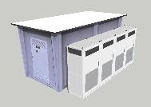

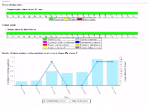




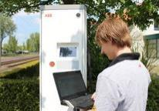

Product portfolio EV Charging
ABB offers complete solutions for eBus charging
High power platform | Overnight charging CCS / 50 –150kW | Opportunity charging 150 - 450kW | Separate MV transformer station
Connectivity | Globally compliant server architecture | IT system integration | Web modules & statistics
Service | ABB global NOC support | > 250 trained local ABB experts | 3rd party training for partners
API platform
> 50 successful integrations

Slide 28
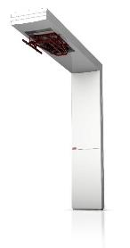

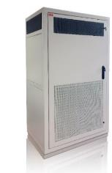




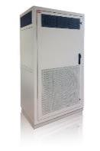


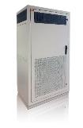
Product portfolio EV Charging
Overnight and on-street opportunity charging
Opportunity chargers
Overnight chargers
HVC 150P
HVC 50C
CCS-2
HVC 300P
HVC 100C
CCS-2
HVC 150C
HVC 450P
P: Pantograph
C: Cable
CCS-2

Slide 29
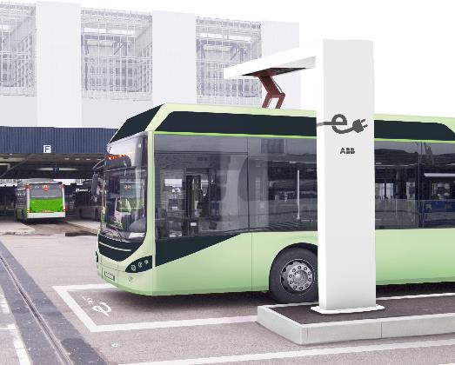


Opportunitiy charging
Reliable, scalable, based on industry standards
Automated connection system
High power DC transfer to bus
Wireless communication to bus
Based on
  EN/IEC 61851-23
  ISO/IEC 15118
OppCharg compatible
Industrial quality power cabinet
150kW, 300kW & 450 kW modular
Redundancy per each 150kW module
200-920 VDC
Galvanic isolation
Remote management
150 kW
150 kW
150 kW

Slide 30
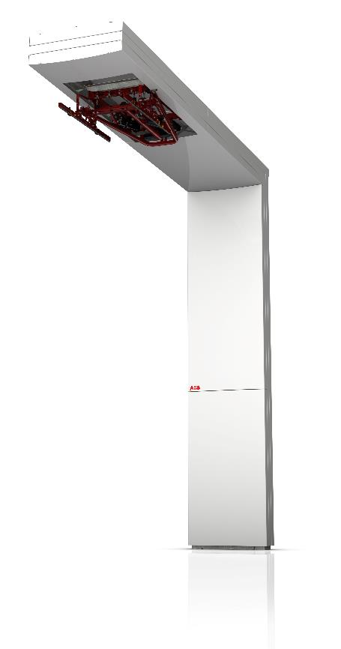
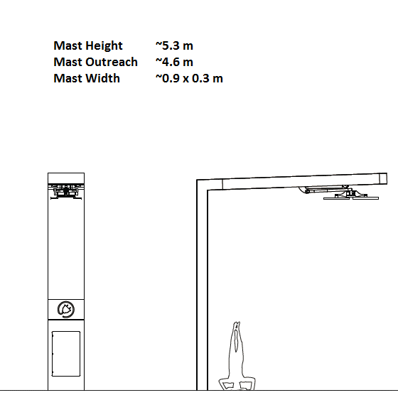
Charge mast with pantograph
Standard ABB mast design
Product in development, all data subject to change

Slide 31
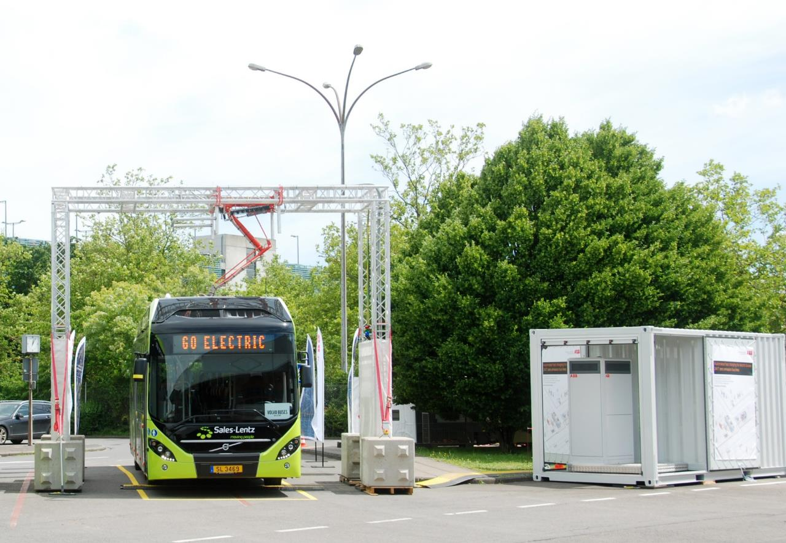
Mobile charger
For demonstrations and Proof of Concept

Slide 32
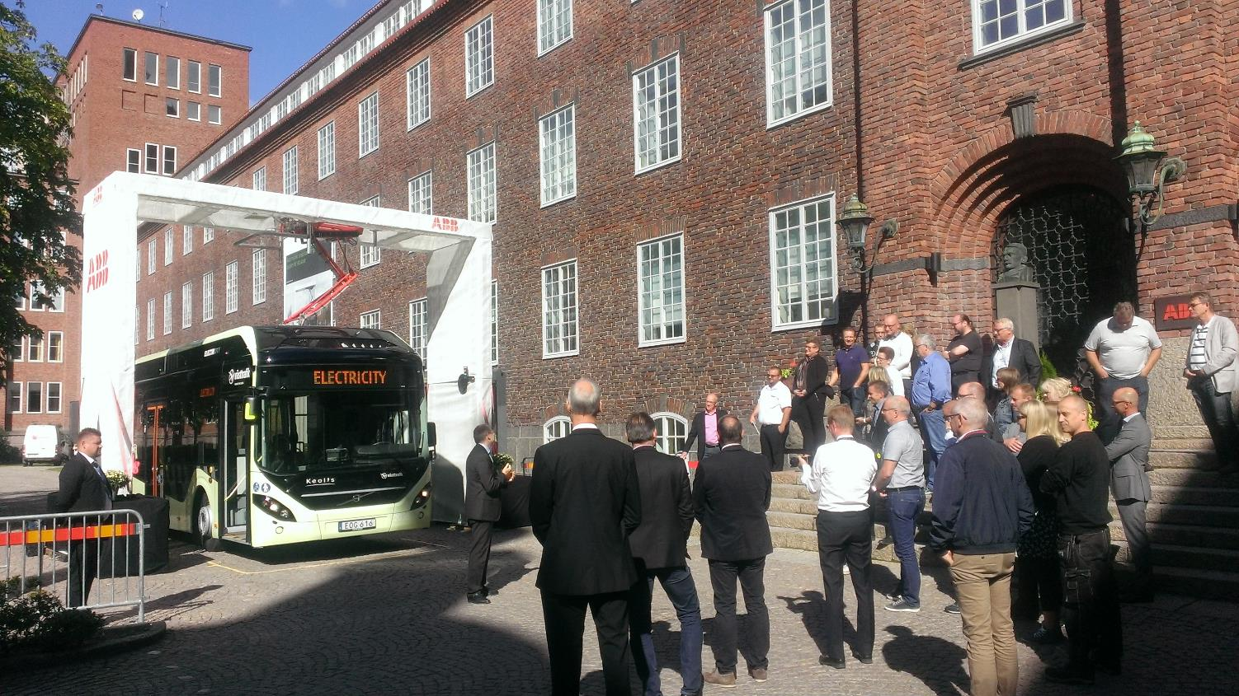
Mobile charger
For demonstrations and Proof of Concept

Slide 33
Overnight charging
With CCS-2 connector + cable
Industrial quality power cabinet
50kW, 100kW & 150 kW
50 and 100kW field upgradable
Redundancy from 3 x 50kW power module
Cable with connector (max. 200A DC)
200-920 VDC
Open industry standards:
  CCS-2
  EN/IEC 61851-23
  ISO/IEC 15118
Remote management and support
HVC 50C
HVC 100C
HVC 150C

Slide 34
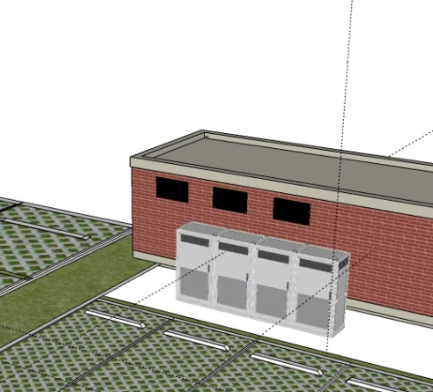
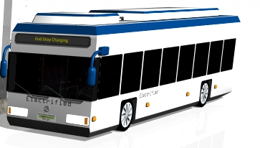
A practical solution for busy terminals & depots
Minimal space required close to the busses
Compact charge box with cable close to bus parking area
Power converters at distance at convenient location

Slide 35

Overnight charging 50 kW- 150 kW
ABB’s field upgradeable system is future proof
Strictly Confidential
HVC 50C
HVC 100C
HVC 150C
Upgrade
Upgrade
Upgrade can be done in the field by adding an extra module.
No groundworks, digging and disturbance to the site required
More busses with large battery capacity in the fleet
2017
2018
2019
2020
2021
2022
> 100 kWh
> 200 kWh
> 300 kWh
> 400 kWh
> 500 kWh

Slide 36
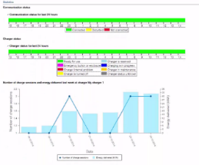










A proven platform for Connected Services
From off the shelve web-modules to IT system integrations
Demand response
Distribution system management
Using alternative energy sources
Grid-side
Web modules
Real-time status
Case handling
Statistics & graphs
Data download
Authorization / user management
API’s
Connect to any back-office or IT system
OCPP API
Service API
Power control API
Access management
Performance reporting
System integration
Fleet operator
Logo’s are examples. We do not have exclusive cooperation with any of the solutions
Notes:
Different areas that are linked to EV charging.
All areas have different information interest
This can’t be handled locally at the charger. Therefore we have implemented a cloud solution
Cloud solution is a platform that uses open API’s (preferred to use standards)

Slide 37

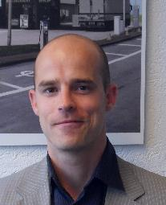
Daan Nap
Sales Director e-Bus Europe
Product Group EV Charging Infrastructure
Mobile: +31 (0)6 41064194
Email: daan.nap@nl.abb.com
www.abb.com/evcharging
© ABB Group
February 10, 2017 | Slide 37

Slide 38
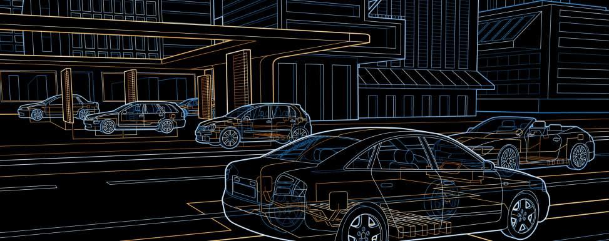

Arne Sigbjørnsen
Manager EV Charging Infrastructure
Product Group EV Charging
ABB
Mobile: +47 90 85 77 85
Email: arne.sigbjornsen@no.abb.com
www.abb.com/evcharging
© ABB Group
February 10, 2017 | Slide 38

Slide 40
Installation of eBus charger

Slide 41
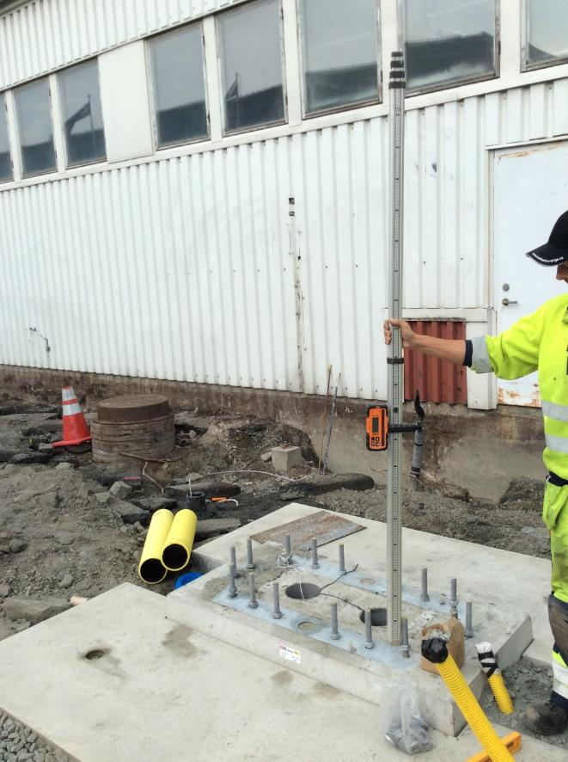

Example of installation process

Slide 42


Example of installation proces

Slide 43

Example of installation proces

Slide 44


Example of installation proces

Slide 45

Example of installation proces

Slide 46

Example of installation proces

Slide 47

ABB the global partner
Global partner ship ABB as a partner:
Partner for full system delivery (buses + chargers)
Experienced, dedicated Product group for DC fast Charging
Turn key delivery of infra projects
Experienced service organization
Global expert on local grids (low and medium voltage)
Strong partner for testing and R&D

Slide 48
Product portfolio
ABB offers complete solutions for eBus charging
High power platform | Overnight charging CCS / 50 – 150kW | Opportunity charging 150 -450kW | Separate MV transformer station
Connectivity | Globally compliant server architecture | IT system integration | Web modules & statistics
Service | ABB global NOC support | > 250 trained local ABB experts | 3rd party training for partners
API platform
> 50 successful integrations

